Slide 1
Autonomous Systems and Transport Security

Slide 2
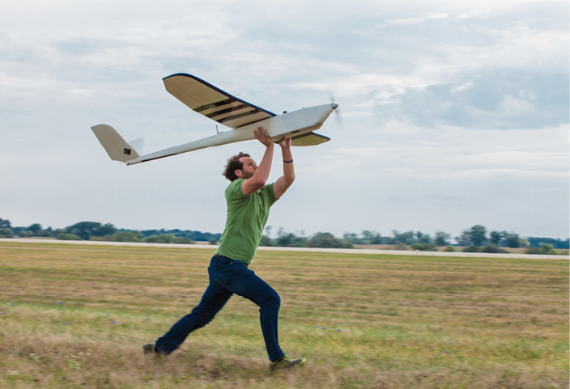
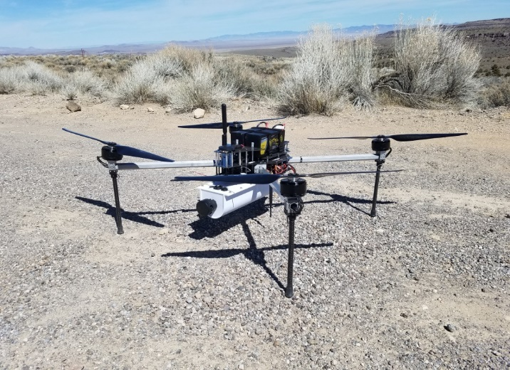
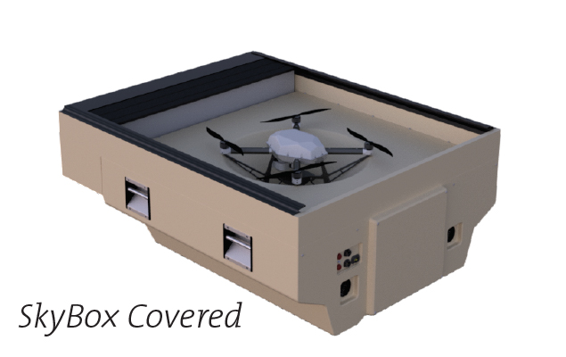
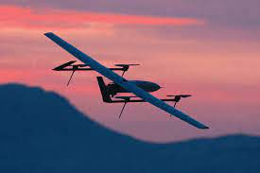
Common Types of UASs
Fixed Wing
Pros: Endurance, Speed, Distance
Cons: Launching/recovering, Size
Multirotor
Pros: Launching/recovering, Maneuverability, Stability
Cons: Endurance
Tethered
Pros: Endurance, Stability
Cons: Maneuverability, Static in most cases
Hybrid
Pros: Endurance, Speed, Distance, Maneuverability
Cons: Size, Weight
Notes:
Image References:
LIVESKY™ SENTRY - Hoverfly Technologies
Technical Details — Hybrid Project

Slide 3
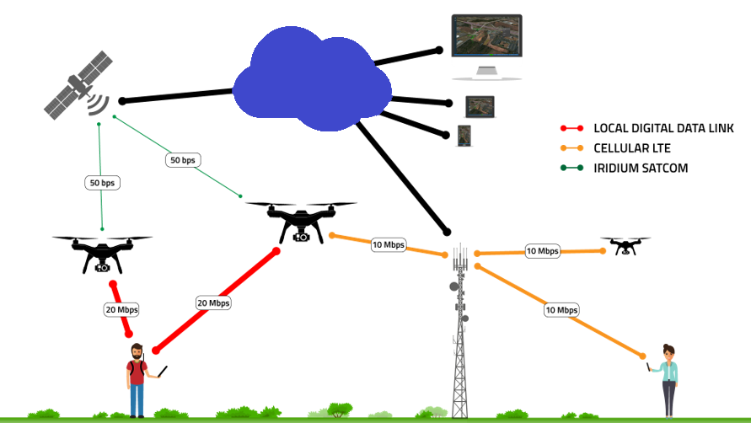
Capabilities
Payloads
Cyber attack (WiFi)
Jamming devices
Retransmission of video or frequencies and downlink
Reconnaissance (visible and non-visible spectrum sensors)
Explosive, obscurants, chemical
Beyond Visual Line Of Sight (BVLOS) Navigation
Cellular and GPS control and full autonomy
Launch and forget
Swarming / Multiple drone use
Operator controlling many drones or several launching autonomously
Low signatures
Smaller electric drones are hard to see and hear
Some systems are harder to pick up on radar or other signal detection systems
Ease of purchase and use (proliferation of certain brands like DJI)

Slide 4
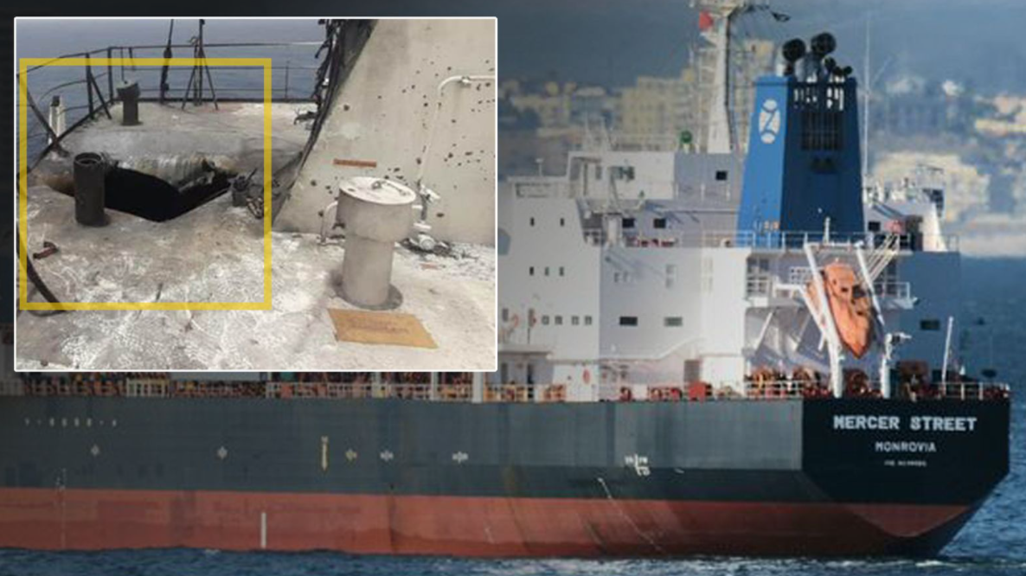
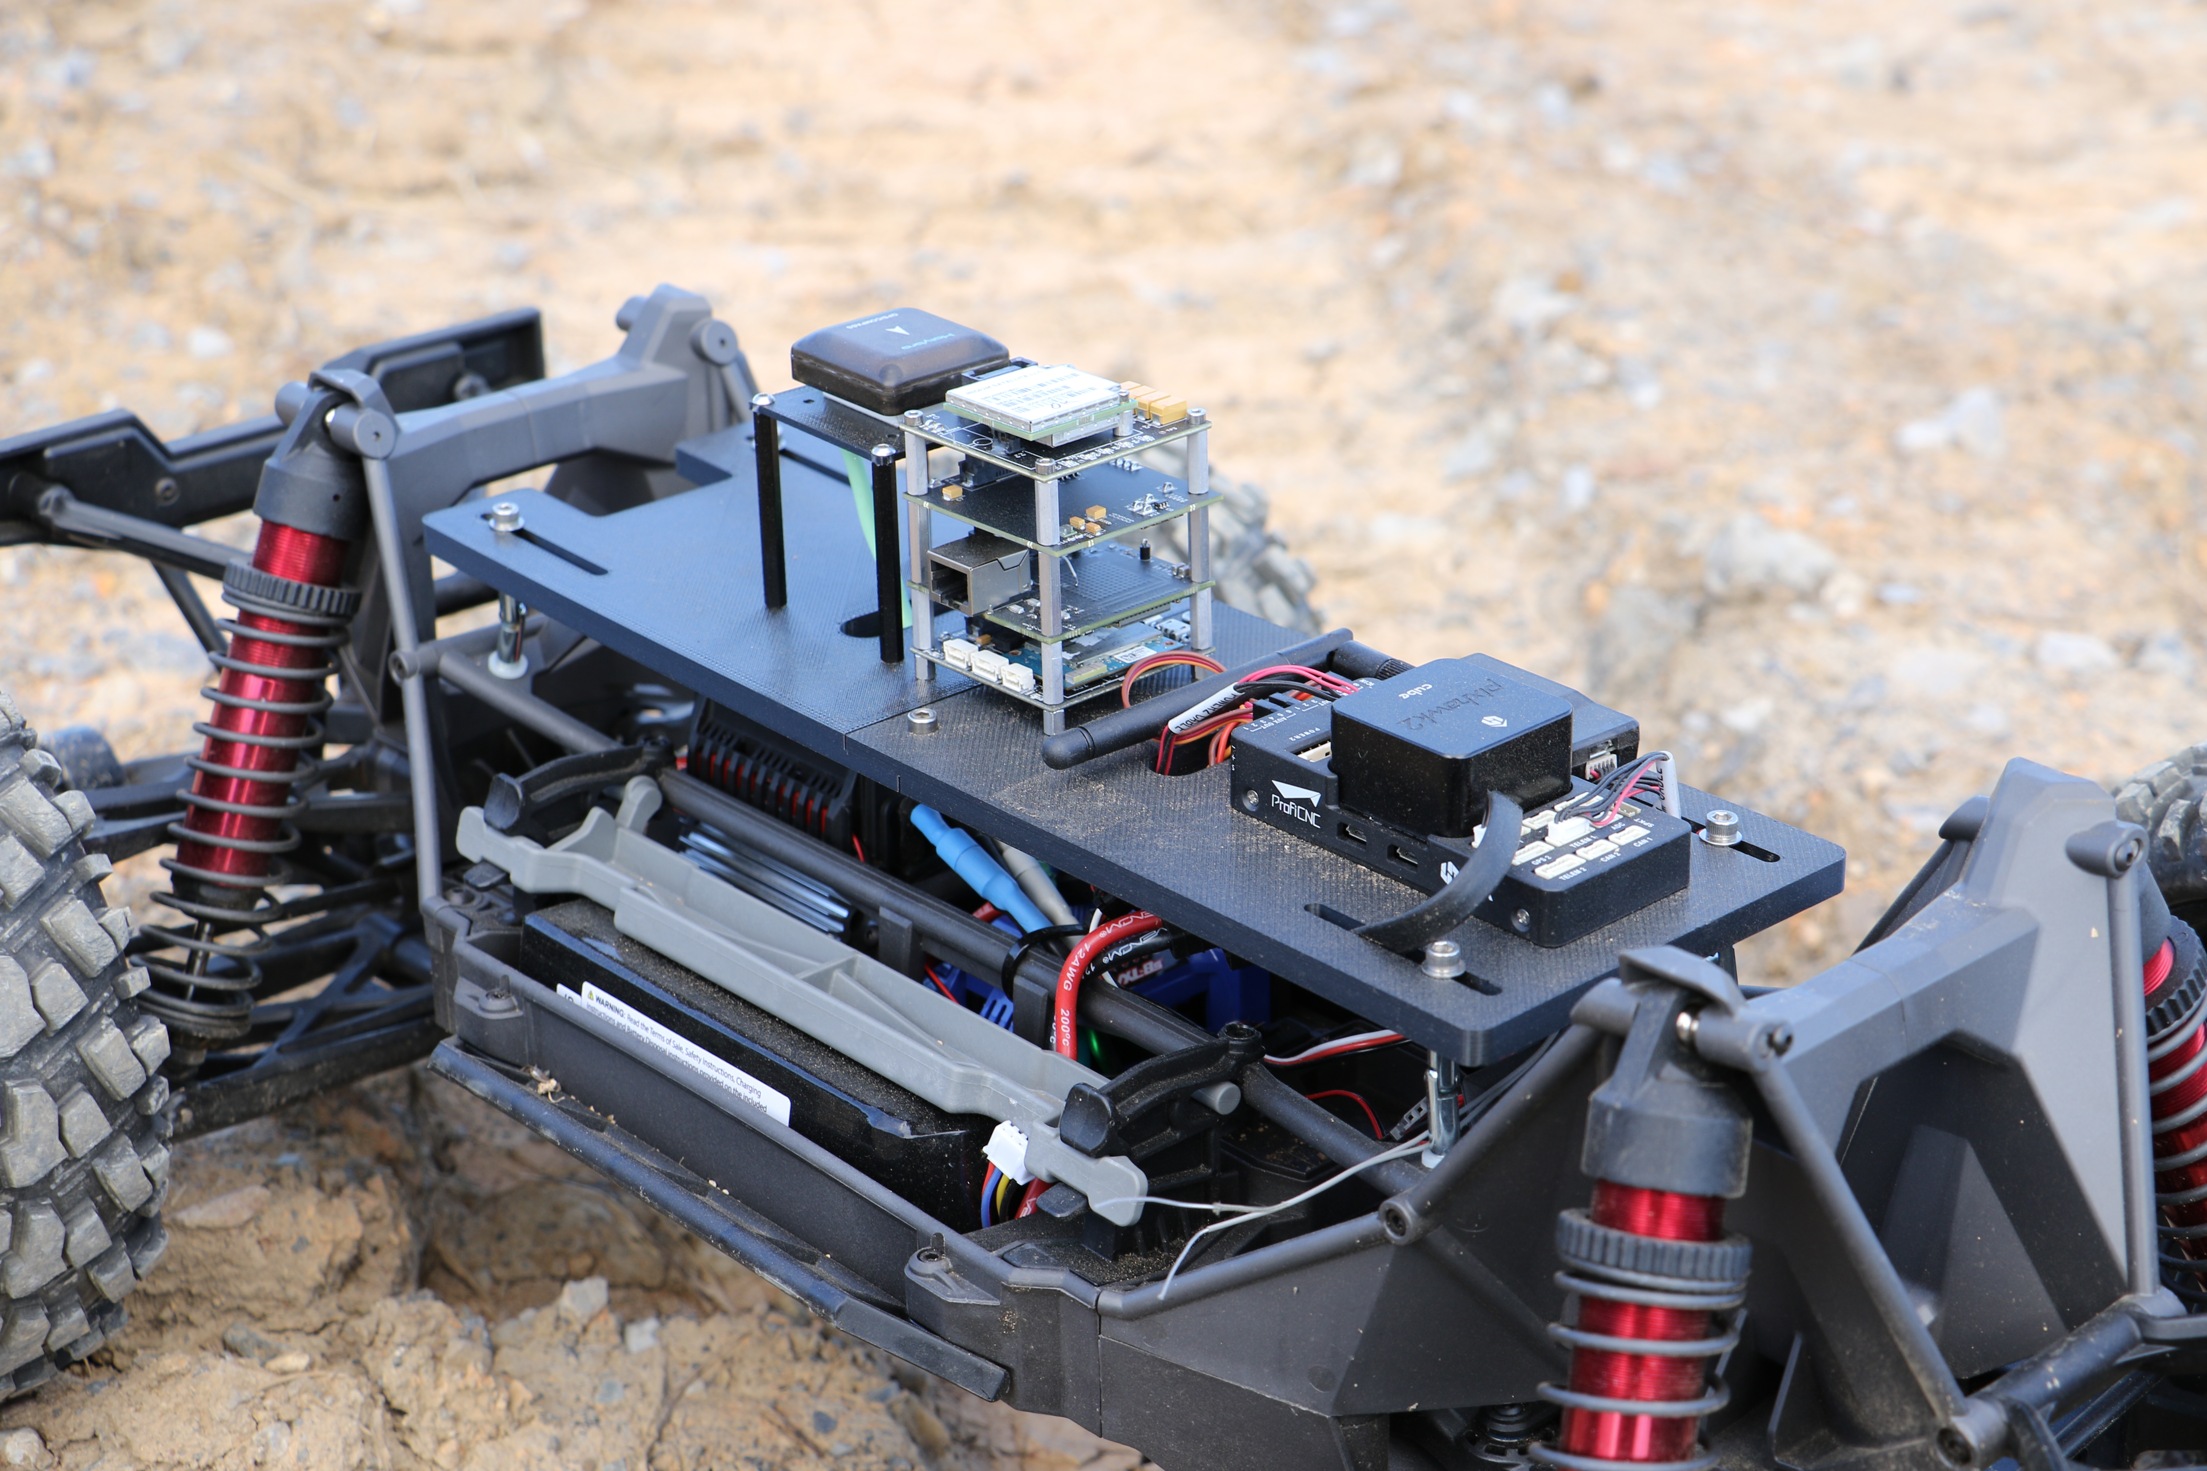
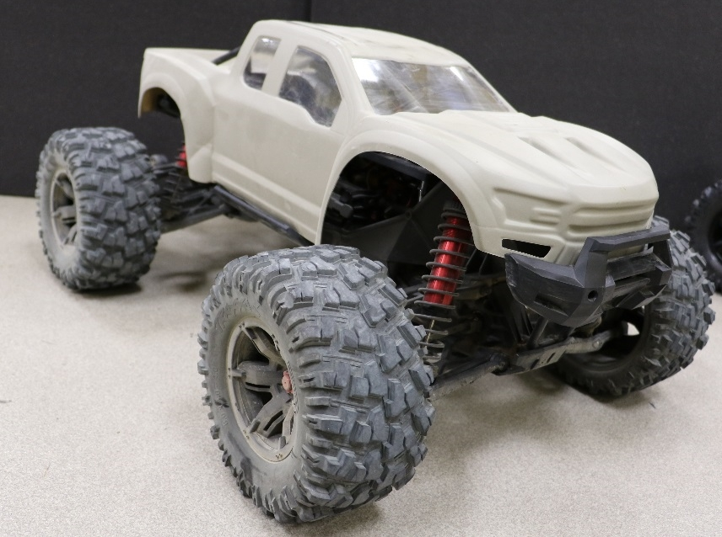
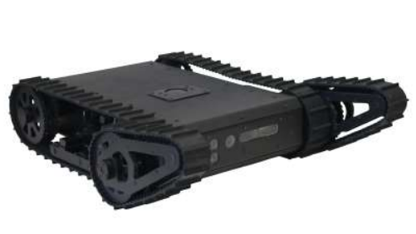
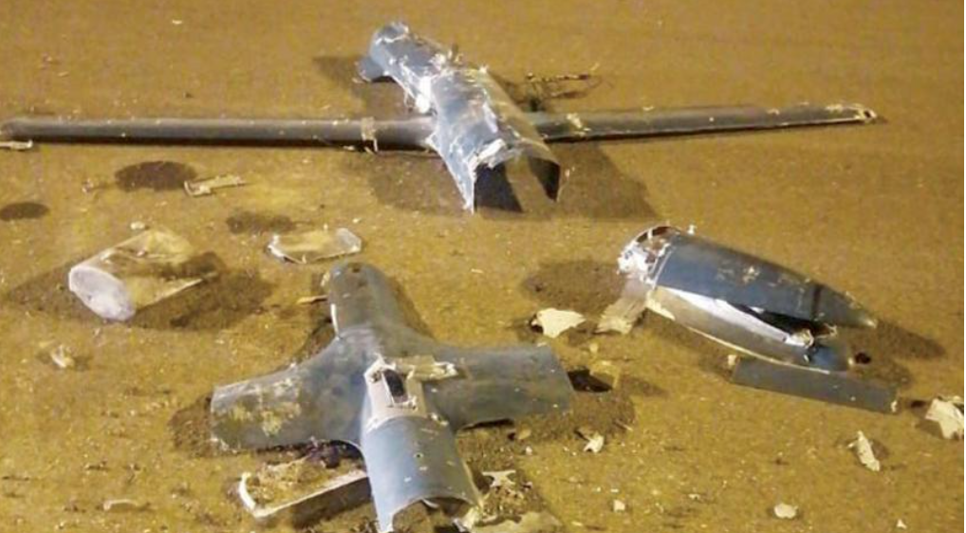
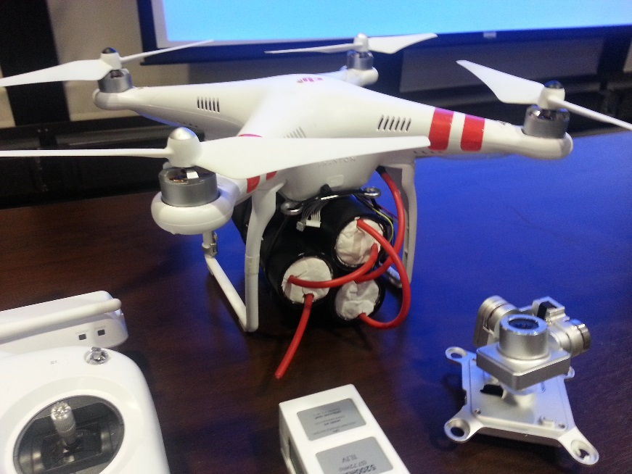
Considerations
Ground Based Systems
Submergible and Semi-submergible
Wheeled and tracked vehicles
Weather
Advantages and disadvantages
Route Recce
Operating Costs
System and user training/certification
Federal and State Regulations
Adversary Use
Sabotage vs theft
Challenges exist for moving targets
when operating autonomously
Notes:
Image References:
Dr Robot Inc.: WiFi 802.11 robot, Network-based Robot, robotic, robot kit, humanoid robot, OEM solution
https://news.sky.com/story/maritime-wars-did-the-attack-on-the-mercer-street-deliberately-target-its-crew-12371962
https://english.aawsat.com/home/article/3237196/int%E2%80%99l-solidarity-saudi-arabia-against-houthi-attack-jazan-airport

Slide 5
Counter UAS
What are you trying to protect?
How much warning is required?
Where can detection systems reside?
What are the threat UAS capabilities and component makeup?
What mitigation strategies are allowed?
Futureproof: How will the adversary evolve?
Detect – React – Mitigate
*Tracking happens throughout this process

Slide 6
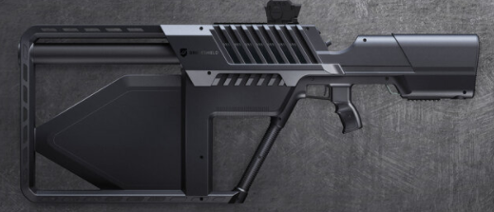
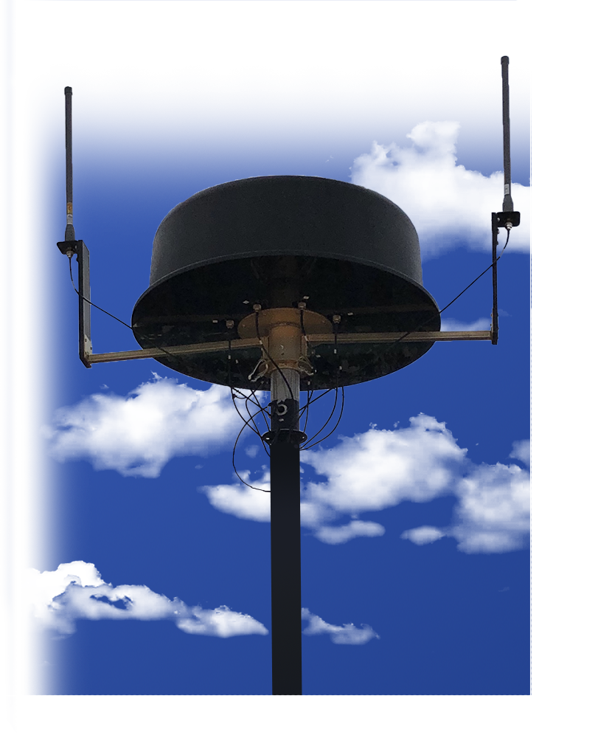
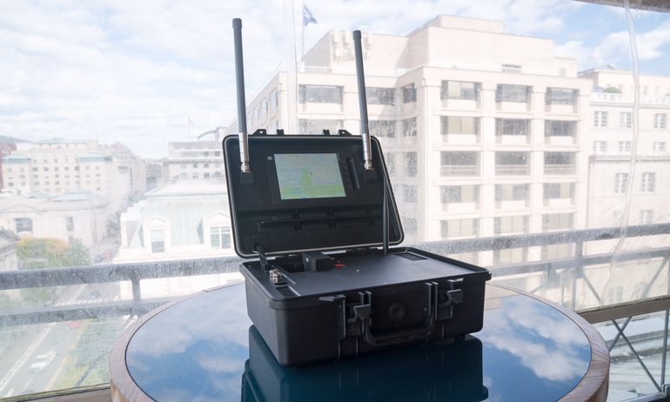
Counter UAS Systems
How do you implement CUAS when material is on the move?
Passive vs Active Systems
Common Types
Visual / EO (detect and mitigate)
Radar (detect)
Radio Frequency (detect and mitigate)
Most cost effective and most proliferated
Acoustics (detect)
Other methods of mitigation include: Netguns, other drone systems, jamming, conventional weapons
Notes:
Image References:
LIVESKY™ SENTRY - Hoverfly Technologies
Technical Details — Hybrid Project
DroneGun Tactical — DroneShield
SKYWALL PATROL - openworksengineering.com
SkyView-DIV2 - Verus Technology Group, Inc.
Aeroscope - DJI

Slide 7
Conclusions
Adversary use
Friendly use
Can increase situational awareness
Reconnaissance / mapping
Other uses
CUAS
Systems are costly
Single system doesn’t work against all types of drones
Most CUAS systems are designed for fixed sites
Analyzing the need to use and counter drone systems is a crucial step to maintaining security when material is in its’ most vulnerable state.
Notes:
Image References:

