Slide 1
Ramin Pashayev
Central Asia and Azerbaijan Regional Transport Security Dialog 2022
Security Regime for Transport of Radioactive Materials in the Republic of Azerbaijan
The State Agency on Nuclear and Radiological Activity Regulations
of the Ministry of Emergency Situation of the Republic of Azerbaijan

Slide 2
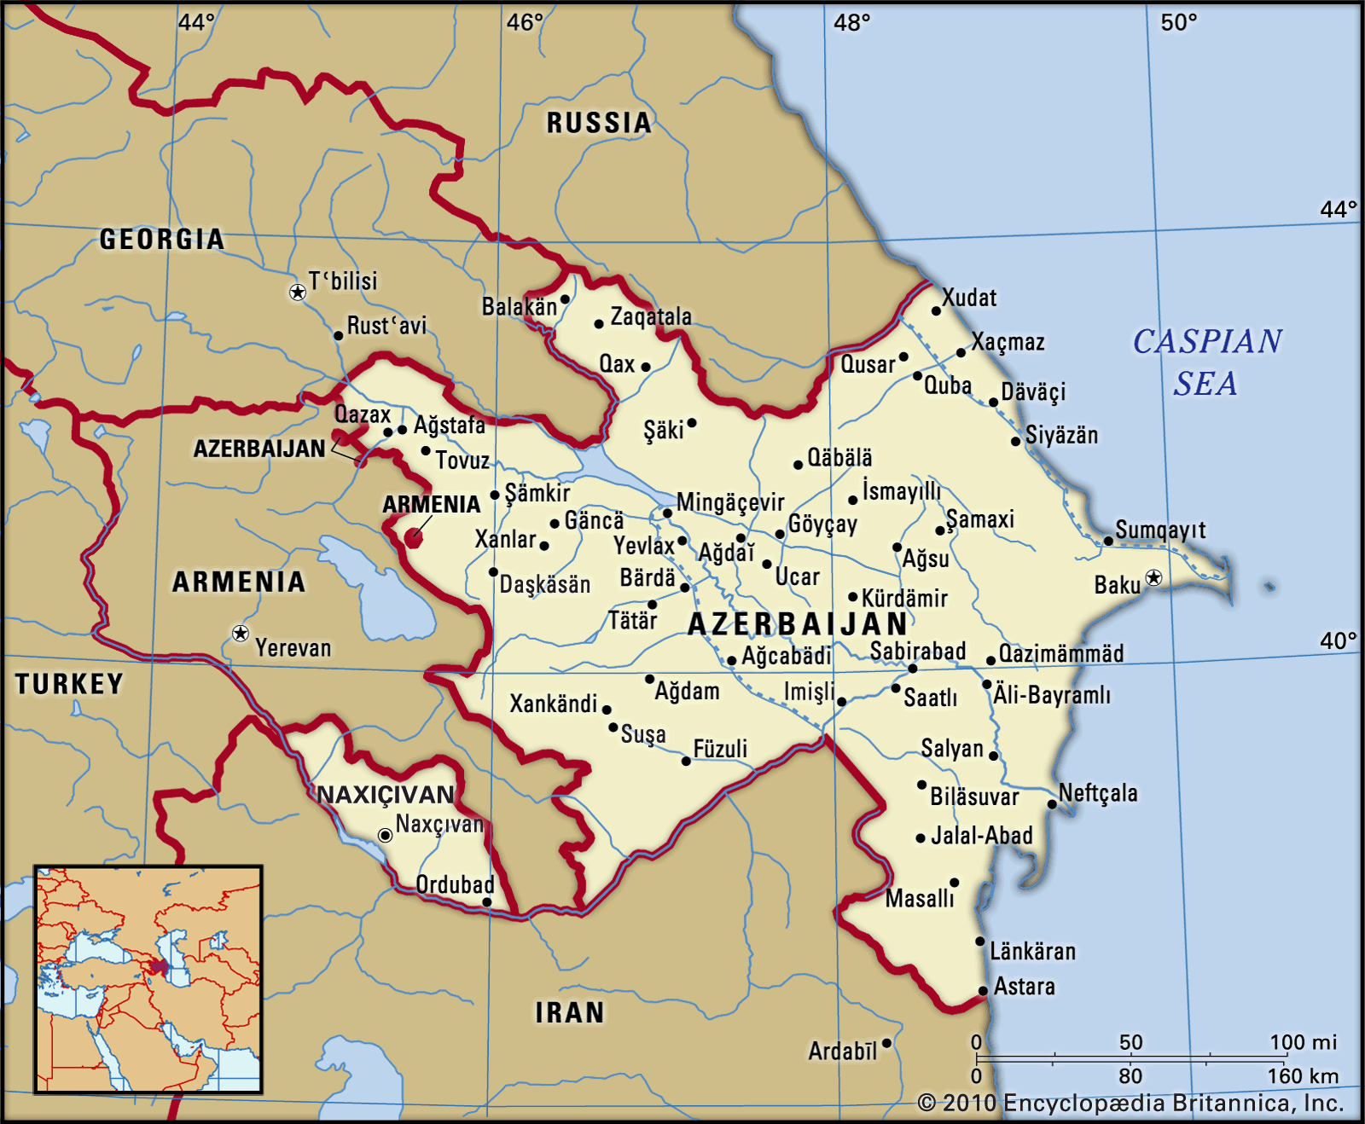
Introduction
Azerbaijan has a favorable territorial location, being at the crossroads of Europe and Asia, it has a great potential for laying various profitable transport hubs. Today, Azerbaijan is both an exporter, an importer and a transit region for many shipments and transport communications. Achieving complete stability in the region and preventing separatism open up even greater opportunities for the development of interregional transport communications.
At the same time, the development of various fields of activity leads to the need for regular transportation of not only ordinary, but also goods classified as dangerous goods. And with the increase in the number of such shipments, there is a need to automate the tracking of the movement of such goods, monitoring compliance with agreed and approved procedures, systematizing and improving of authorization and inspection procedures aimed at monitoring compliance with the requirements for the safety and security of radiation hazardous goods, as well as timely detection of deviations and shortcomings.

Slide 3
Introduction
Today in the Republic of Azerbaijan, there are no nuclear installations and waste management facilities of the nuclear fuel cycle, as well as no extraction and processing of uranium ores.
Radioactive sources, as well as nuclear materials available in the territory of the Republic of Azerbaijan, are mainly used for oil and chemical industry, construction, research institutes and medical facilities;
About 80% of all radiological facilities are concentrated in the territory of the capital of the Republic of Azerbaijan and Absheron Peninsula.
The largest amount of radiation hazardous goods regularly transported in the country are industrial gamma radiography devices used to check the quality of welds, densitometers and moisture meters used for road construction works, equipment designed for geophysical studies in the oil and gas industry, etc.
It is expected that the demand for radiation technology will continue to increase with the national economic development.

Slide 4
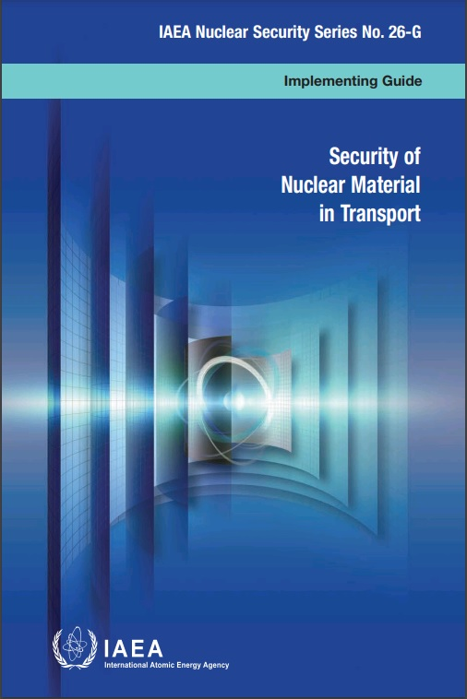
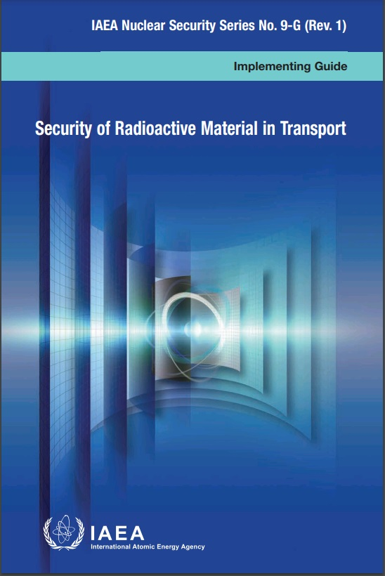
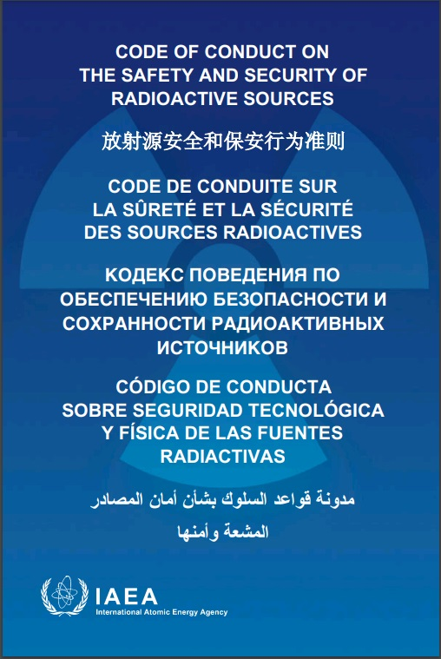
IAEA publications in support to strengthening of the national transport security regime
The IAEA's Nuclear Security Series provides international consensus guidance on all aspects of nuclear security to support States as they work to fulfil their responsibility for nuclear security.

Slide 5
The main types of the nuclear materials existing in the Republic of Azerbaijan
Pu/Be neutron sources for well-logging activities in the oil and gas industry, etc.
Biological shielding of industrial gamma-radiography devices;
Biological shielding of medical gamma-radiotherapy equipment;
Low activity calibration and control sources, as well as solutions used for contrasting in electron microscopy, containing radionuclides which are also classified as nuclear materials;
There are also various types of radioactive waste containing small amount of nuclear material.

Slide 6
Types of available radioactive sources
Currently, the share of used radioactive sources belonging to the category 1 and 2 comprises only about one percent of the number of all available radioactive sources. The country has a regulatory infrastructure that includes legislative and regulatory requirements for licensing, inspection, inventory and other relevant functions, responsibilities and obligations.
The Figure shows the percentage of the number of used sources distributed by category:

Slide 7
Organizations using radioactive sources in radiological activities
The bottom diagram shows the percentage of enterprises owning radioactive sources whose main radiological activity is related to geophysical surveys (well logging) and industrial radiography:

Slide 8
The influence of international treaties and obligations on the radioactive sources security regime formation.
On July 18 of 2000, the Republic of Azerbaijan joined to the European Agreement concerning the International Carriage of Dangerous Goods by Road (ADR).
Azerbaijan became a member of the International Atomic Energy Agency (IAEA) in May 2001. Since then, Azerbaijan has been consistently integrating the relevant infrastructure in accordance with the requirements and recommendations of the IAEA, as well as using the IAEA technical documentation in developing internal documents and introducing a source security regime for all types of practical activities, including transportation.
On December 09 of 2003 the President of the Republic of Azerbaijan signed the Law "On Joining to the Convention on the Physical Protection of Nuclear Materials" based on decision of Milli Mejlis. On 18 March 2016 the Republic of Azerbaijan officially joined to the 2005 Amendment to the Convention on Physical Protection of Nuclear Materials by the decision of Milli Mejlis and Law signed by the President of the Republic of Azerbaijan.
In 2014 the Republic of Azerbaijan expressed its full political support to the Code of Conduct on the Safety and Security of Radioactive Sources and to the Supplementary Guidance on the Import and Export of Radioactive Sources. The State Agency on Nuclear and Radiological Activity Regulation (SANRAR) of the Ministry of Emergency Situations was one of the initiators for this decision. The Head of SANRAR was appointed as a contact point for the Code of Conduct purposes.
According to the Constitution of the Republic of Azerbaijan, the international agreements, wherein the Republic of Azerbaijan is one of the parties, constitute an integral part of the legislative system of the country and whenever there is disagreement between normative-legal acts in legislative system of the Republic of Azerbaijan (except Constitution and acts accepted by referendum) and international agreements, wherein the Republic of Azerbaijan is one of the parties, provisions of international agreements shall dominate.

Slide 9
Local legislative system established for security of radioactive materials in transport .
In the Republic of Azerbaijan, the relevant legislative and regulatory acts require the provision of necessary procedures aimed at ensuring the security of radioactive sources during transportation. In particular, the Law on Radiation Safety of the Republic of Azerbaijan, the Law on Licensing and Permissions, the Rules for the Transport of Dangerous Goods and other relevant regulatory legal acts are required the following actions to be carried out before the transportation of radiation dangerous goods:
Import, export and transit of nuclear and other radioactive materials should be realized based on the permissions issued by the Cabinet of Ministers after the positive resolutions of Regulatory Authority and other associated organizations. There are national legislative acts, which define rules for authorization and control of export, import and transit of materials subject to export control;
Each vehicle designed to transportation of radioactive materials must be certified by the Regulatory Authority.
Each transportation route should be officially agreed with the Regulatory Authority and Internal Affairs Bodies (Traffic Police).
Any organization that intends to carry out activities related to the transport of radioactive materials must apply to the regulatory body and obtain official permission for a specific type of activity.
There is a national legislative and regulatory framework governing the requirements and rules for issuing special permissions and regulate authorization procedures.
There are national regulations for the transport of dangerous goods by road, rail, sea and air.

Slide 10
Creation of a single regulatory body in the field of regulation of nuclear and radiological activities
Head of the Agency
Deputy head
Department on Nuclear and Radiological Activity control
Secret
sector
Sector on management in case of nuclear and radiation emergencies
Deputy head
General
sector
Maintenance department
Department on Financial Accounting and technical supplies
Department on expert assessment of nuclear and radiation safety and education
Department on Special permissions and State registry
Normative Technical Department
April 24, 2008 the President of the Republic of Azerbaijan signed a decree on creation of regulatory authority, State Agency on Nuclear and Radiological Activity Regulations (SANRAR) under the Ministry of Emergency Situations, which gives the regulatory function in considerable extent to the sole body.
According to its Statute, the supervision on compliance with radiation safety and security
requirements at facilities and organizations involved in any nuclear and radiological practical activities is included in main responsibilities of SANRAR. The SANRAR of MES have rights to make a decision on granting or denying permissions for radiological activities (including transportation of radiation dangerous goods), to carry out inspections and to verify implementation of regulatory requirements, to make decisions and provide opinions on authorization of export/import activity and to carry out other regulatory functions.
Notes:
In 2008, a single regulatory body was created in Azerbaijan by a relevant Presidential Decree and endowed with the relevant regulatory powers. SANRAR has no technical support organization and research institutes directly subordinate. However, SANRAR has the opportunity to apply to the specialized enterprise “Izotop”, which is also a structural unit of the Ministry of Emergency Situations to provide the necessary technical support in solving various technical issues and has this experience in its activities.
In "Izotop" specialized enterprise has created the necessary infrastructure for carrying out radiation measurements, performing the necessary tasks for sampling and sample preparation, conducting gamma-spectrometric and radiochemical analyzes of solid and liquid samples, measuring the ionizing radiation dose rate as by means of special transport, as well as on foot. This organization has a Hot Chamber for identification, testing and manipulation of radioactive sources, specialized laboratories and facilities for decontamination of contaminated vehicles, personal protective equipment or other objects, etc.

Slide 11
SANRAR activities
The main activities of SANRAR are as follows:
Development and improvement of legislative framework (laws, regulations, guides etc.);
State accounting and control of ionizing radiation sources, nuclear materials and facilities;
Authorization of nuclear and radiological activities and related facilities;
Supervision and control on implementation and compliance to the law, regulations and other rules’ requirements on nuclear and radiation safety and security (inspection);
Enforcement;
Coordination of emergency response and preparedness;
Participating in authorization and control of export/import of nuclear and radioactive materials;
Review and assessment of radiation protection and nuclear security;
Preparation and submission of appropriate reports under the safeguards obligations and other international requirements, etc.

Slide 12
Notification and inventory of ionizing radiation sources, nuclear materials and facilities
According to the requirements of the Cabinet of Ministers’ Decision "On measures to strengthen control on radiation safety in the Republic of Azerbaijan" # 76 dated July 11, 1997 all organizations, regardless of ownership or form of government should conduct an annual inventory of radioactive substances and other ionizing radiation sources and systematically submit the annual inventory results to the Regulatory Body. The same obligations on accounting of ionizing radiation sources (including nuclear materials), radioisotope equipment and gauges and providing the relevant inventory acts to the Regulatory Body are required by the "Statute on rules for the state monitoring of environment and natural resources" approved by Decree of the Cabinet of Ministers #90, dated July 01, 2004.
According to its Statute approved by Decree of the President of the Republic of Azerbaijan #74 dated April 03 of 2009, ensuring of improvement of oversight and control systems on nuclear and radioactive materials and other ionizing radiation sources, creation of their database and conduction of accounting and State Registry was included in obligations of SANRAR.

Slide 13
Notification and inventory of ionizing radiation sources, nuclear materials and facilities (cont.)
The regulatory body maintains and regularly updates the records on all nuclear and radioactive materials available in the country in authorized use by implementation of their state accounting and control responsibilities. This database, among other regulatory functions, is used to detect the loss of such materials in a timely manner, and also helps to quickly provide accessible information about the history of these sources, their owners and responsible persons.
For rational inventory management and with the aim to facilitating inspections, by SANRAR was assigned the corresponding ID numbers to each nuclear material separately. These ID numbers were applied to all nuclear materials available in the country and reflected in nuclear materials database created in SANRAR. Registration of nuclear materials and regular reports are maintained in accordance to the requirements of Agreement Between the Republic of Azerbaijan and the International Atomic Energy Agency for the Application of Safeguards in Connection with the Treaty on the Non-Proliferation of Nuclear Weapons.

Slide 14
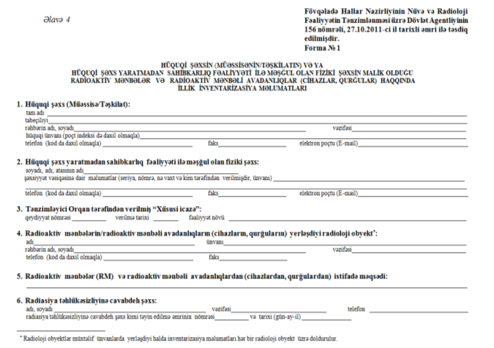
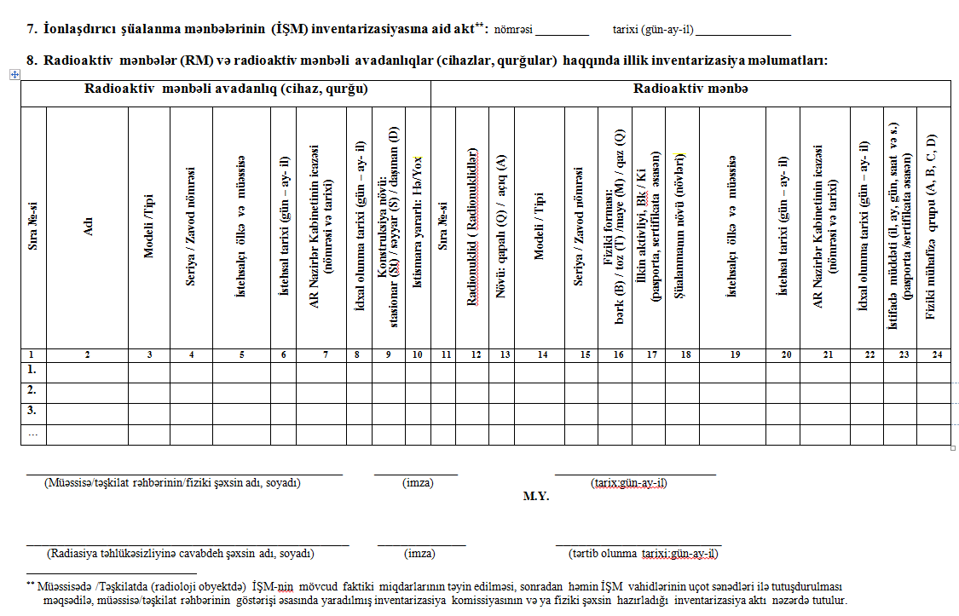
Notification and inventory of ionizing radiation sources, nuclear materials and facilities (cont.)
SANRAR has prepared and approved the forms for recording and submission of annual inventory data on ionizing radiation generators, radioactive sources and radioisotope equipment. Inventory and the forms for submission of inventory results of nuclear materials are carried out in accordance to the IAEA requirements and recommendations. All obtained information is verified and entered into a created in SANRAR electronic database, and regularly updated.

Slide 15
Notification and inventory of ionizing radiation sources, nuclear materials and facilities (cont.)
All inventory data is kept in the following separate databases:
Database of radioactive sources and radioisotope devices;
Database of ionizing radiation generators; and
Database of nuclear materials.
The Regulatory Body periodically carries out physical inventory of ionizing radiation sources and nuclear materials during inspections and rechecks the received information. Inventory of nuclear materials is maintained in SANRAR and periodical reports are sent to the Safeguards Department of IAEA, according to the Protocol Additional to IAEA Safeguards Agreement.

Slide 16
Authorization of nuclear and radiological activities and related facilities
At present the MES (SANRAR) issues a special permission as a state official document for all activities associated with the use of radioactive and nuclear materials, including their transportation and exploitation of radiation hazardous facilities.
The local legislation requires that any legal or physical person intending to be engaged in any practical activities or to go in possession of any ionizing radiation sources should address to the Regulatory Body for issuing a Special Permission and submit appropriate documents.
Information on physical protection of sources, installations and storage facilities, as well as on measures to prevent unauthorized persons from accessing to the radiation-hazardous and controlled areas, also information related to the persons designated as responsible, is one of the necessary documents to apply for obtaining of the special permission. For transport activities also required to provide schemes for loading, fastening and unloading of radioactive material on vehicles, approved transportation routes, certificate on compliance of vehicles with safety and security requirements and information on measures and means used to ensure physical protection during transportation.

Slide 17
Supervision and control
SANRAR makes the first inspection as a part of the process for granting of the Special Permission and then carries out regular inspections periodically. Methodology of inspection is based on international practices and IAEA recommendations, in which the procedure for the inspection from its initiation until the final conclusion of the inspection is defined, including check-lists for conducting an inspection, as well as on the follow-up of remedial actions.
All organizations performing practical activities related to use of ionizing radiation sources according to the risk level are divided into three groups of risk:
High (inspections each year);
Medium (inspections every 2 years); and
Low (inspections every 3 years).
The Risk-based Oversight and implemented risk assessment system helps to systemize of conducted inspections. Schedule of the planned inspections should be approved on November of each year by the Head of SANRAR and submitted accordingly to the electronic system maintained by the Ministry of Justice, and this information is made available for the inspected party. Results of each inspection and taken measures should be also reflected at the same electronic system.

Slide 18
Enforcement
SANRAR has rights to apply enforcement measures. The articles 235 and 268 of the Code of Administrative Offences may be used by SANRAR to apply the relevant sanction measures.
The Criminal Code of the Republic of Azerbaijan foresees criminal penalties for illicit trafficking of radioactive substances, nuclear weapons, materials and equipment, as well as illegal handling, theft and illegal obtaining of any radioactive materials etc. SANRAR has rights to provide the collected information and documentation to authorities of the relevant executive power, if violations, which can be considered in accordance with the Criminal Code of the Republic of Azerbaijan as crime, have been discovered.

Slide 19
Coordination of emergency response and preparedness
In the frame of IAEA National TC Project AZB/9/006 ‘Supporting the Preparation of the National Radiological Emergency Plan (NREP)’ by employees of SANRAR was elaborated the draft of the National Radiological Emergency Plan (NREP), which clearly outlines the roles and responsibilities of all organizations involved in the preparedness and response phases during nuclear and radiological emergency situations.
The draft of the national radiation emergency plan provides for integration with the responses of other organizations during emergencies involving a combination of actual and perceived radiation hazards. The draft plan describes concepts of operations, and roles and responsibilities of all responding organizations, and their relationships with each other, summarizing more detailed plans and ensuring that all the other planning is integrated and compatible.

Slide 20
Export/import control
According to the Presidential Decree 'On further liberalization of foreign trade in the Republic of Azerbaijan' No 609 (24.06.1997) and Decree of the Cabinet of Ministers “On the approval of certain regulations in connection with the implementation of the Law on Export Control” No 230 (15.12.2005) - all nuclear materials, technologies, equipment and facilities, special non-nuclear materials and radioactive sources are subject of export control.
Import, export and transit of nuclear and other radioactive materials should be realized based on the permissions issued by the Cabinet of Ministers after the positive resolutions of MES SANRAR and other associated organizations. There are national legislative acts, which define rules for authorization and control of export, import and transit of materials which is subject to export control.

Slide 21
Development and improvement of the legislative framework
Today the Republic of Azerbaijan pays much attention to the strengthening of the legal framework and regulatory infrastructure in all areas of the safety and security. This tendency is directed, among other things, to the definition of requirements in the field of ensuring of nuclear security and physical protection of potentially dangerous and specialized facilities, as well as nuclear and other radioactive materials. Thus, the Cabinet of Ministers’ decree dated April 4, 2016 approved the Special Construction Standards aimed to the determining of security and physical protection methods for buildings, premises and elements of fence structures along the perimeter of the relevant facilities, as well as rules and parameters for equipping such facilities with the engineering structures and security systems. According to the categorization given in these standards, the objects of the nuclear power complex are assigned to the 1-st category, and the facilities engaged in the manufacture, production or storage of radioactive substances in the 2-nd category in accordance to the requirements for equipping with the physical protection and security systems.
Over the past few years, several draft regulatory documents were prepared by the Regulatory Authority to improve the regulatory framework in the field of accounting of radioactive materials and the introduction of a graded approach for application of control and supervision depending on the potential hazards and threats.

Slide 22
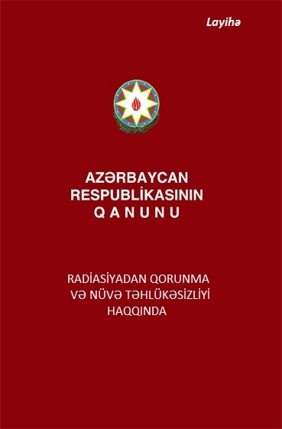
Development and improvement of the legislative framework (cont.)
A draft of the new Law on Radiation Protection and Nuclear Security was prepared in the framework of the Twinning Project. One of the main purposes of the draft Law are closely related to establishing a legal framework for the physical
protection of nuclear and radioactive materials in accordance with obligations under the international treaties and agreements to which the Republic of Azerbaijan is a party. Special requirements and provisions related to the nuclear security and physical protection of radioactive sources, nuclear materials, nuclear and radioactive wastes and installations were established in Chapter 7 of the draft Law. IAEA recommendations and international practices, as well as relevant IAEA Guidelines and international conventions were taken into account during the process of drafting. The adoption of this law will further strengthen of national security regime.

Slide 23
Thank you for your attention !
Atoms For Peace
Ramin Pashayev
Head of Department on Special Permission and State registry
E-mail: raminpashayev@gmail.com

