Slide 1
Challenges and Opportunities in the Development of Transport Security Regulations for Nuclear and Other Radioactive Materials
Marc Fialkoff
Regulatory Specialist
Oak Ridge National Laboratory
Central Asia and Azerbaijan Regional Transport Security Dialog
April 2022

Slide 2
Outline for Presentation
Importance of Transport Security Regulations
Development Challenges for Regulatory Drafting of Transport Security Regulations
  Legal Considerations
  Technical Considerations
Strategies for Successful Drafting
Conclusions

Slide 3
Importance of Transport Security Regulations
Transport is complex and regulations provide a legal framework to ensure material is secure throughout the journey from origin to destination and all points in between.
Multiple Factors
  Multi-modal
    Road, Rail, Maritime, Aviation
  Multi-jurisdictional
    Domestic Transport vs. International Transport
  Multi-stakeholder
    Agencies
    Shippers and Carriers
    Law Enforcement

Slide 4
Regulatory Development Challenges
Challenges to developing transport security regulations
  Adapting the regulations to the national situation
    Geography, threat, other considerations
  Challenge in defining the scope of the regulations
    Radioactive material/sources vs. nuclear material
  Interfacing with transport safety requirements
  Limited human resources in developing transport security regulations

Slide 5
Legal Considerations
Port Authority
Airport Authority
A “shared regulatory space”
  Multiple Agencies
  Possible overlap in responsibility
  Splintering of authorities
Defining roles and responsibilities
  Individual agency roles and responsibilities
  Shipper and carrier roles and responsibilities
  Local law enforcement roles and responsibilities
Police
Customs
Military Forces
The Transport Security Flower
Receivers
Energy Ministry
Shippers
Regulatory Body
Transport Ministry
Intelligence
Agencies
Transport Carriers

Slide 6
Legal Considerations continued
A pre-cursor: Safety and Security for Transport of Nuclear and other Radioactive Materials
  Safety: protecting humans and the environment from the harmful effects of ionizing radiation
  Security: protecting material from malicious acts of individuals
Not just a question of language, but a question of structure
  Two separate regulations (Security Regulation and Safety Regulation), OR
  One integrated regulation (Security and Safety Regulation)
Translation and interpretation issues for the authorized persons.

Slide 7
Legal Considerations continued
The importance of the legal inventory as discussed by the IAEA
Helps frame the boundaries of the regulation
  Nuclear Law
    Status of the Nuclear law
    Regulatory functions of the Competent Authority to regulate transport security
  Other Dangerous Goods laws and International Commitments
    Safety of Life at Sea/International Ship and Port Facility Security Code
    Chicago Convention and International Air Transport Association Dangerous Goods Regulations
Helps organize stakeholders for input and drafting

Slide 8
Technical Considerations
What material is covered by the transport security regulation?
  Radioactive Material including Radioactive Sources
  Nuclear Material
  Uranium Ore and material of economic but not radiological consequence
This selection may influence the structure of the regulation and the security levels and corresponding security measures.
Regional Considerations may play into this question especially for international transport of nuclear and other radioactive material.

Slide 9
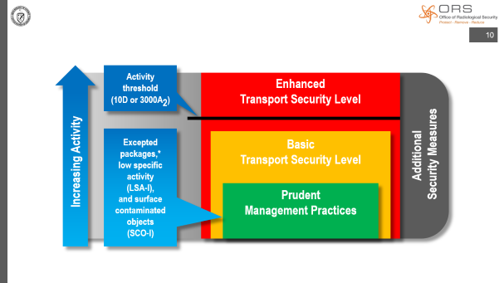
Technical Considerations: Security Level Assignment
Nuclear Materials
  Category I, II, III according to the CPPNM
  Reflected in Nuclear Security Series No. 13 and NSS 26-G
Radioactive Material including Sources
  NSS 9-G (Rev. 1) added more detailed guidance to each security level
    Prudent management practices;
    Basic measures; and
    Enhanced measures added

Slide 10
Activity
threshold
(10D or 3000A₂)
Enhanced
Transport Security Level
Excepted packages,*
low specific
activity
(LSA-I),
and surface contaminated objects
(SCO-I)
Increasing Activity
Basic
Transport Security Level
Additional
Security Measures
Prudent
Management Practices
Notes:
##
Zoom slide. Click again to return.
From NSS 9-G (Rev. 1) - "the regulatory body may require additional security measures in addition to any security measures already prescribed for a transport security level“
From NSS 9-G (Rev. 1) - "excepted packages with activity not exceeding the level permitted for radioactive material not in special form"
##

Slide 11
Technical Considerations continued
With developing transport security regulations, countries have begun integrating nuclear material and radioactive material into the same regulation.
Poses a challenge to ensure security measures protect the material and are in alignment with international guidance particularly those IAEA implementing guides NSS 9-G (Rev. 1) and NSS 26-G.

Slide 12
Strategies for Successful Drafting
Drafting Committee
  Critical to success in drafting any regulation but moreso in transport security.
  Other modal requirements
    Maritime Security- Coast Guard, Navy, Maritime Administration
    Aviation Security- Airport Authority
    Rail- Transport Ministry
  Law Enforcement
    Especially national and local law enforcement
  Other relevant stakeholders (intelligence agencies, customs, etc.)
Coordination frameworks for drafting can support the effort
  Informal networks or formal coordination agencies

Slide 13
Strategies for Successful Drafting:
Security Levels
Radioactive Material (determined by activity) | Nuclear Material (determined by mass)
 | I
Cat 1 & Cat 2 | II
Cat 3 | III
Excepted packages, low specific activity (LSA-I), and surface contaminated objects (SCO-I) | Below Cat III
Security Level cross-walking for those regulations that include nuclear and radioactive materials.
Structural resolution
  Avoid trying to cross walk and structure the regulation such that there are three or more sections.
    Example
      I. General Requirements
      II. Radioactive Materials
      III. Nuclear Materials
Technical approach
  Hybridization
  Requires careful review of IAEA publications to ensure security measures are aligned to material being protected in transport.
An example cross-walk framework developed by an IAEA Member State in their transport security regulation

Slide 14
Strategies for Successful Drafting
Include Lawyers and Physical Protection Experts in the drafting process.
  Lawyers speak one language
  Physical protection experts speak another language
Both are needed to ensure that the regulation is legal within the national and regulatory framework but also can be implemented to ensure physical protection of material.
The IAEA Guidance can help bridge the language gap between legal requirements and physical protection implementation.

Slide 15
Conclusions
Regulations are critical to support a strong nuclear security regime.
A strong regulatory framework ensuring the physical protection of nuclear and radioactive materials during transport support protecting material during the most vulnerable stage in their life cycle.
While transport is complex and challenging, support from stakeholders, regional partners, and international partners, can help support regulatory development needs.

