Slide 1
Addressing the Insider Threat
U.S. Department of Energy
National Nuclear Security Administration

Slide 2
Module Objectives
Consider the potential for insider threats in various positions involved in the transport of radioactive/nuclear material
Proactively plan to mitigate this risk

Slide 3
Insider Definition
An insider has authorized access (either escorted or unescorted) to controlled areas and/or shipments.
Insiders may include:
Employees
Former employees
Contractors/Consultants
Suppliers
Visitors
Industrial collaborators
Regulators/Inspectors

Slide 4
Insider Capabilities
Knowledge
Access
Authority

Slide 5
The Insider Threat
Because of their access, authority, and knowledge, the insider has
Ability to bypass some technical and administrative security measures to commit theft or sabotage
Ability to complete objectives through a series of separate actions over an extended time period to minimize their chance of detection and maximize their likelihood of success
Opportunity to select the most vulnerable target and the best time to perform the malicious act

Slide 6
What kinds of insider threats do facilities/transport activities face?
Training delinquencies
Illness
Fatigue
Lack of attention/concentration
Petty theft
Intentional malicious:
Theft
Sabotage
Unwitting/ Unintentional
Witting/ Intentional

Slide 7
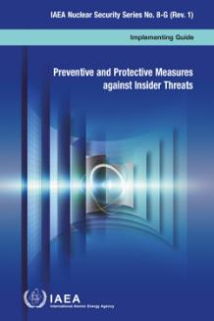
IAEA Reference Documents
NSS-13 - Implementing Guide for IAEA NSS No. 13: Nuclear Security Recommendations on Physical Protection of Nuclear Material and Nuclear Facilities (INFCIRC/225/Rev. 5)
NSS-8 - IAEA Nuclear Security Series No. 8-G (Rev. 1): Preventive and Protective Measures against Insider Threats

Slide 8
Common Insider Motivations
Ideological– fanatical conviction
Financial– wants/needs money
Revenge– disgruntled employee or customer
Ego– “look what I am smart enough to do”
Psychotic– mentally unstable but capable
Coercion– family or self threatened

Slide 9
Insider Characteristics
Passive
Insider
Non-violent
Active
Violent
Notes:
Passive insiders are non-violent and limit their participation to providing information that could help adversaries to perform or attempt to perform a malicious act.
Active insiders are willing to provide information, perform actions and may be violent or non-violent. Active insiders are willing to open doors or locks, provide hands-on help and aid in neutralizing response force personnel.
Non-violent active insiders are not willing to be identified or risk the chance of engaging response forces and may limit their activities to tampering with accounting and control, and safety and security systems. Violent active insiders may use force regardless of whether it enhances their chances of success; they may act rationally or irrationally.

Slide 10
Addressing the Insider
There is no one solution
Each individual facility must assess the insider threat specific to that site
The best way to mitigate insider actions is to create a programmatic approach designed to detect acts through technical and nontechnical means
Systematically implement the design
Utilize proven practices to provide a great deal of detection and deterrence of insider acts
Customize and test for the specific facility
When addressing the insider, there is no one solution.

Slide 11
Measures Against Possible Insiders
Individuals applying for access
Exclude potential insiders
Individuals with authorized access
Exclude further potential insiders
Preventive measures
Trusted Individuals with opportunity
Minimize Opportunity
Insider initiating a malicious act
Detect, delay and respond
Protective measures
Insider completing a malicious act
Mitigate or Minimize
IAEA Nuclear Security Series No. 8: Preventive and Protective Measures against Insider Threats

Slide 12
Preventive Measures
Identity verification
Trustworthiness assessment
Escort/surveillance
Security awareness
Confidentiality
Quality assurance
Employee satisfaction
Compartmentalization (of data, activities, and physical areas)
Sanctions

Slide 13
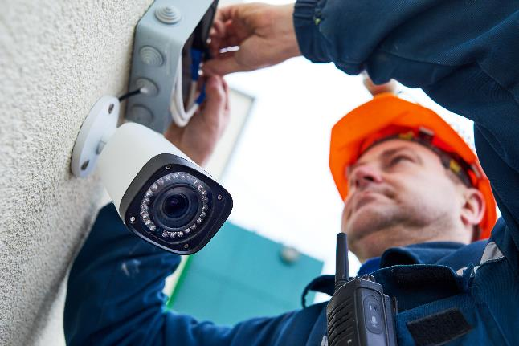
Protective Measures
Detection
Delay
Response

Slide 14
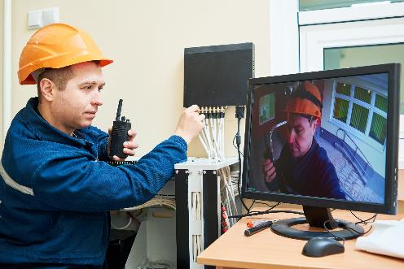
Detection
Alarms must be assessed to be effective
Longer delay may be necessary for insider detection
Sample elements
Two-person rule
Access control
Tracking personnel within facility
Contraband detection
Monitoring (alarms, processes, operations, inventory)
Certification, inspections, and audits
Notes:
It is critical that a procedure for reporting of alarms be established between operations personnel and security personnel to ensure that alarms are quickly communicated to security personnel in the central alarm station. The actuation of an alarm should be communicated even prior to operations personnel assessing its cause (malicious or accidental). Operations personnel should monitor sensitive equipment, systems or devices to verify that no tampering or interference has taken place, or to provide for the timely detection of such tampering or interference. Routine testing and maintenance operations have a significant impact on equipment availability and the prevention or correction of a deficiency or failure that could have a malicious origin. These operations may be very effective in detecting possible malicious acts on equipment or systems in relation to protecting nuclear material or sensitive areas. When a routine testing or maintenance operation leads to a modification of the initial conditions of a system, a requalification of this system should be performed. It is advisable to perform the requalification independently of the operation (test or maintenance) leading to the modification. This approach contributes to both prevention by deterrence (for fear of the consequences) and detection. One measure to mitigate the consequences of a malicious act is to have the capability rapidly to replace parts that have been damaged. To achieve the desired goal successfully, it is prudent to provide protection for spare parts so that it would be difficult to destroy or compromise both the installed parts and the spare parts for vital equipment. Protection can be provided by, for example, installing barriers, storing the spare part at a distance from the installed part and frequently monitoring storage. Inspections and audits, in particular unannounced inspections and audits,might be an efficient way to prevent and protect against unauthorized removal of nuclear material and sabotage. Inspections and audits can detect compromised equipment or abnormal conditions and, thus, can provide assurance to operators, the competent authority or the State that preventative and protective measures are effectively implemented.

Slide 15
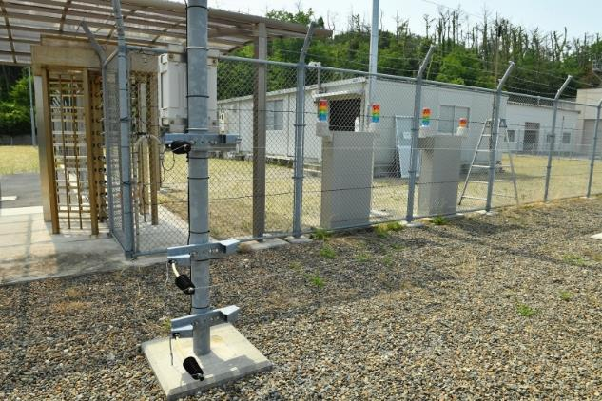
Delay
Increase task time of adversary
Delay penetration of area
Locks
Barriers requiring skill/special tools
Multiple layers
Personnel
Redundant equipment
Auto shutdown/closure
Notes:
Delay is provided by personnel, procedures or physical barriers that increase the task time of an adversary. Most barriers are designed to delay penetration of areas, rather than to delay the carrying out of malicious acts, and
thus have only limited impact on insiders. However, it is possible to developbarriers to delay malicious acts close to equipment or material. For example, locking a piece of equipment, such as a valve or a switchboard, creates a delay for insiders attempting to carry out an act of sabotage. Barriers close to equipment or material are especially effective when the area is under continuous surveillance.
For insiders who do not have access to certain areas or material, installing barriers that an adversary could not overcome without using contraband items or highly specialized skills further strengthens prevention by deterrence and increases the likelihood of detection. Multiple layers of different physical or procedural barriers along all possible insider paths will complicate the progress of an insider by requiring a variety of tools and skills. Upgrading a barrier to force insiders to use more sophisticated tools complicates the requirements for resources, logistics, training and skills. Sophisticated resources may not be available at the facility and may have to be introduced on the site by insiders. By delaying the malicious act in this manner, insiders could be detected and defeated. Delays can also be accomplished by the use of specially trained security personnel, such as guards. In some cases, the presence of such personnel may result in a significant delay in order to circumvent them, particularly for insiders with limited resources. As a result of system safety designs that provide for some level of system self-protection, such as redundant equipment, automatic equipment shutdown and automatic valve closure, the task of an insider may be complicated by requiring the insider to defeat multiple redundant and dispersed facilities andequipment. These features can delay a malicious act and prevent it from being successfully carried out.

Slide 16
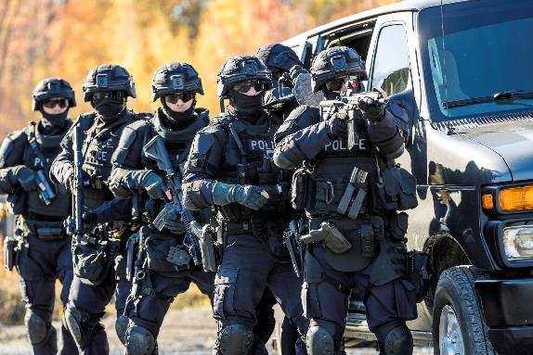
Response
May be made by operations or security personnel
Typically, operations personnel respond to the act to reverse, mitigate, or minimize it
Security personnel typically respond to insiders
All employees should be trained to react and transmit alarms as necessary
Notes:
Response to a malicious act by an insider can be made by both operations personnel and security personnel. Typically, operations personnel respond to the malicious act in order to reverse, mitigate or minimize it, and security personnel respond to insiders. Classical analysis of response to outsider threats compares the response force time with the time required for a sequence of outsider acts necessary to complete a malicious action. The implicit assumption in an outsider threat analysis is that the outsider will be easily identified anywhere on the site. None of this may be true for insiders, since a malicious act committed by an insider can consist of several acts separated in both time and space. Unless insiders are identified when detected, it may be difficult to apprehend them among the workers.
As mentioned above, an insider would not necessarily need to perform all the acts in a prescribed order, nor in quick succession. An insider may commit single acts and then wait to see if they are detected. The non-continuous nature of acts that insiders might attempt can seriously complicate the security response necessary to identify and apprehend them. As a result, investigation will play a more important role in response to insider threats. Furthermore, operations specialists may be required to assist in the investigation to predict, from the abnormal event, what further malicious acts might be attempted. Every employee and contractor on the facility site not only should be prepared to detect a malicious act but also should be trained to react appropriately to protect themselves and the facility, and should know that the first action to take after detecting an event is to transmit the alarm according to a specified set of procedures. The procedures for transmitting the alarm should be a part of security awareness training. It is important to recognize that any persons involved in response may themselves be insiders, and therefore response procedures should be developed with this assumption. For example, an insider in the response team might use an emergency exercise, simulate an emergency or create an actual emergency to mask a malicious act.

Slide 17
Comprehensive Approach to Insider Mitigation
Layered defense
Technical
Multiple protection layers utilizing detection and delay
MC&A
Administrative/Personnel
Procedures
Instructions
Sanctions
Access control rules
Confidentiality rules
Technical Solutions
Non-Technical Solutions

Slide 18
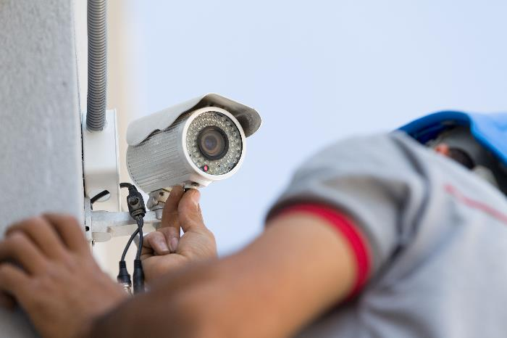
Technical Solutions to Insider Risk
Sensors/Alarms
CCTV
Access control systems
Locks/TIDs
Barriers
Measuring devices
Inventory, reporting, and accounting systems

Slide 19
Non-Technical Solutions to Insider Risk
Screening
General awareness
Observation and reporting
Trustworthiness programs
Proven procedures
Adequate training
Strong security culture

Slide 20
Nuclear Security Culture
Beliefs and attitude
Principles
Management systems
Behavior
Leadership
Personnel
Notes:
NSS-7 NSC

Slide 21
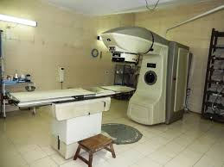
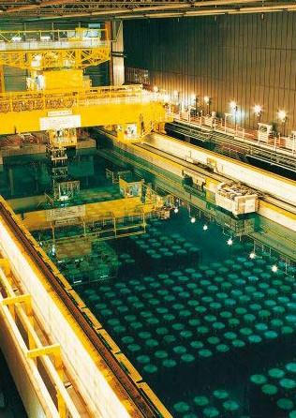
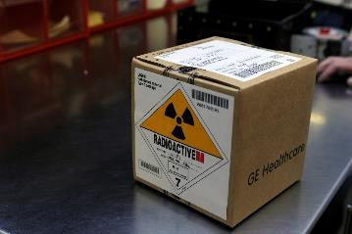
Transport Considerations
Consider the potential for insider threat during the life cycle of a transport activity
From origination site
During transit
To its final destination

Slide 22
Summary
The insider threat presents unique problems to both safety and security.
Proactive programs and a strong security culture can help identify and deter potential insiders.
Each staff member supporting transportation operations plays a role in ensuring safe and secure shipments.

Slide 23
Questions/Commnets

