Slide 1
Транспортировка ядерных материалов: пересечение международных границ
Май, 2022
Мэт Д. Кинг

Slide 2
Вопросы, возникающие при пересечении международных границ
Правила регулирования
Планирование физической защиты
План транспортной безопасности
Операции в случае нештатной ситуации
Notes:
Regulatory Requirements- These will generally identify WHICH requirements exist regarding the assignment of responsibility for the security of the radiological material throughout the shipment. The Regulatory Guidelines should identify the NEED for specific constraints, and where each constraint applies during the process.
Physical Protection Planning discusses baseline over-arching requirements that all planning must seek to fulfill – things such as “At all times the TCC should know where the target material is located”; “At all times the TCC should be able to communicate with the convoy commander” and/or “At all times the convoy commander should be able to communicate with all vehicles comprising the convoy as well as any and all secondary responders at various points along the entire route”. “At all times it should be clear to all participants where the closest Local Law Enforcement Agency (LLEA) responders are located. As the convoy passes through one jurisdiction and enters another a check point should be called to ensure all parties are aware that X Agency is now taking up primary response duties from Y Agency, whose region we just departed from”, etc. “At all times the condition of the target load should be able to be assessed, whether by cameras, verbal report from truck driver, or a verbal report from an escort vehicle moving directly behind the shipment vehicle”. “In the event of an unplanned emergency event or potential emergency event’, the automated transport security system should be activated (if it is not already) such that video imagery will be live-streamed to the TCC or TOC/EOC throughout the unplanned emergency event duration to assist with management of post-event response activities should these become necessary.” These are baseline requirements to ensure the physical security of the material being transported. It isn’t necessarily critical that ‘How this will be accomplished’ needs to be discussed at this point, but the fact that these are basic physical security requirements should be clearly understood.
TSP requirements fill in the details of the physical protection plan. It lays out who does what, and who oversees the process from origin to destination. The PPS has already laid out all the “How’s”.
The Contingency Operations will describe the overall response requirements which include road accidents, natural disasters that block highways or flood bridges as well as loss of load.

Slide 3
Цели
По завершении участники буду знать, что такое :
Ответственность за материалы во время международной перевозки
Меры безопасности в планах физической защиты, предпринимаемые во время транспортировки
Необходимость наличия плана действий в нештатной ситуации
Угрозы, существующие во время транспортировки
Дополнительное планирование, необходимое для международных перевозок

Slide 4
Транспортная безопасность на международных границах
Какие затруднения могут возникнуть?
Повышенная уязвимость
Вопросы юрисдикции
Преследование
Следует избегать пробелов при передаче ответственности
Notes:
Photo Credit – Secured Transportation Services, LLC (Company owned photo)

Slide 5
Законодательные рамки
Руководства МАГАТЭ
Ответственность за ядерный материал во время транспортировки
Ответственность государства

Slide 6
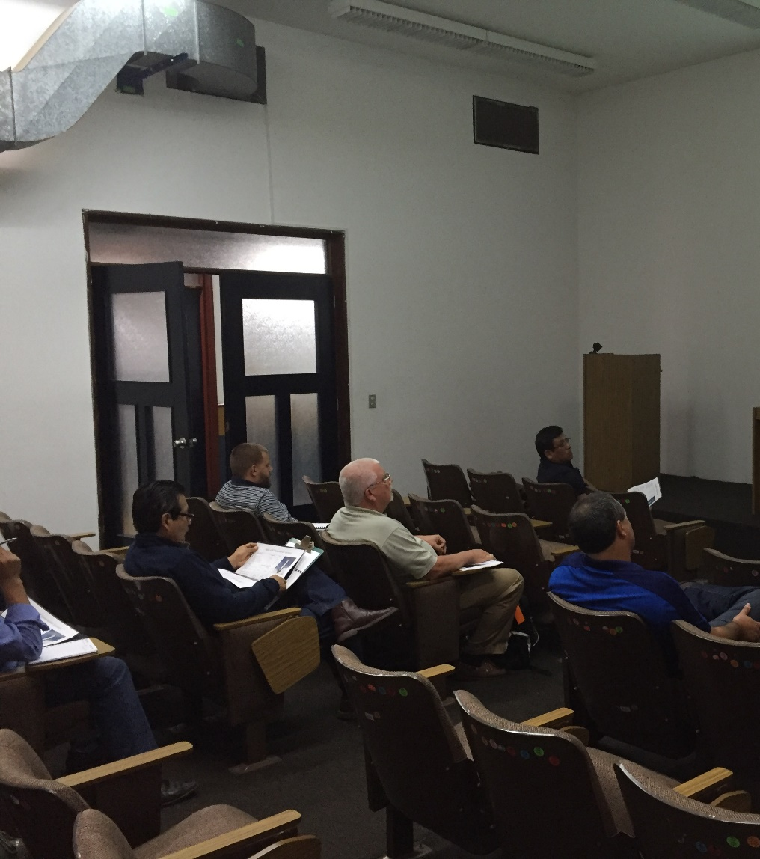
Возложенная ответственность
МАГАТЭ опубликовало документ «Безопасность ядерного материала при транспортировке», описывающего перевозку ядерного материала через международные границы.
Согласно Конвенции о физической защите ядерного материала (КФЗЯМ):
Для материалов категории II или III транспортировка производится в соответствии со специальными мерами безопасности и специальными предварительными договоренностями в соответствии с юрисдикцией и правилами экспортирующей и импортирующей стран, с указанием времени, места и процедур передачи ответственности.
Notes:
Photo Credit – Secured Transportation Services, LLC (Company owned photo)

Slide 7
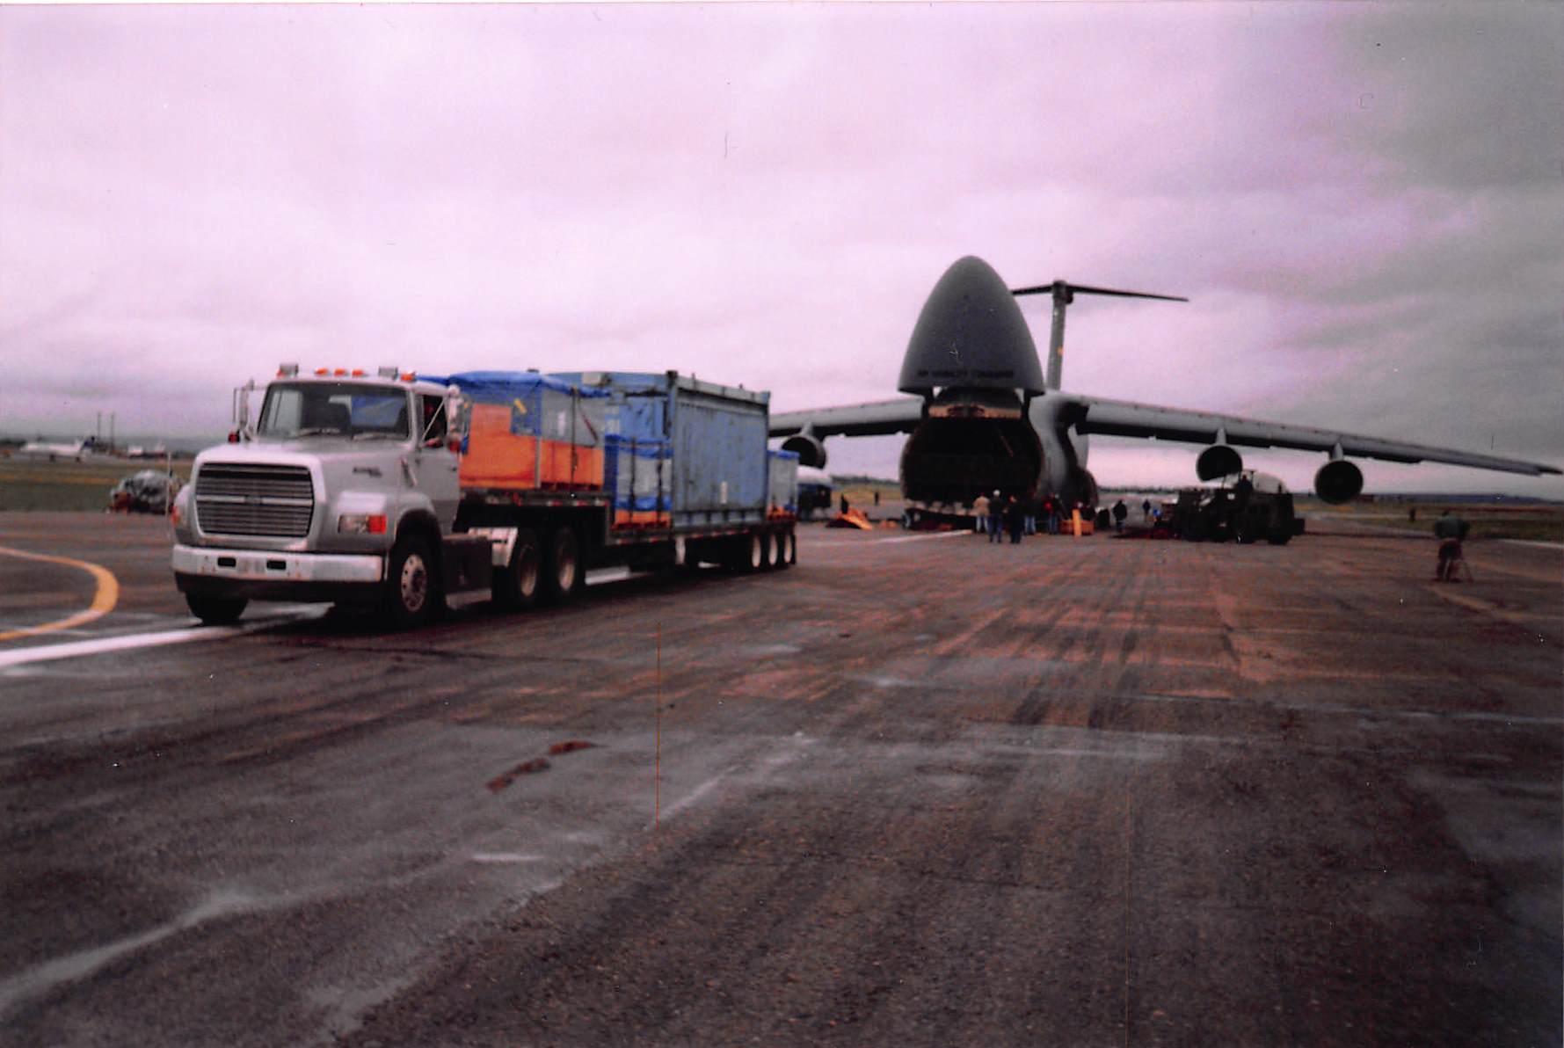
Типы координации
Предварительная координация и формальные соглашения
Соглашения о передаче ответственности
Распределение ответственности на всех этапах
Страны несут ответственность за обеспечение физической защиты груза
Notes:
The State plays a decisive role in security matters:
-firstly, the State is directly involved in gathering intelligence and assessing the risk of malicious action that may impact nuclear facilities and radioactive materials; this type of risk changes constantly, and the State must check that the security measures are constantly adapted to the current situation.
The State defines the design basis threat that must be used to design and assess physical protection systems;
The State also plays a determining role in the response to be given to counteract certain malicious activities by means of intervention by law enforcement agencies;
Managing a nuclear security event resulting from a malicious act requires input from a greater number of State bodies than managing an emergency related purely to safety issues. For example, law enforcement agencies and the judicial authorities may be involved;
Lastly, the State defines the rules relative to confidentiality and the protection of information and sets up a security check for anyone requiring access to sensitive activities or information.
Talking Points:
This assigned responsibility must be coordinated before shipment and provided in a written, legally binding, formal agreement to all parties involved.
References should also be made to intergovernmental agreements which govern mutual responsibilities and transfer of responsibilities to and from each affected State.
It is crucial to assign responsibility at every point of the transportation (Examples - Shipment initiation, scheduled stops, crossing borders, storage of material, etc.). This includes notifying any transit States of passage.
It is a States responsibility to provide physical protection for a shipment, within its own borders and on vessels registered to that State while in international waters or airspace until the shipment enters another State’s border.
Photo Credit – Secured Transportation Services, LLC (Company owned photo)

Slide 8
Ответственность государства-отправителя
Государство-отправитель должно:
Убедиться, что все государства являются членами КФЗЯМ
Заключить официальные соглашения по обеспечению физической защиты в соответствии с международными соглашениями
Получить официальные декларации, МоВ
Удостовериться, что лицензии и разрешения были выданы.
Notes:
The shipping State should ensure that all involved States are prepared to accept these responsibilities before a shipment is authorized. Below are several ways in which a State can ensure that involved States, including transit States, are prepared to accept these responsibilities:
- Verifying that all States are party to the Convention on Physical Protection of Nuclear Material (CPPNM);
- Concluding formal agreements to ensure physical protection will be implemented in accordance with international agreements;
- Obtaining formal declarations -such as signed Memoranda of Understanding (MOU) - that physical protection will be provided in -accordance with internationally accepted guidelines;
- Ensuring that licenses or authorizations containing or incorporating appropriate physical protection arrangements have been issued.

Slide 9
Специальные соображения при планировании
Протокол по реагированию на нештатные ситуации
Меморандумы о взаимопонимании (МоВ)
Двусторонний план транспортной безопасности
Трансграничная взаимопомощь может включать:
Notes:
Formal procedures may be used to reach negotiated agreements regarding resources or assets of one country being available to assist another across a border, or the formal Transfer of responsibility for a Transportation Control Center (TCC) or Emergency Operations Center (EOC) from the Point of Origin Country to the Destination Country. Examples of these procedures include:
Establishing formal negotiations between involved countries to determine situational or contingency response protocols such as in the event of a cross-border pursuit or assisting in environmental remediation or clean-up across borders
Documenting agreements reached via bilateral discussions using Memorandum of Understanding (MOU). A Memorandum of Understanding is a legal document describing an agreement between two or more parties. It expresses a convergence of will between parties, indicating an intended common line of action, rather than a legal commitment.
Assigning all responsibilities in the event of a Security or Safety Incident to specific participants in the Memorandum of Understanding (MOU) and including these specific assignments in the Transportation Security Plan.
Questions to ask panelist:
Does your country implement IAEA guidelines with respect to the secure transportation of radiological and nuclear materials?
Does your country have adherence to these guidelines as required in your regulatory policies and documents?
Assignment of Responsibility throughout movement of radiological material – how does your country assign responsibility for the various phases of material transportation? Who is responsible for the phases of preparation of Transport Plans, Oversight of Control for material enroute, and Responsible for the direction of secondary responders and off-site resources for events that may occur in-transit?
In your country, does the shipping state ensure that all involved States are prepared for material transfers? Who oversees these preparatory arrangements? How do they proceed to involve all the necessary groups and/or states?

Slide 10
Планирование физической защиты
Коммуникации
Ответственность за физическую защиту
Меморандум о взаимопонимании

Slide 11
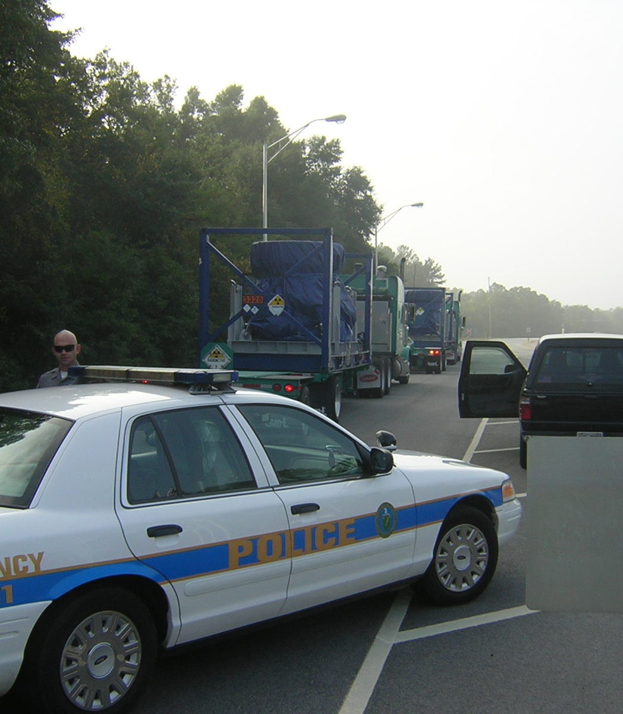
Что учитывать при физической защите
Коммуникации
Вооруженная охрана/сопровождение
Гарантии и чувствительная информация
Notes:
Shipping and receiving States should establish measures to provide communication regarding the continued integrity of the shipment and to ensure responsibility for response planning and capabilities is defined and fulfilled.
When armed guards/escorts are used to protect a shipment, having a written and accepted agreement is critical. These agreements should be done at State level as opposed to by commercial organizations and should clearly identify responsibility for response planning and identify response capabilities for the shipment. Protection of information should be exercised in the making and dissemination of these agreements.
Where sensitive information is involved in agreements and arrangements, appropriate measures should be taken to protect that information. For example, shipping and receiving times are very sensitive due to reduction of delay measures during loading and unloading.
Photo Credit – Secured Transportation Services, LLC (Company owned photo)

Slide 12
Ответственность за физическую защиту
Распределение обязанностей за физическую защиту
Реализация операторами и службой сопровождения
Передача ответственности за физическую защиту
Ответственность за реагирование
Notes:
Within the physical protection regime all necessary physical protection responsibilities, including those for response forces throughout the duration of the shipment, should be assigned at all levels of government.
All physical protection responsibilities are assigned by the State throughout the transport to the shipper, the carrier, the receiver and other relevant entities.
Responsibility for the shipment’s physical protection can be transferred to the carrier during transport, requiring a carrier that can implement physical protection measures assigned by the shipper.
The State should assign responsibilities for response, including among various levels of government, the shipper and/or carrier during transport.

Slide 13
Государства должны применять градированную и гибкую политику доверия
Ответственность государства заключается в идентификации потенциальных целей для саботажа и определении тех из них, которые требуют защиты
Необходимо заранее подготовить планы действий на случай прогнозируемых осложнений, которые могут произойти на границе
Заключить все МоВ до отправки груза.
Что учитывать при физической защите
Notes:
States should apply a graded and flexible approach in the determination of its trustworthiness policy which coincides with State laws and regulations to cover all individuals involved in the transportation process.
It is the State’s responsibility to identify potential targets for sabotage and determine which warrant protection. This should take into account capabilities of potential adversaries and their relative ability to cause unacceptable radiological consequences.
A physical protection plan should also include determination of that point at which responsibility is transferred from one authority to another (Ex. At Border crossings). Pre-determined action plans should be made for foreseeable complications that could occur at all borders between States, as LLEA does not have the authority to cross a border.
These pre-established agreements should be discussed and finalized in the MOU and included in the Transportation Security Plan.
Question for Panelist:
What sort of communications are provided in your country to manage and track movements of radiological and/or nuclear material?
How are shipment guarded in your country? Is there one special unit that provides security, or are there many different units able to provide transport security? What sort of training do they receive?
What sort of requirements do the vehicles have? Do they have to meet certain inspections?
What type of training do the truck drivers receive (for security response)? Do they respond themselves, or stay with their trucks while others respond to security events?

Slide 14
Планирование транспортной безопасности
Характеристика региона
Маршруты
Связь и GPS
Грузовая декларация

Slide 15
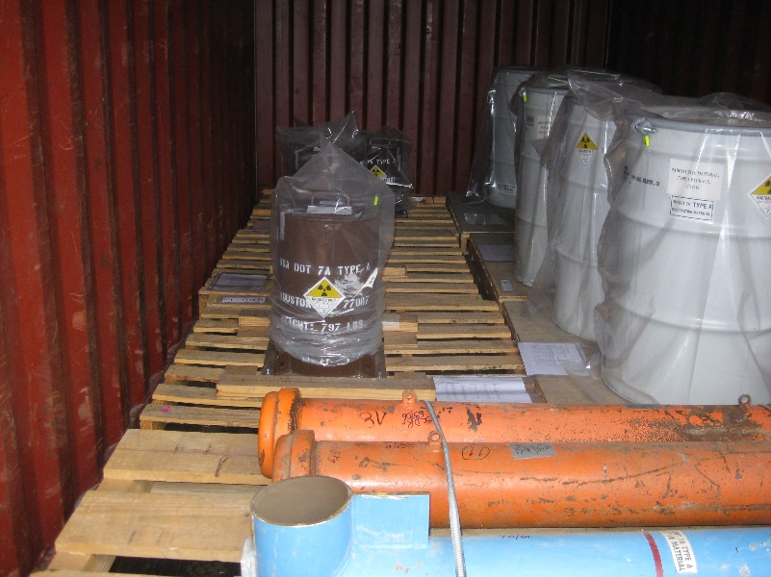
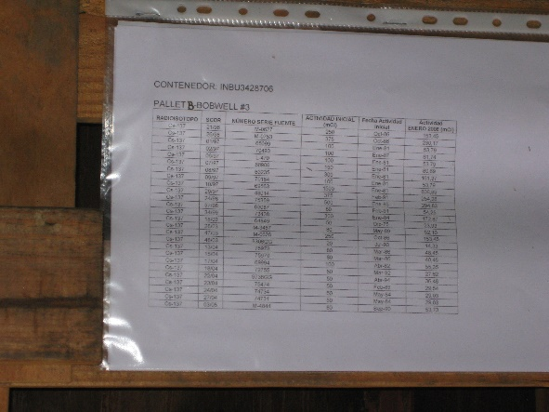
Планирование транспортной безопасности
Планирование транспортной безопасности должно проводиться для каждого транспортного события
Сертификаты и регистрации
Грузовые декларации / документы
Были ли выполнены требования к обучению?
Лицензии и разрешения надзорных органов
Notes:
A Transportation Security Plan is a complex document that describes every facet, every aspect, every agreement made, every preparation installed in vehicles or provided to crew and responders, and every contingency plan establishing a response to any security or safety event.
A Transport Security Plan that has been reviewed and finalized should be created for every transport event.
One key element involves getting all certifications and registrations required by different States for transport of nuclear or radiological material across their borders.
Shipment manifest/papers must be created and dispensed to all involved parties that conform to the international regulations of the states being passed through.
Another key element is ensuring all training requirements will be met for each region and conveyance that will be used in the transport
Photo Credit – Secured Transportation Services, LLC (Company owned photos)

Slide 16
Планирование маршрута для международных перевозок
Опишите регион транспортировки
География
Инфраструктура
Преступность и угрозы
Основные и альтернативные маршруты
Предпочтительный пункт пересечения границы
Места дозаправки
Разрешения в транзитных государствах
Notes:
A thorough characterization of all regions/States that the shipments pass through must be conducted, to evaluate risks and threats, geography, geopolitics, government, economy, infrastructure, corruption, and organized criminal activity.
When determining routes and alternative routes, conditions affecting the shipment should be considered such as: permissible speeds, areas where construction work is or is going to be performed, potential weather conditions, capabilities at planned transfer points and stopover facilities, refueling locations, possible safe havens, or subsistence locations.
Photo Credit – Stock Powerpoint Photo

Slide 17
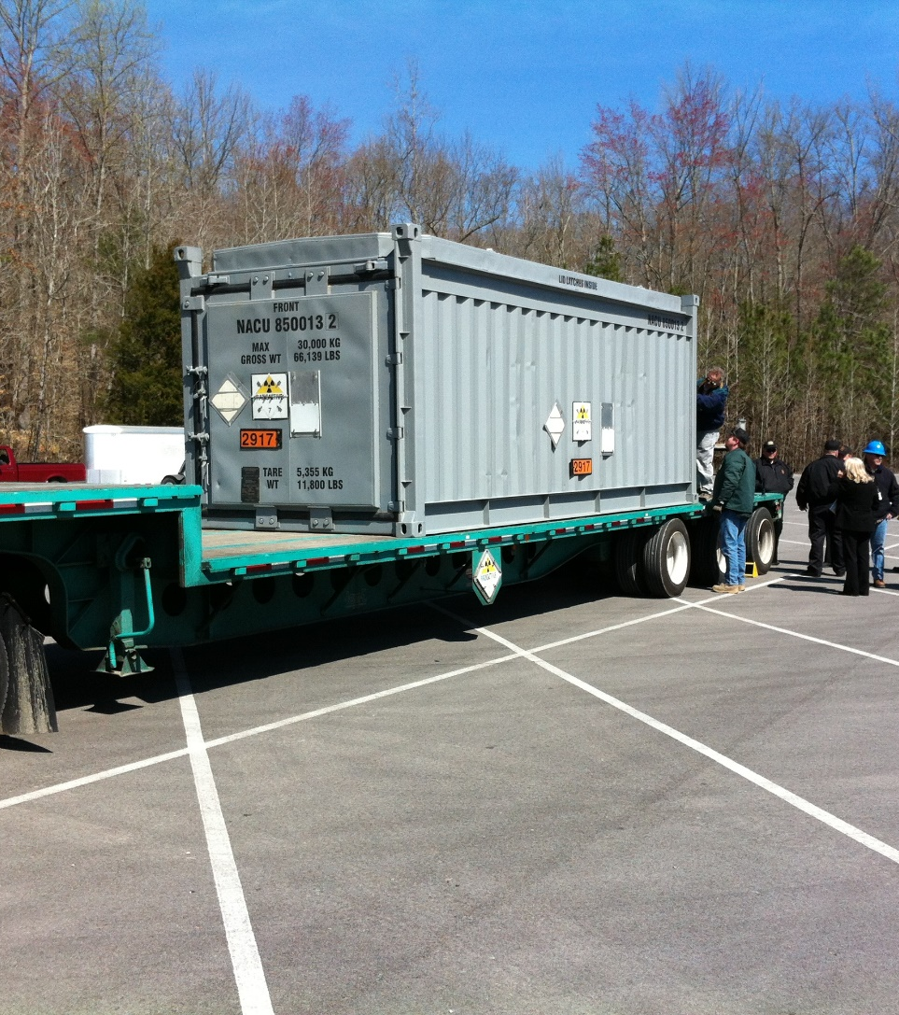
Ключевые элементы планирования маршрута
Важные аспекты, которые необходимо учитывать:
Резервные средства связи и отслеживание GPS
Контрольные пункты для Центра управления транспортом (ЦУТ)
Безопасные убежища
Месторасположения служб экстренной помощи, больниц, эвакуаторов и других служб экстренного реагирования по маршруту следования
Notes:
Critical things to be added to a TSP include:
Redundant communication and GPS tracking must be implemented, used and monitored throughout the shipment from beginning to end.
Check Points give the Transport Control Center (TCC) an initial search area if a shipment goes silent. The search area is calculated from the last check point using elapsed time and estimated speed to calculate the radius of distance the vehicle could have traveled in any direction.
Safe Havens should be pre-determined and included in the TSP along with knowledge of locations of EMTs, hospitals, wreckers, and other emergency responders along the route as it progresses.
Questions for Panelists:
What are some complication that could occur during international border crossing?
What is done for overnight shipments? How are refuels accomplished?
Who writes the Transport Security Plans? Is it the Shipper’s responsibility? Or a joint effort by both the Regulator and the Shipping Company?
Who is responsible for planning the many different requirements for conduct and management of radiological shipments in your country? How much is done by the regulator and how much is done by commercial shipment companies?
Who conducts the training that implements Transport Security Plans? For example, if inspections must be performed on trucks before a transport occurs, who performs that inspection, and who trains them how to properly inspect the vehicles?
Photo Credit – Secured Transportation Services, LLC (Company owned photos)

Slide 18
Планирование на случай нештатной ситуации
Планы действий в нештатной ситуации включают действия, которые должны предприниматься в случае несанкционированного выноса или саботажа
Включают альтернативные маршруты
Стратегия сил реагирования
Трансграничное реагирование/обмен информацией
Международные соглашения о реагировании
Notes:
The State should create a contingency plan including actions that should be taken in the event of unauthorized removal or sabotage of the nuclear material.
These plans should include alternative routes in the event of unforeseen problems.
Response force strategy should also be included in a contingency plan.
Photo Credit – Stock Powerpoint Photo

Slide 19
В программе реагирования. Должны учитываться материалы вне регуляторного контроля
Государство несет ответственность за информирование МАГАТЭ о потере контроля
Информирование пограничных государств
Обнаружение и возвращение пропавшего или украденного материала
Notes:
-Once it is reported the shipment has been stolen, misplaced or is missing, the situation is beyond the control of the shipper or carrier’s control and becomes a primary responsibility of the response framework coordinated by the State.
-If nuclear material is stolen or missing it becomes The State’s responsibility to report the loss of control to the appropriate international organization and other States in accordance with international obligations and national legislation.
-Informing bordering States would allow alerts to be made to their law enforcement to draw upon their capabilities to monitor for the nuclear material.
Questions for panelists:
Are there any armed personnel who escort shipments of radiological or nuclear material?
If yes, who are they – i.e. are they military personnel or state or local law enforcement staff?
Who trains the responders in your country? Is there one central training academy that trains all of them, or are there regional or local training facilities that different responders are sent to?
Do the various response units have opportunities to exercise their responding activities with each other on a periodic basis, or is the first time they work together at a real event?
How do they communicate with each other? Are their radios all on the same channel?
How does the Transport Control Center (TCC) or Emergency Operations Center (EOC) in your country monitor the status of the shipments enroute? Who operates that TCC or EOC?
If an attack occurs, who is responsible to manage the response to that attack? Does a military commander take over, or is a civilian manager in charge of managing the response?
Does your country identify Safe Havens along various routes for convoy vehicles that may encounter threats during radiological material transfers?

Slide 20
Вопросы?

