Slide 1
Overview of ORS Mobile Source Transit Security (MSTS)
27 May 2022

Slide 2
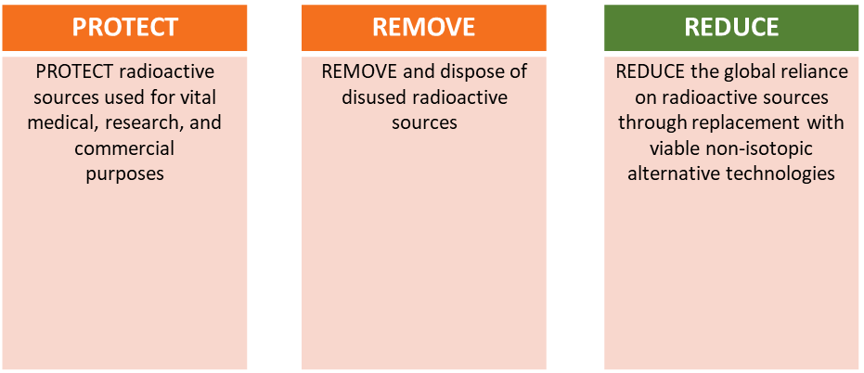
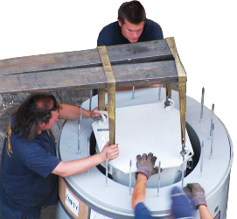
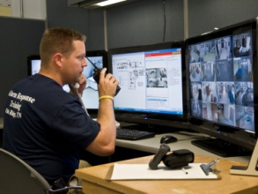
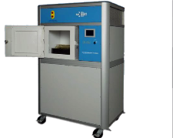
Office of Radiological Security
Mission: ORS enhances global security by preventing high activity radioactive materials from use in acts of terrorism

Slide 3
Security Challenges for Mobile Sources
Characteristics of Mobile Devices | Security Challenges
Devices are portable and move from storage facilities, to transport vehicles, to job sites Transported and used across wide geographic areas Used at job site for varying lengths of time Used in harsh and sometimes remote locations Relatively small devices/containers Sources exposed instead of contained during operation | Security extends beyond storage location Limited remote alarm notification and surveillance during transport and use Reliance on manual procedures and operator communication during transport and use Limited options for addressing “delay” Response jurisdictions can be difficult to determine Device location may be unfamiliar to responders
Enhanced Security Considerations Tracking devices/containers and monitoring source presence Alarm communication methods and reliability (cellular/satellite) Power consumption (battery life) Limited space for sensor and communication components

Slide 4
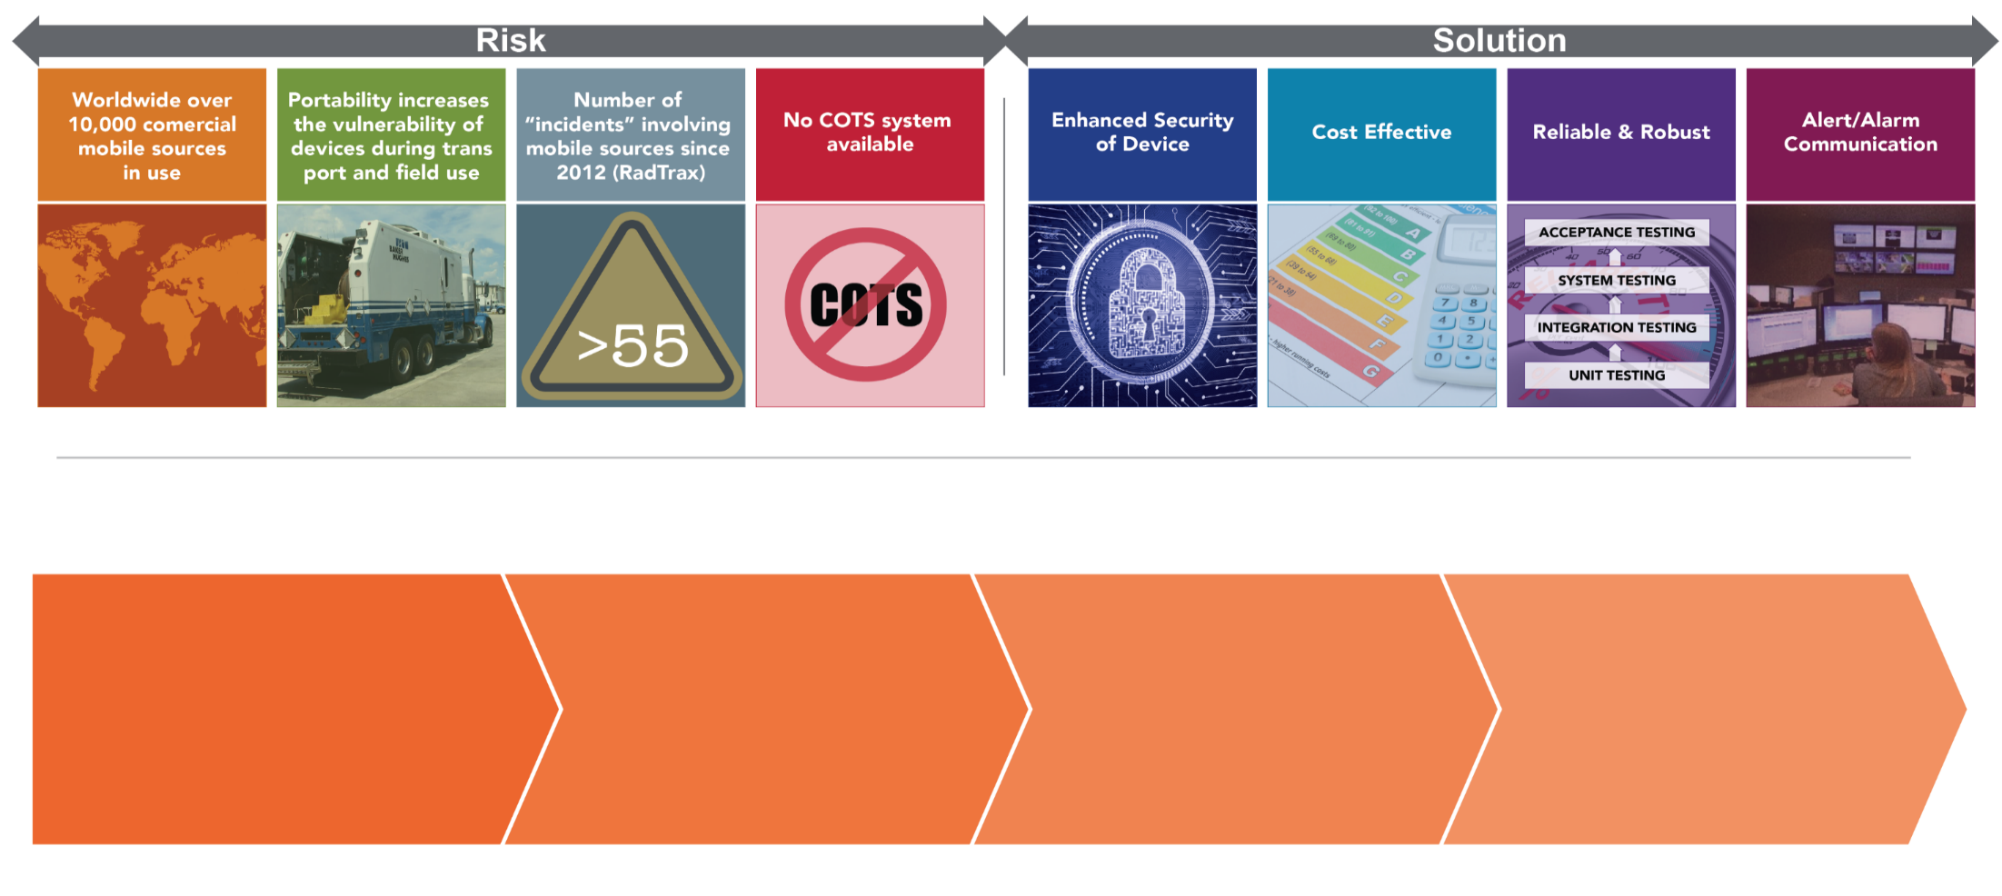
Mobile Radioactive Source Risks and Developing an Effective Solution
Conceptual Design & Development
Pilots and Low-Rate Initial Production
Tech Transfer & Deployment
Integration
4

Slide 5
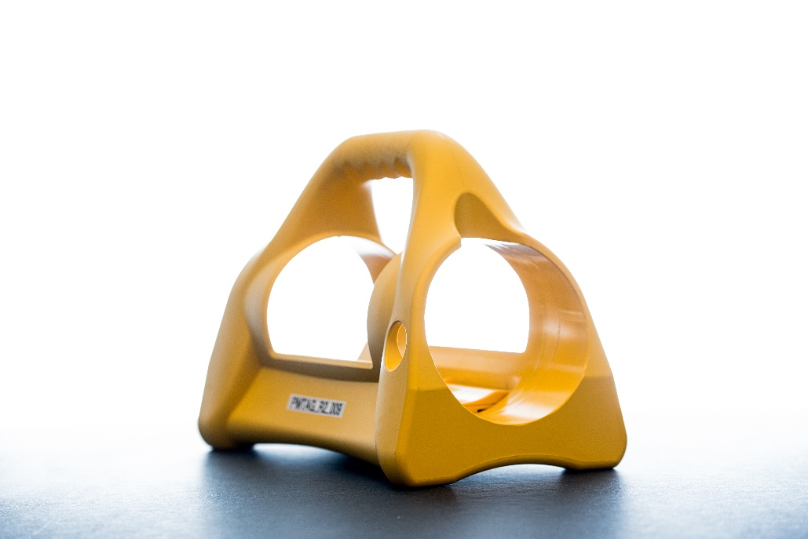
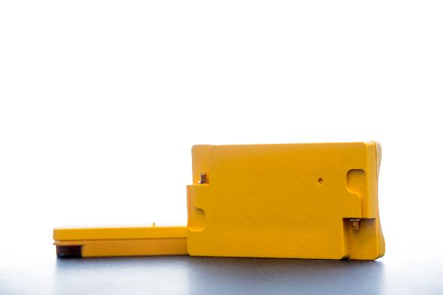
Industrial Radiography
Camera | Persistent Monitoring Tag
Track the Camera
Monitor the Source

Slide 6
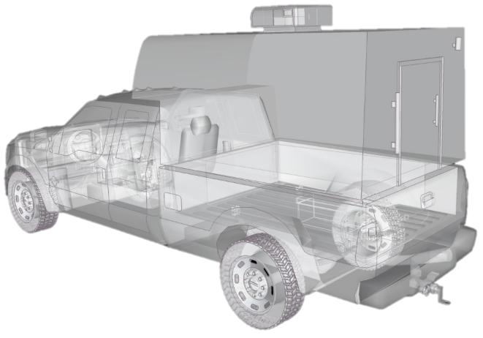
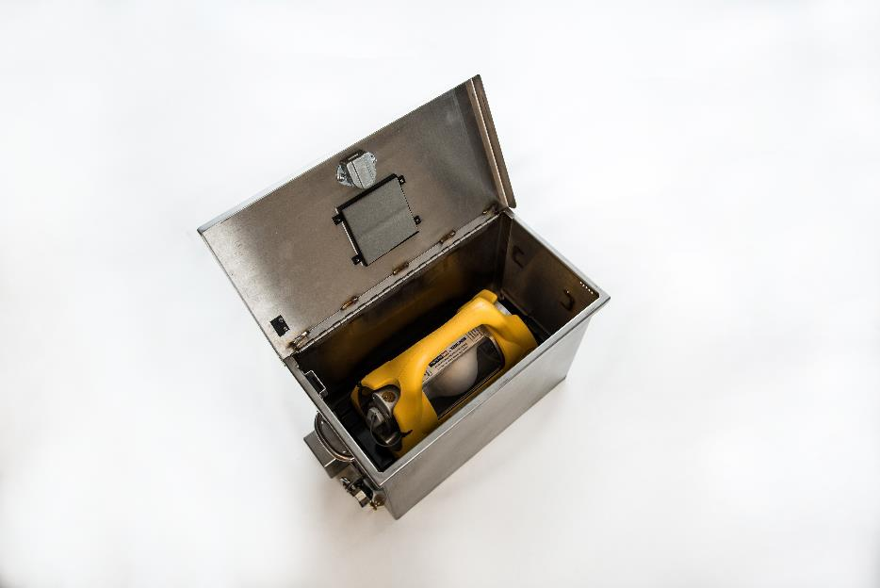
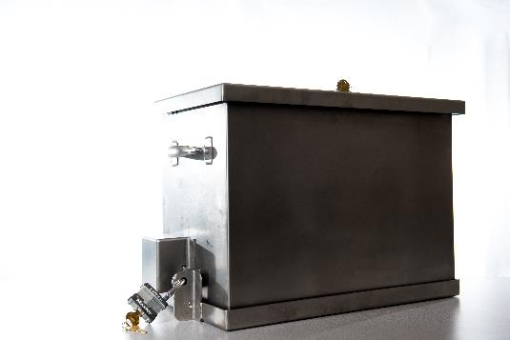
Industrial Radiography
Truck | Secure Transport Box
Track the Truck
Monitor the Camera

Slide 7
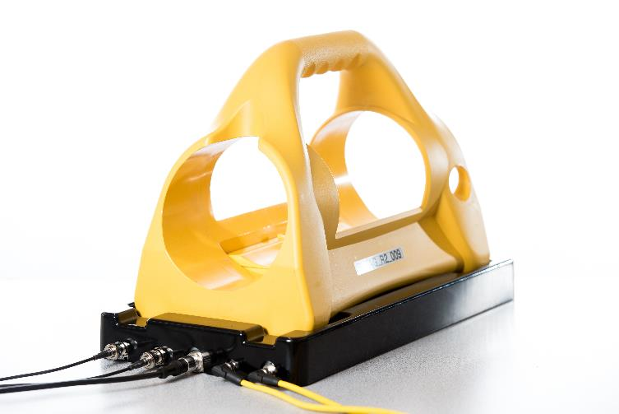
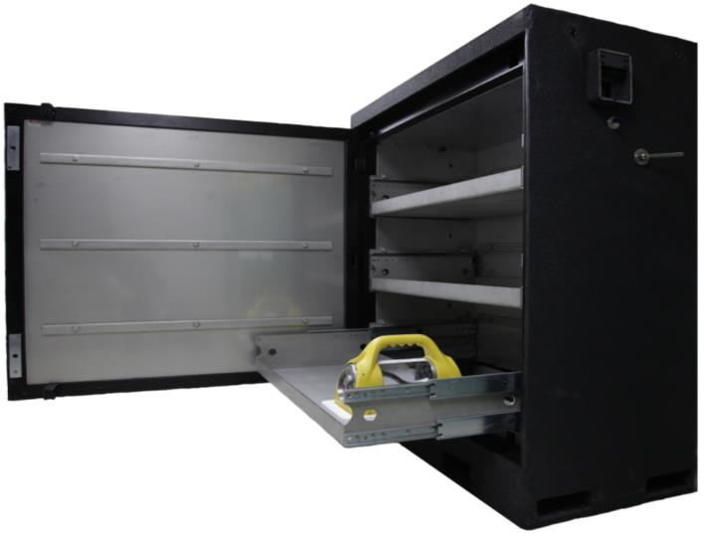
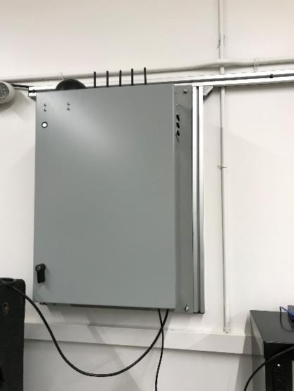
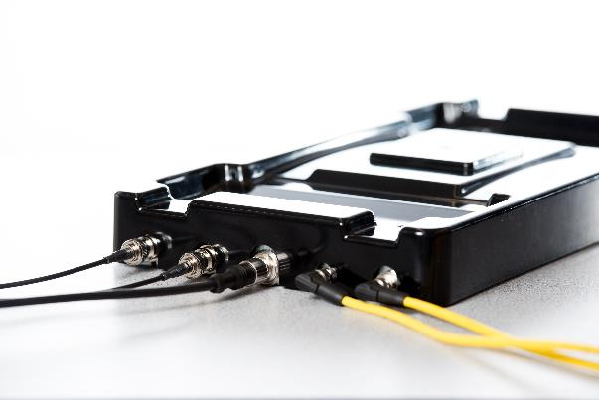
Industrial Radiography
Storage | Integrated Site Security
Secure the Camera(s)
Monitor the Camera(s)

Slide 8
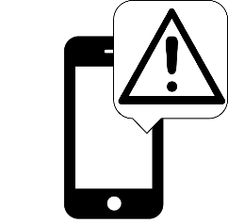
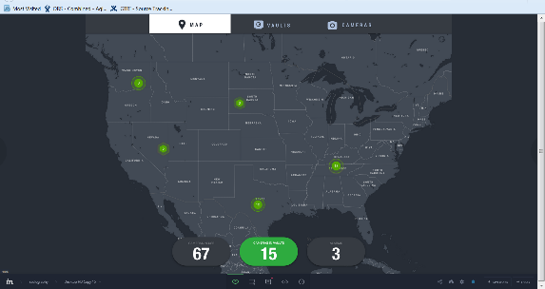
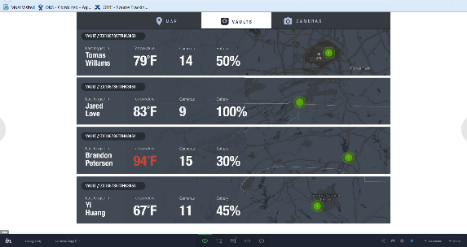
Industrial Radiography
Notifications and Alarms
Receive Wireless Comms
Alert Users

Slide 9
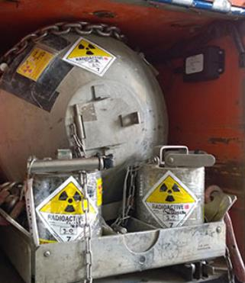
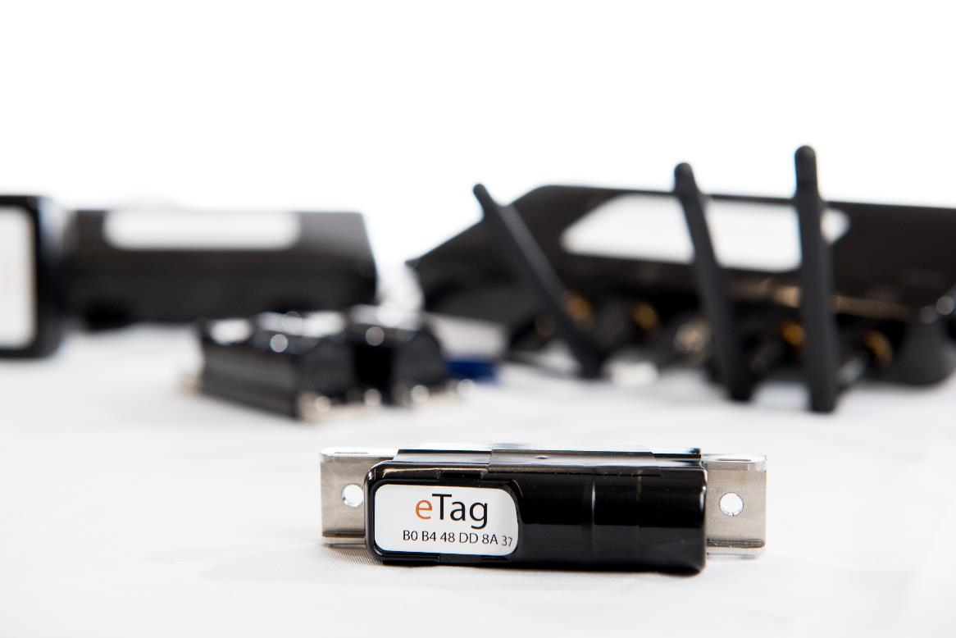
Well Logging
Shield | eTag(s)
Track the Shield
Monitor the Shield Proximity

Slide 10
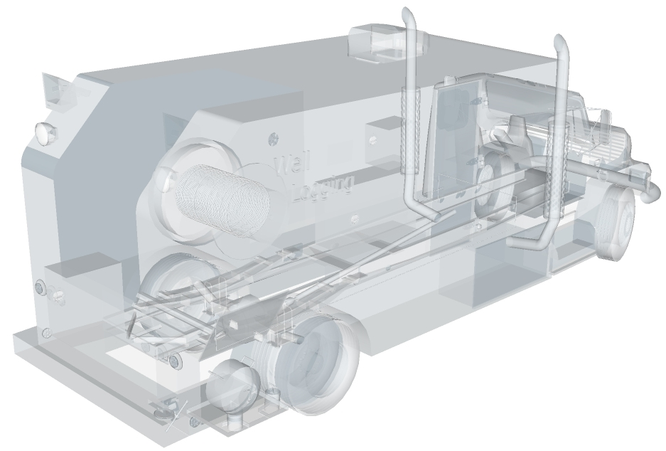
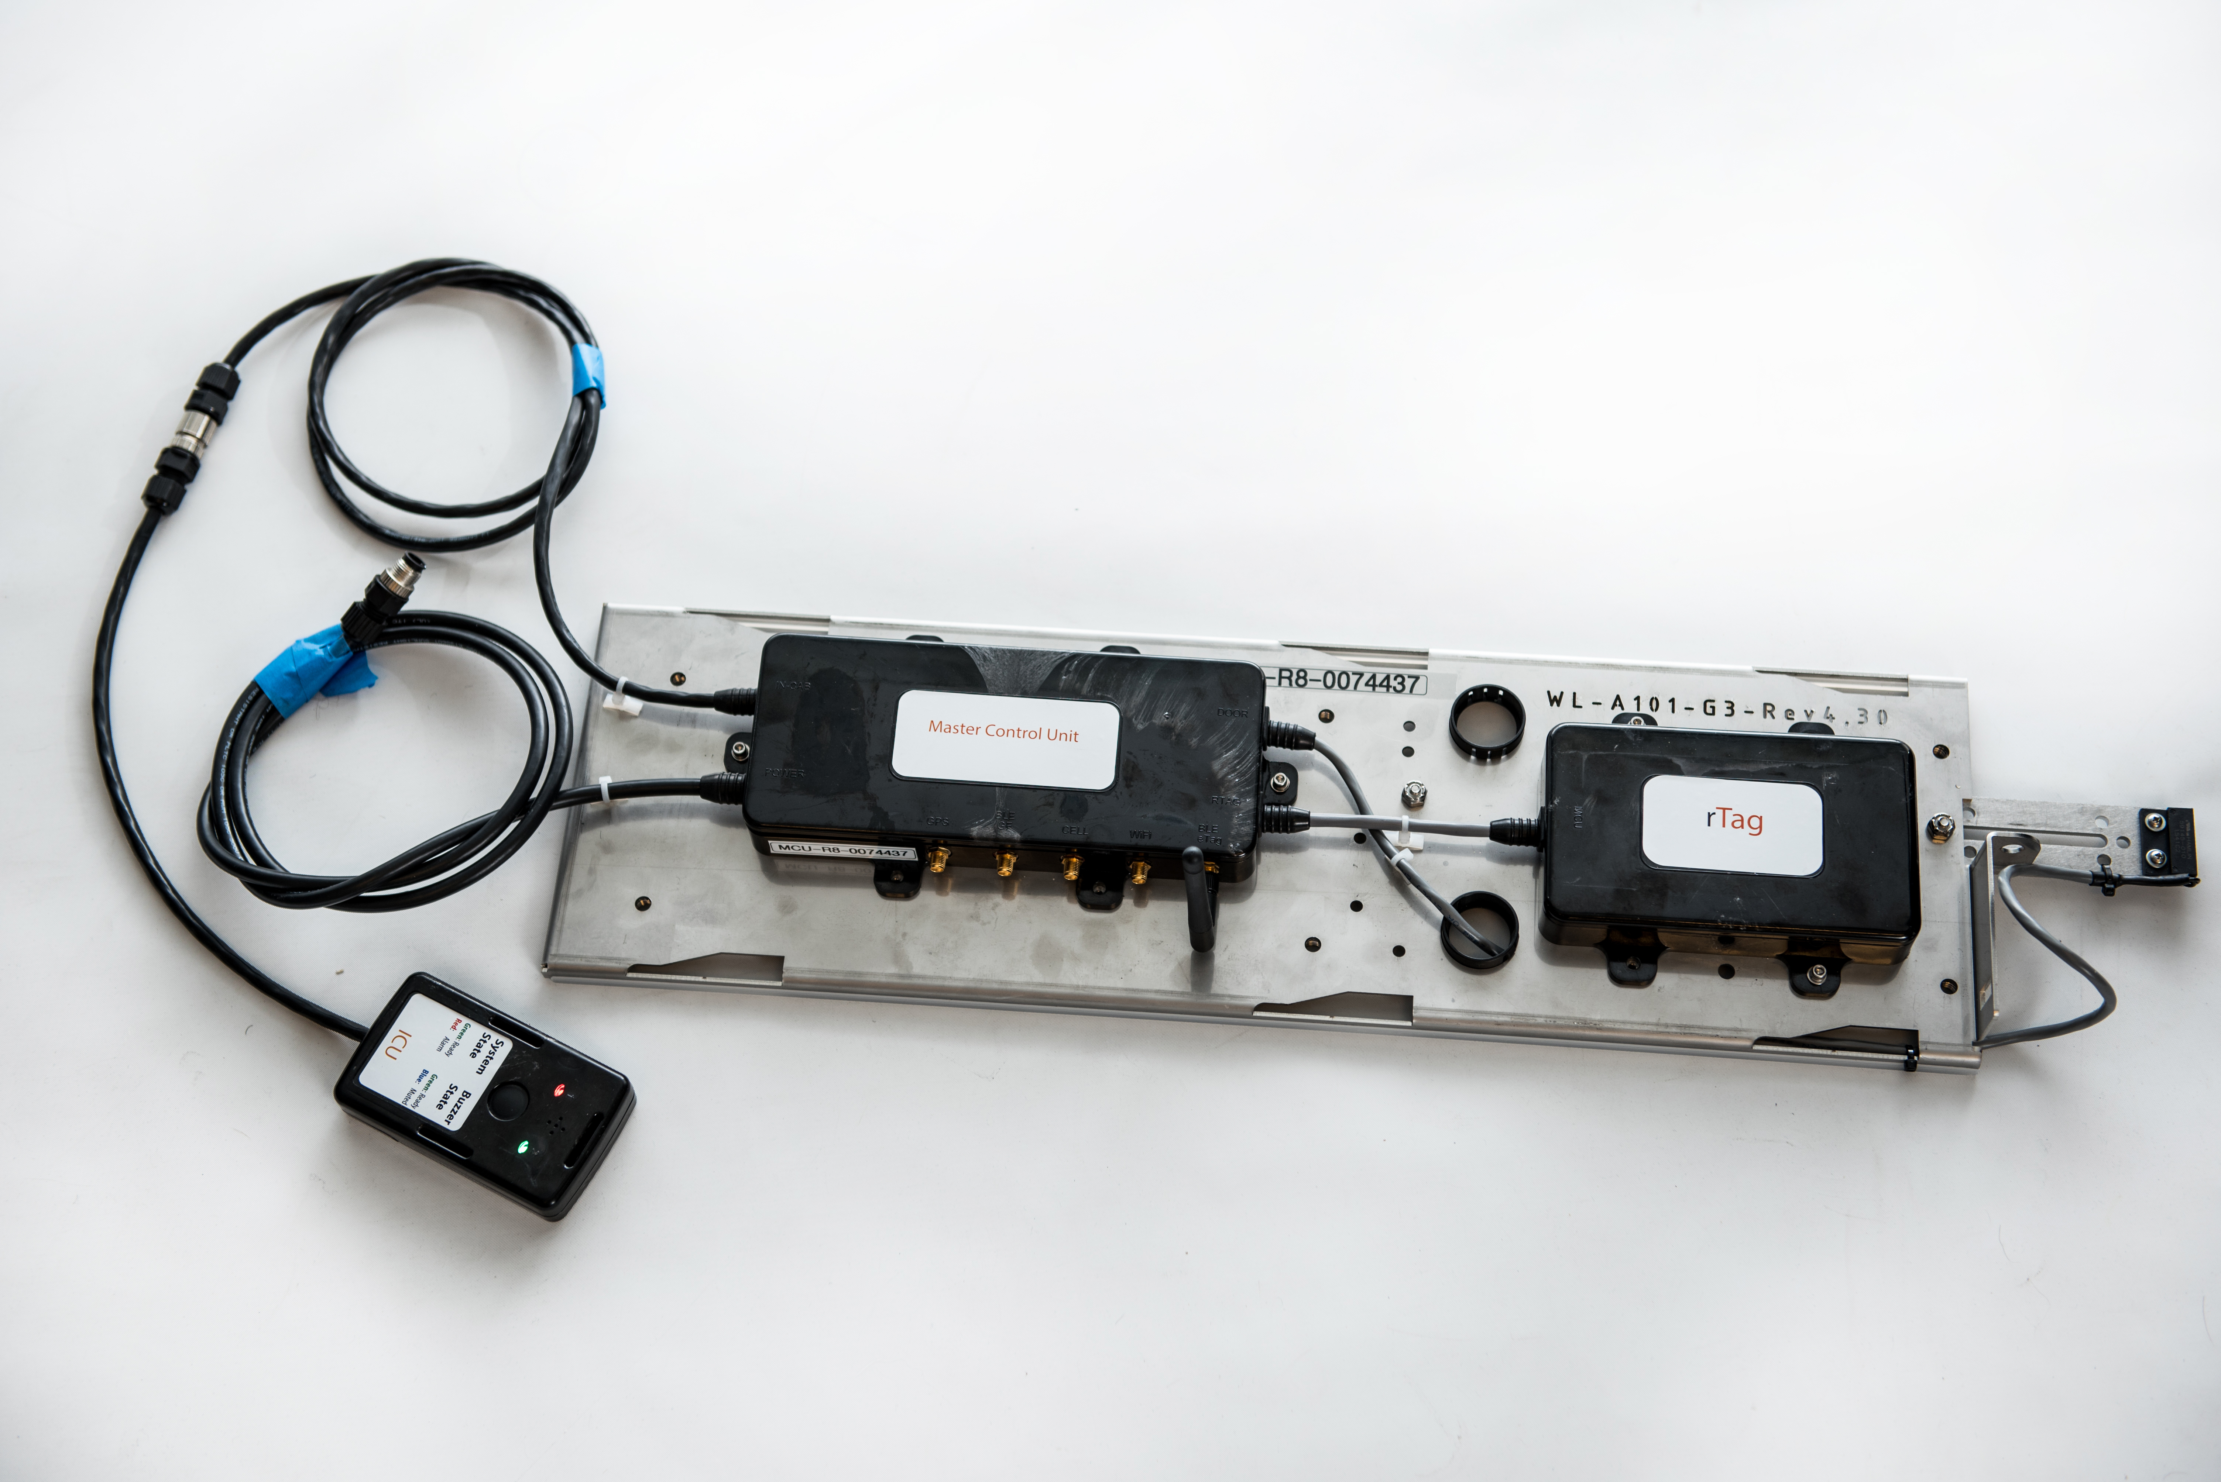
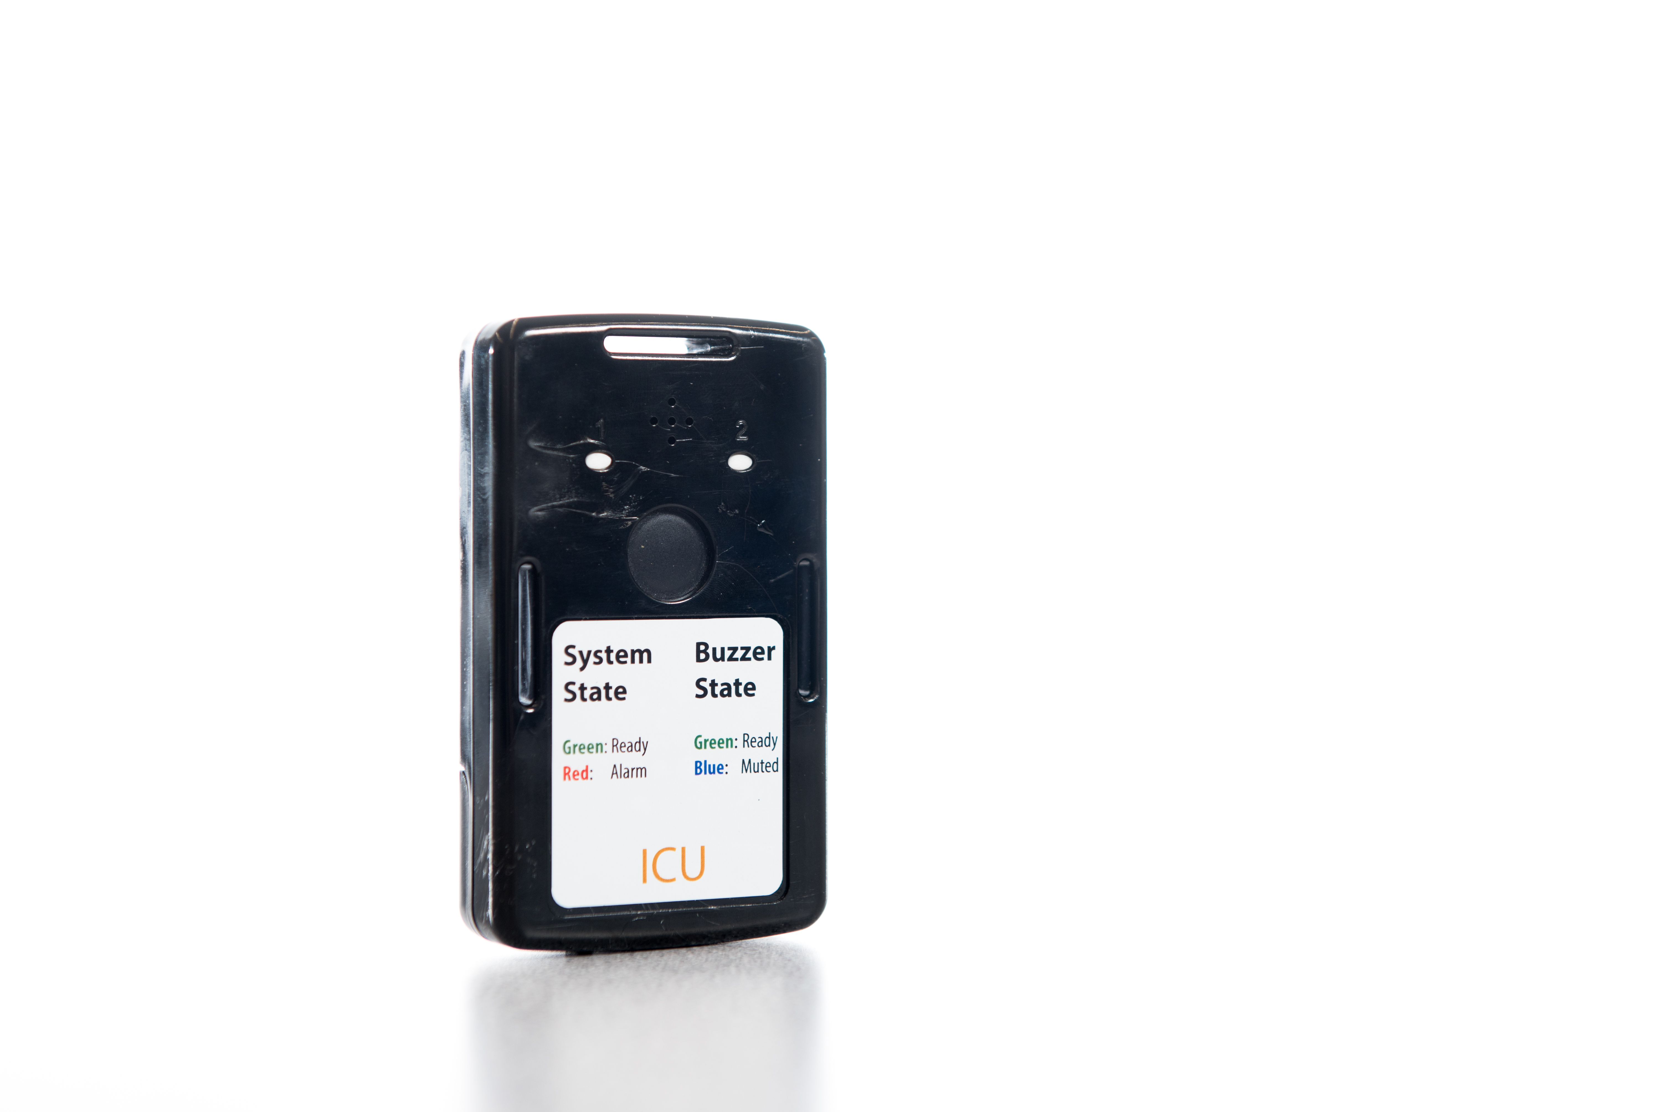
Well Logging
Truck | MCU, ICU, rTag
Track the Truck
Monitor the Shield Proximity
Monitor Source Levels
Overpack | MCU, rTag, and eTag(s)
Track the Shield(s)
Monitor Source Levels

Slide 11
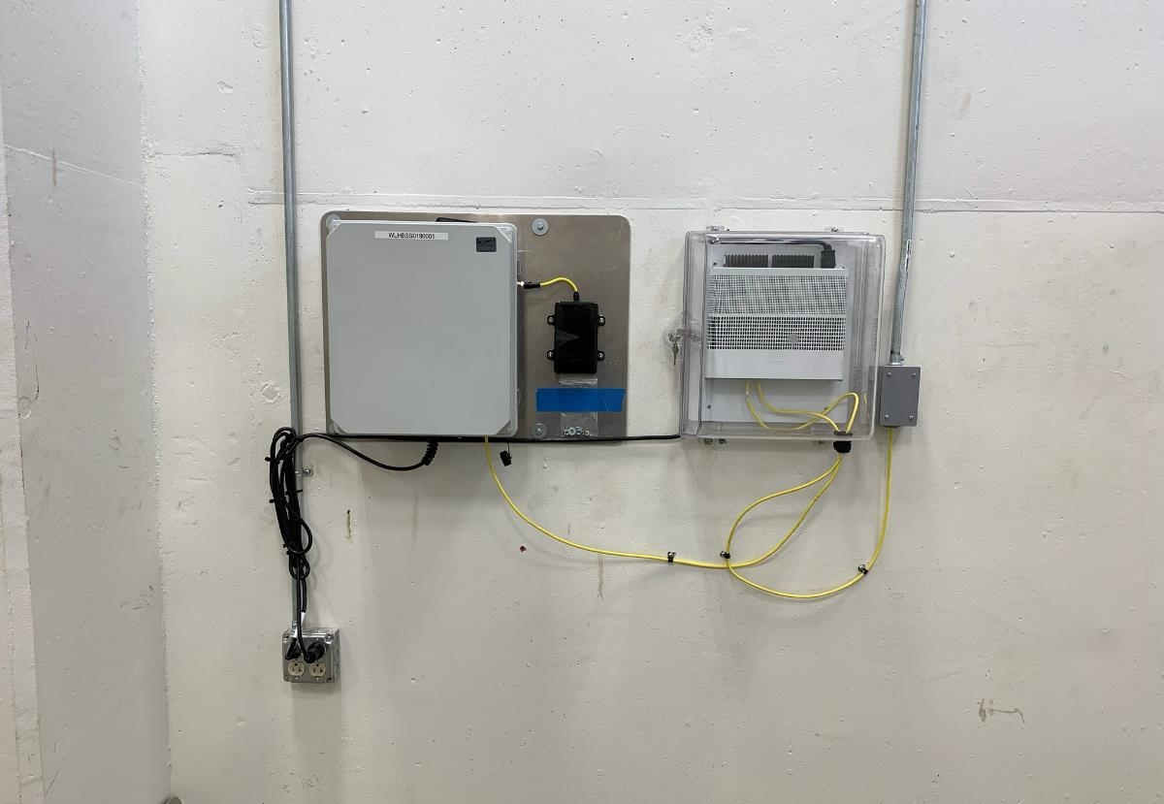
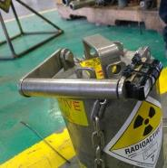
Well Logging
Vault | Homebase Security System
Monitor the Shields(s)
Local Alarm Connections

Slide 12
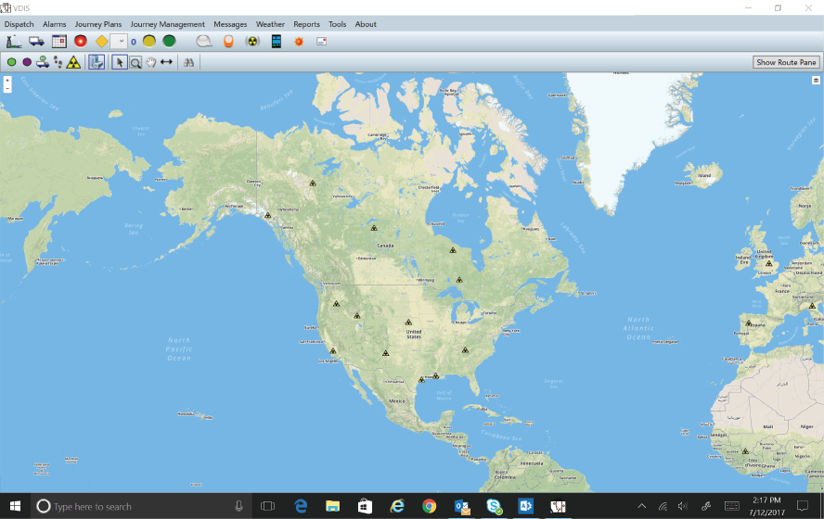
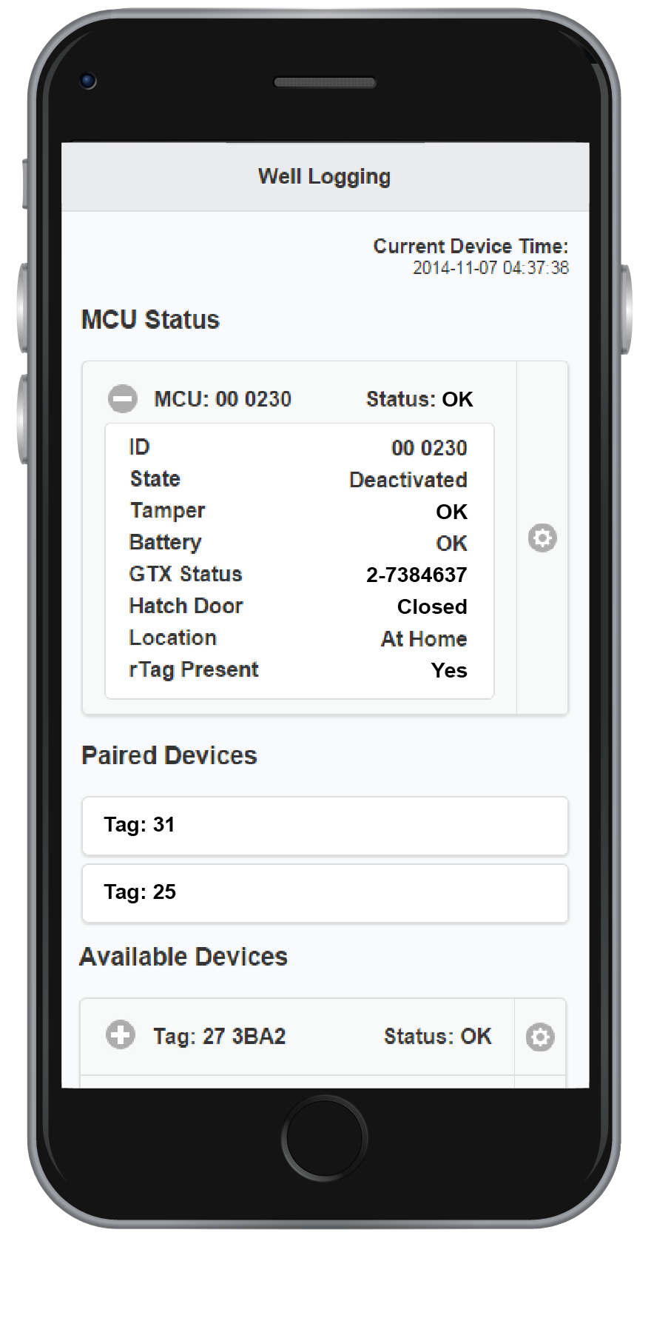
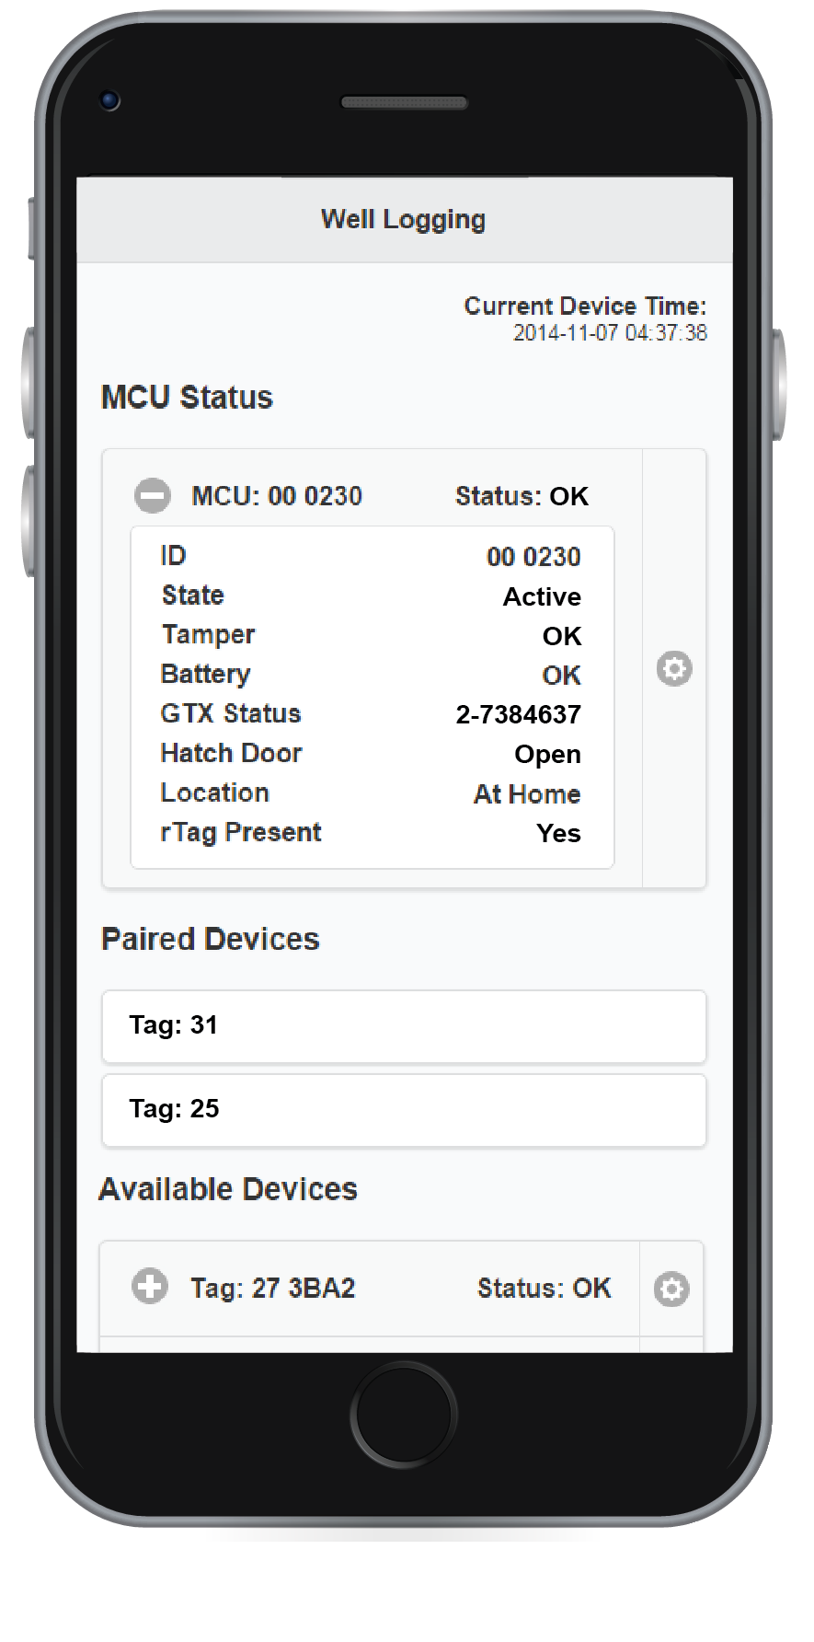
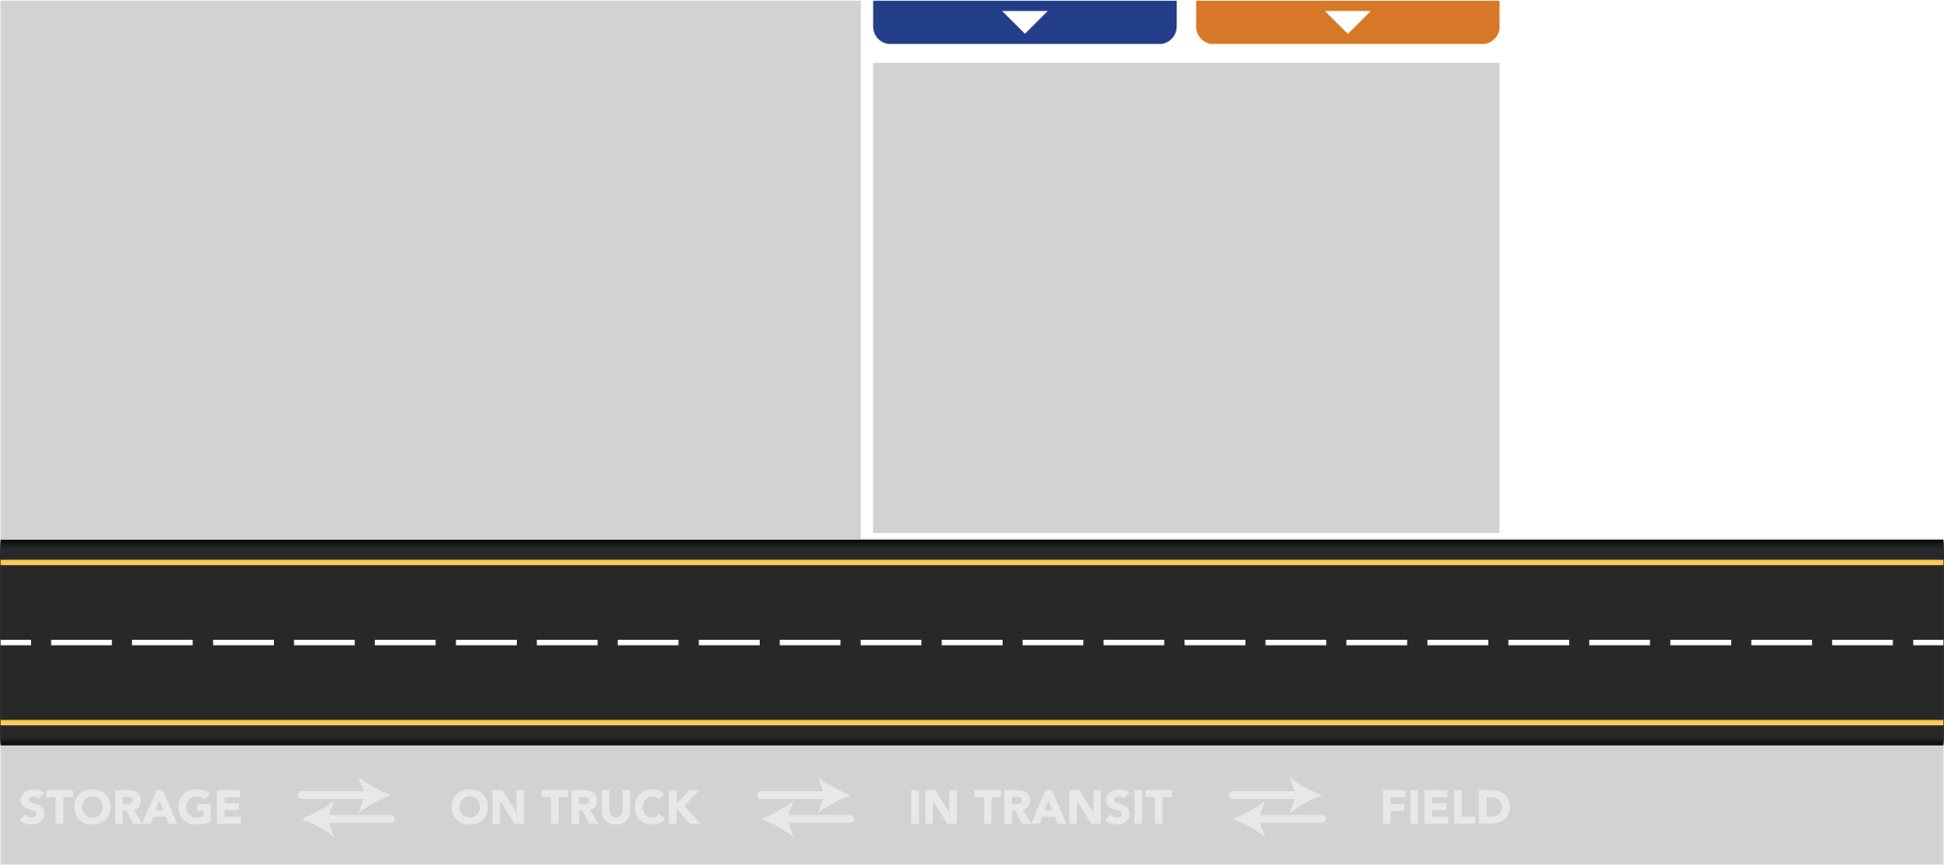
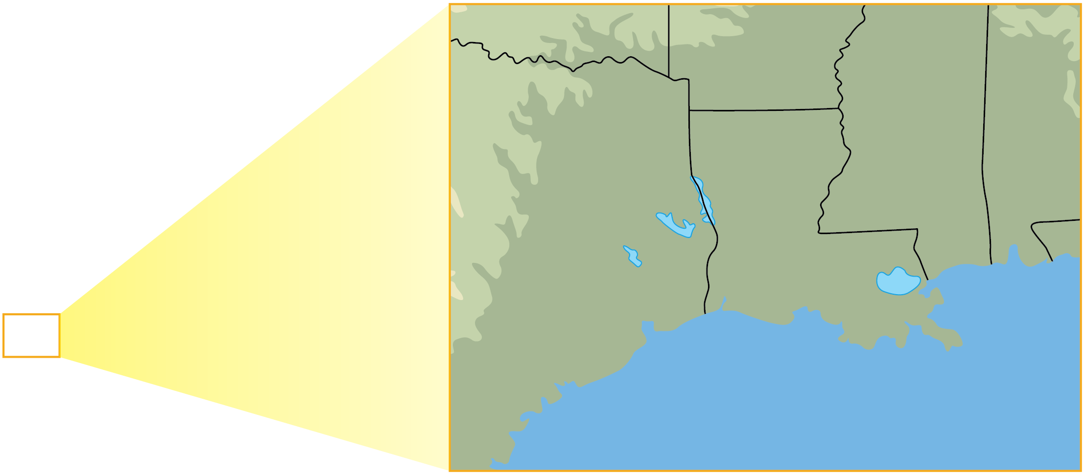
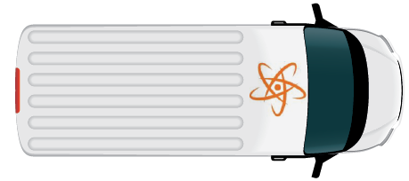
Well Logging
Notifications and Alarms
Receive Wireless Comms
Alert Users

