Slide 1
National Academy of Sciences of Tajikistan Chemical, Biological, Radiological and Nuclear Safety and Security Agency
Central Asia and Azerbaijan Regional Transport Security Dialog
Session 3 - Transboundary Smuggling.
April 28, 2022
Illicit trafficking case in Tajikistan
Bakhtiyor Barotov
Тел: +992 93 776 66 36
e-mail: b.barotov@cbrn.tj

Slide 2
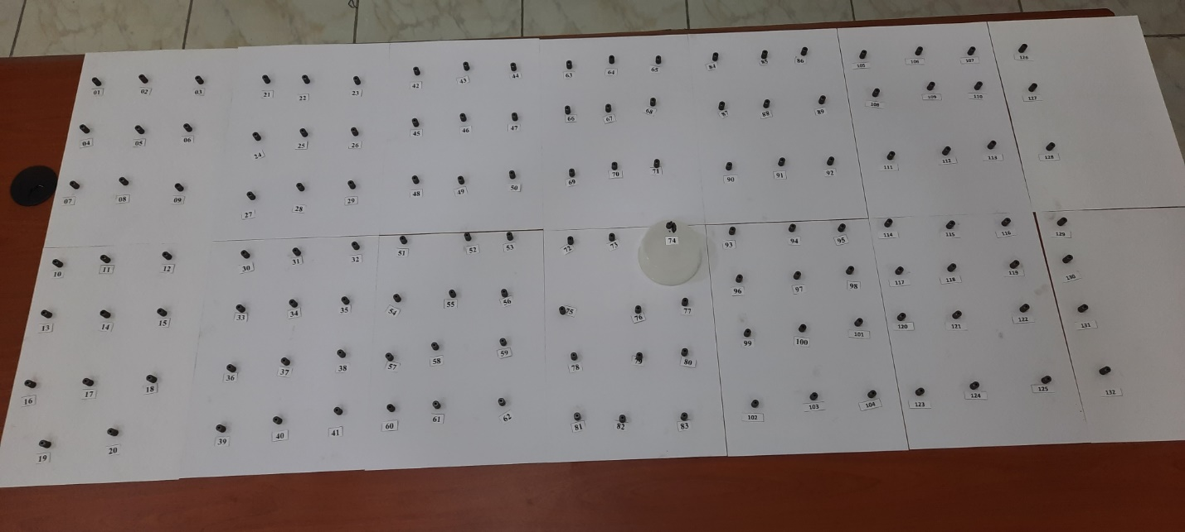
Information on detention
CBRN SSA NANT
State Committee for National Security of the Republic of Tajikistan on May 27, 2021 contacted CBRN SSA (State Regulatory body of Tajikistan) and informed that, during a special operation, several citizens of the Republic of Tajikistan were detained in Dushanbe (Capital of Tajikistan) and from them were found 133 pieces of nuclear material (uranium dioxide tablets) with a total weight of 607 grams.

Slide 3
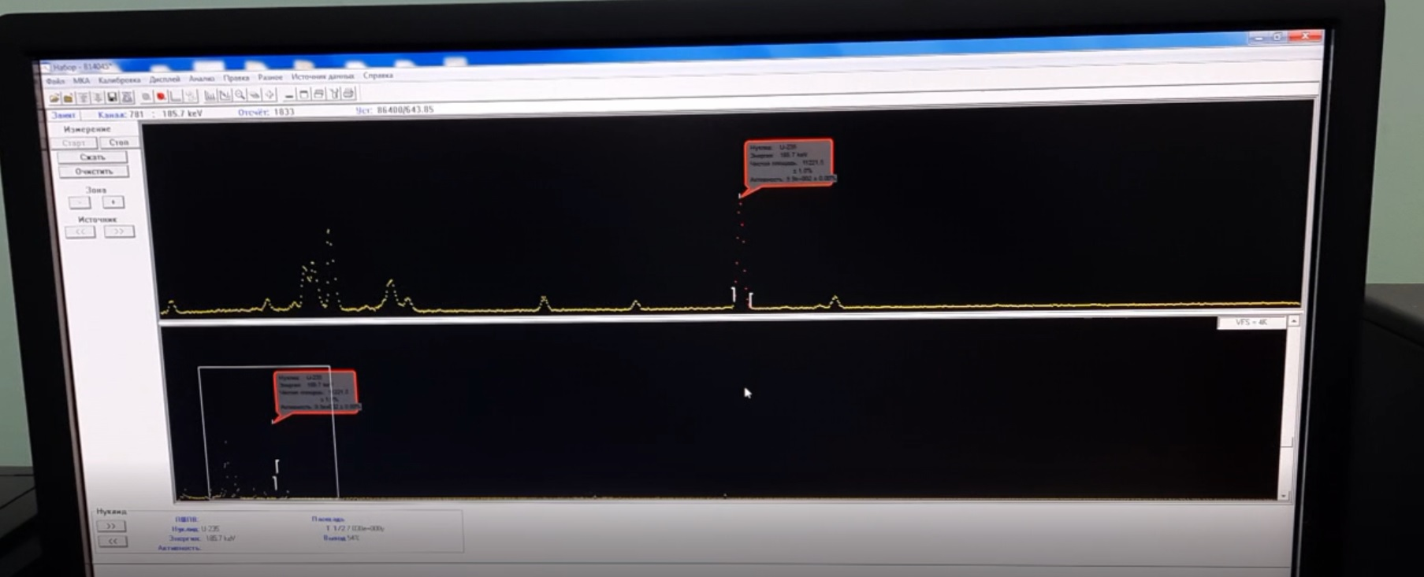
Identification of material
CBRN SSA NANT
Primary gamma-spectrometric analysis showed that this material contains isotopes of uranium U-235 (3-3.5% enrichment) and U-238.

Slide 4
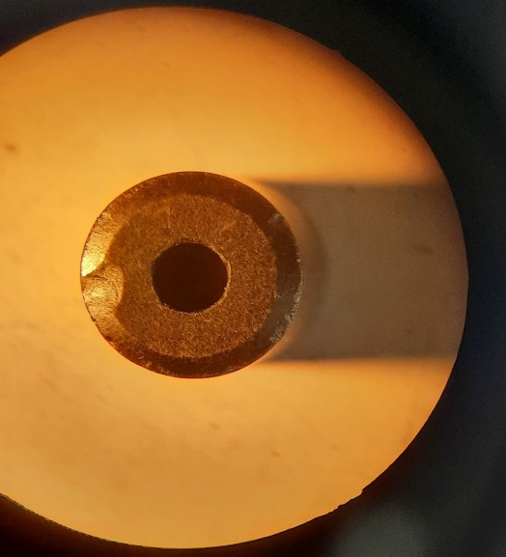
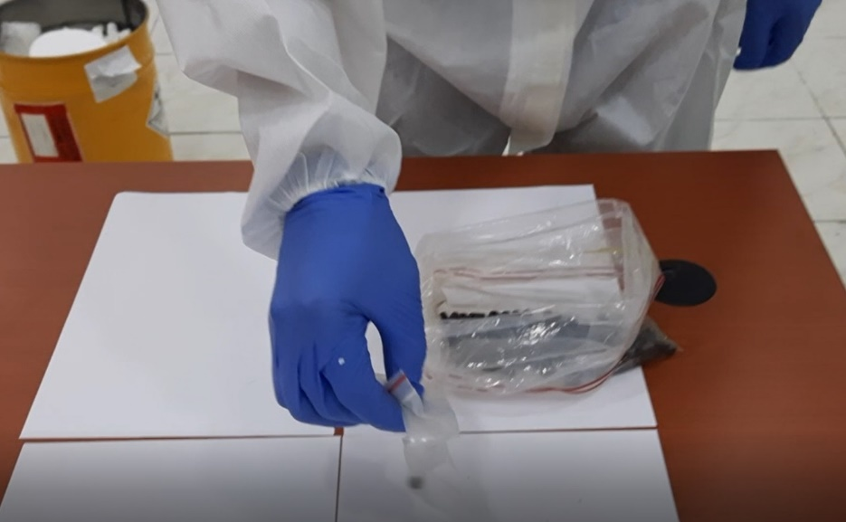
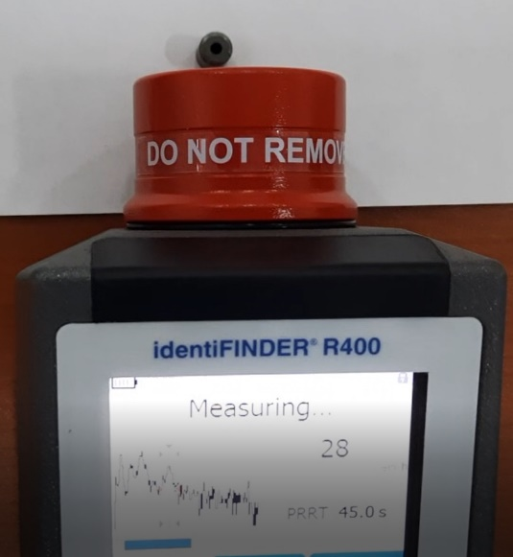
Physical description
CBRN SSA NANT
Physical description: 133 pieces of cillindric Pallets with cylindrical hole in the center, 11 mm long, 7 mm diameter, 2 mm hole, weight 4.5-4.8 grams. No serial numbers in the pallets, dose rate 0,315-0,388 micro Sivert per hour.

Slide 5
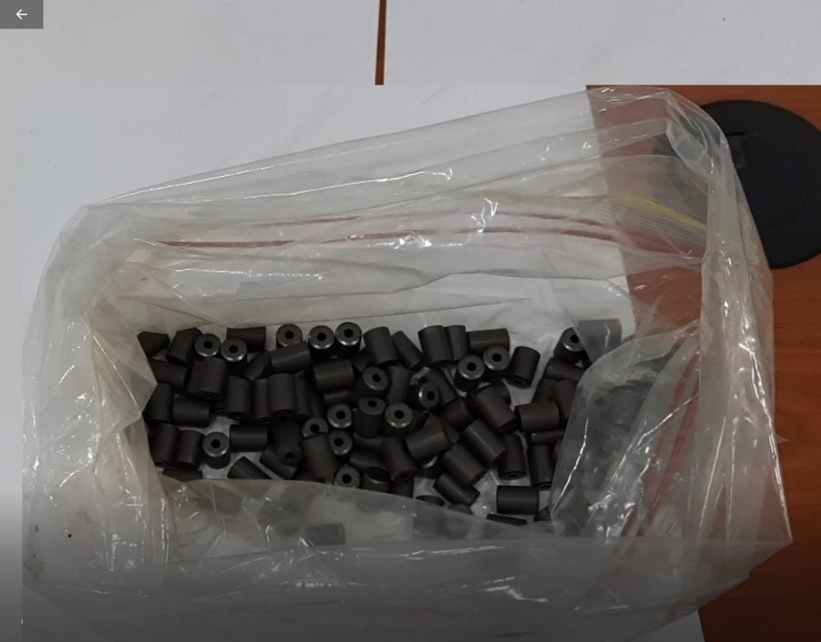
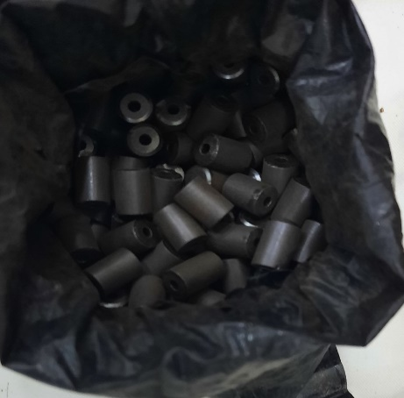
Location of detection
CBRN SSA NANT
Materials were found in black plastic package in the glass bottle in the storage room of detained person. There were no any shielding container or protection material. After checking of national database of radioactive sources, it was identified that materials are not from Tajikistan facilities.

Slide 6
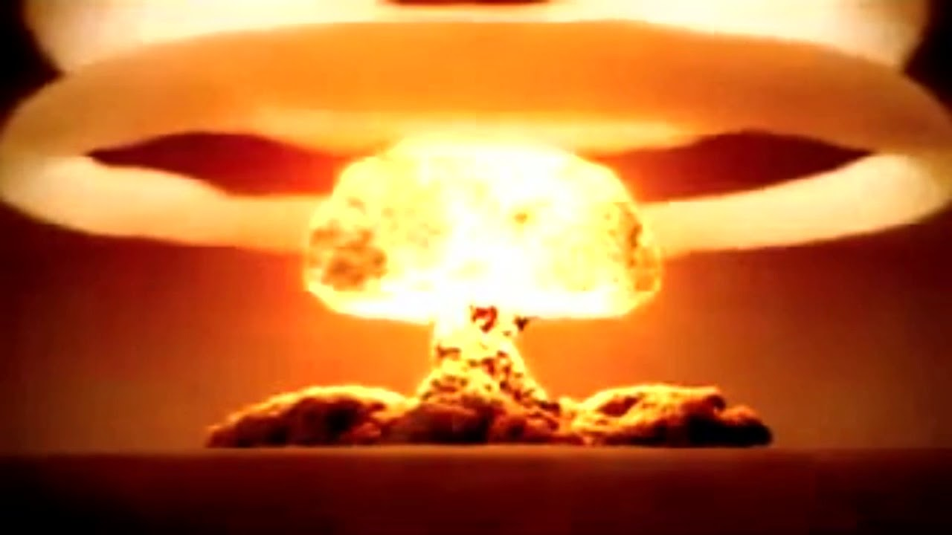
Motivation of smugglers
CBRN SSA NANT
During the interrogation of the detained citizens, it was not possible to find out the origin of this material, since they refer to the provision of the material by another citizen, whom they had not yet been able to detain. This group of people tried to find buyers in order to sell and get a large amount of money. Individuals planned to sell them within the country or to Afghanistan. Should we believe them?

Slide 7
Accusation and Enforcement
CBRN SSA NANT
After investigation and judicial review citizen of Tajikistan Haitmurodov M.T. was convicted under article 193 part 1 of the Criminal code of Tajikistan “Illicit trafficking of radioactive materials”.
Another person due to health condition and old age get only penalties.

Slide 8
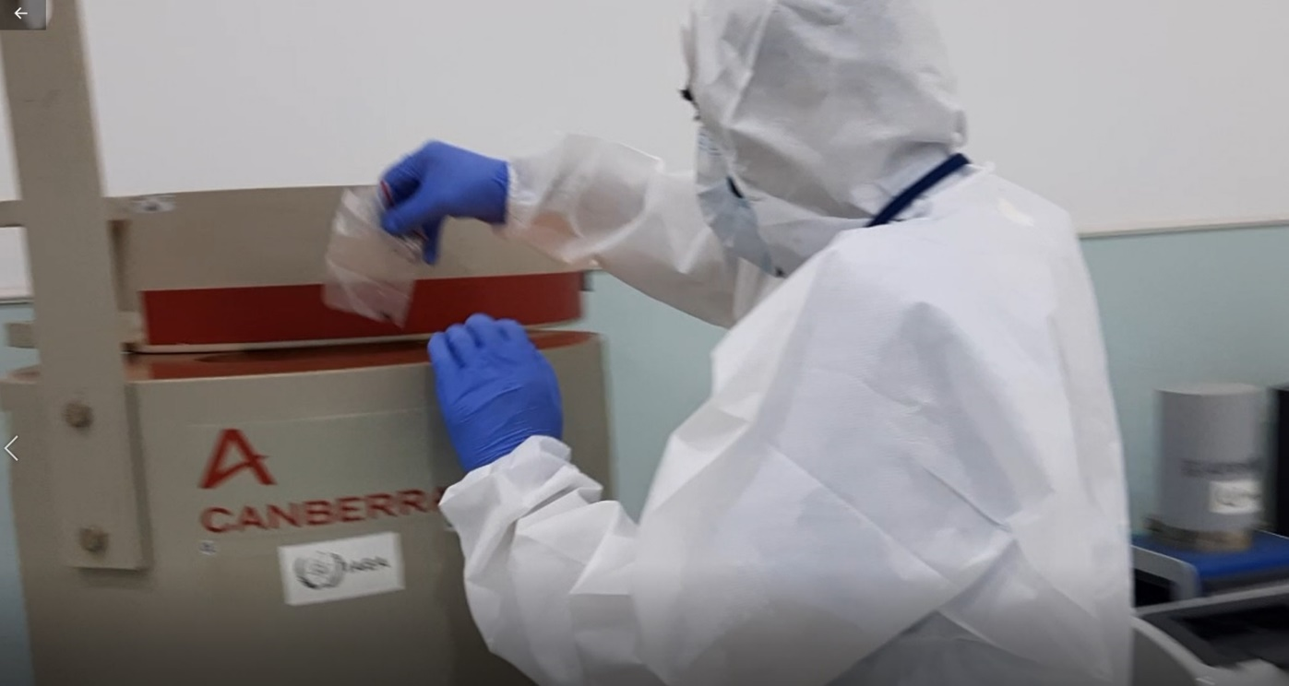
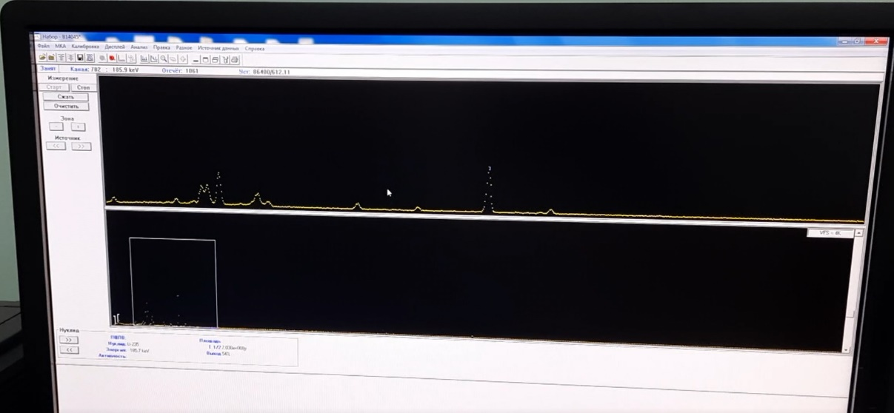
Analytical and forensics capability
CBRN SSA NANT
Analysis performed by Technical Services Laboratory of Chemical, Biological, Radiological and Nuclear Safety and Security Agency, Dushanbe, Tajikistan, in Canberra Gamma-spectroscopy, with HPGe Detector and other instruments.

Slide 9
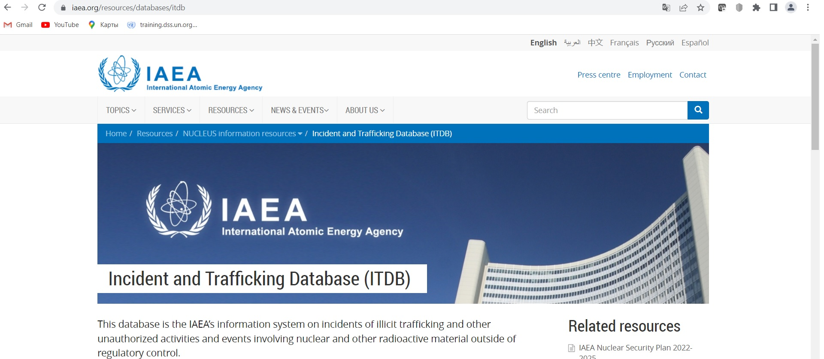
Informing IAEA
CBRN SSA NANT
Based on established procedure CBRN SSA sent INF to IAEA ITDB on 12.07.2021.

Slide 10
Future actions
CBRN SSA NANT
Cooperation with IAEA and other partners on Border protection,
Cooperation on enhancing analytical and forensics capabilities.
Identification of origin of detained materials
Equipping of Law enforcement agencies with radiation detection equipment,
Training of Law enforcement agencies.

Slide 11
Thank you for your attention!
АГЕНТСТВО ПО ХБРЯ БЕЗОПАСНОСТИ НАНТ
Questions?

