Slide 1
Central Asia and Azerbaijan Transport Security Dialogue- Women in Nuclear
Fully engaged professionals in transport security
Rhonda Evans, Head of Programme Development, WINS
9 June 2022

Slide 2
Why should we focus on women in transport security?

Slide 3
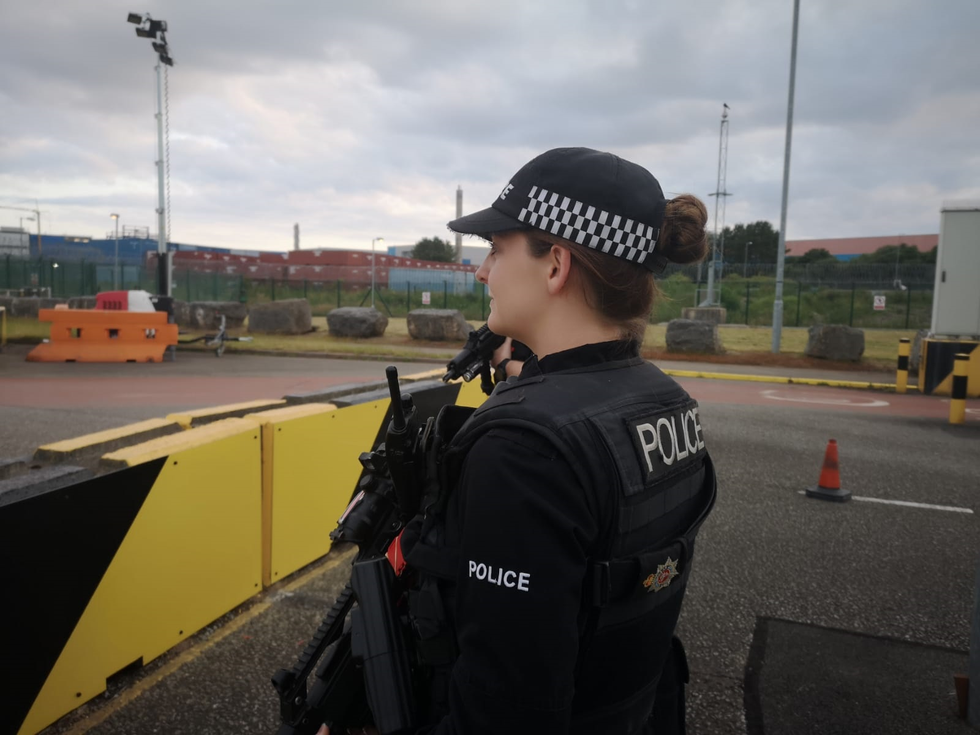
Women are underrepresented in the nuclear sector at all levels, comprising an estimated 20% of the nuclear work force.

Slide 4
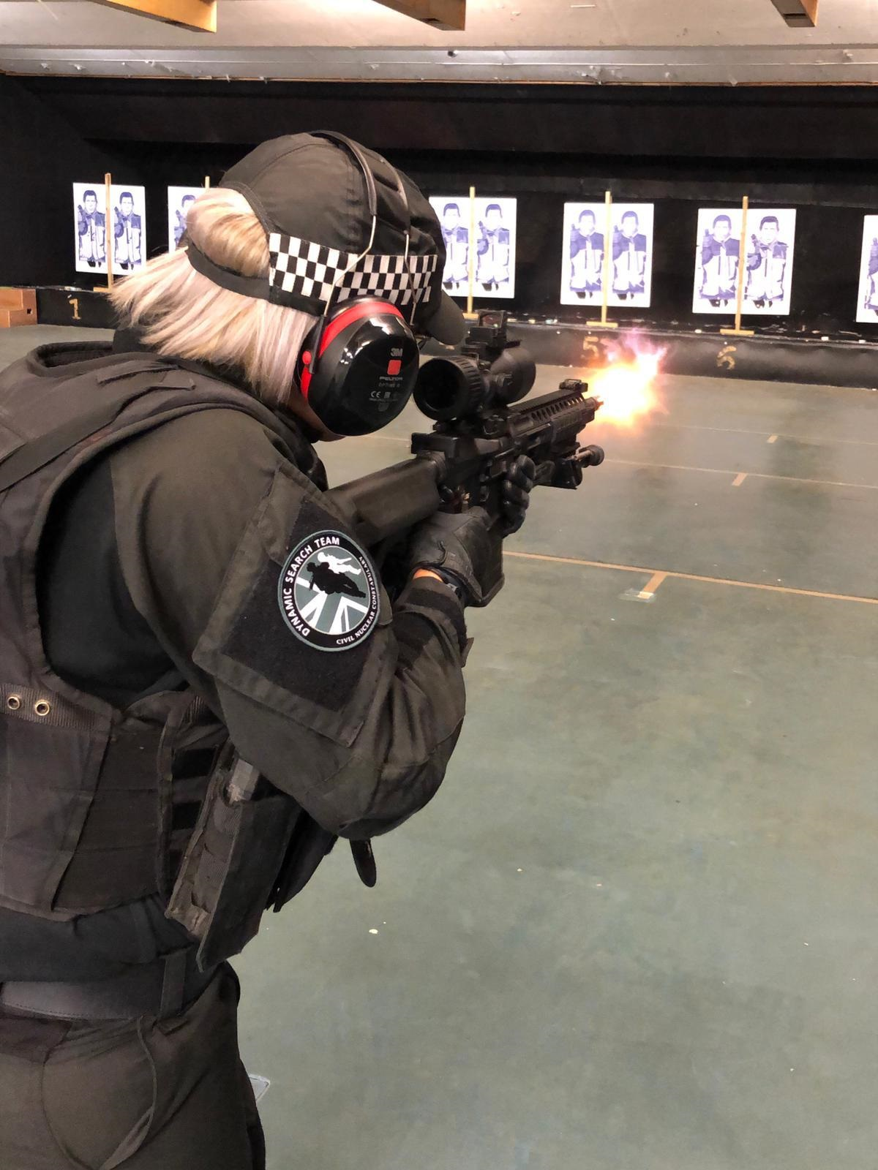
Women are further underrepresented in fields such as cybersecurity and advanced technology (<5%), armed guarding and response (<12%) and transport security

Slide 5
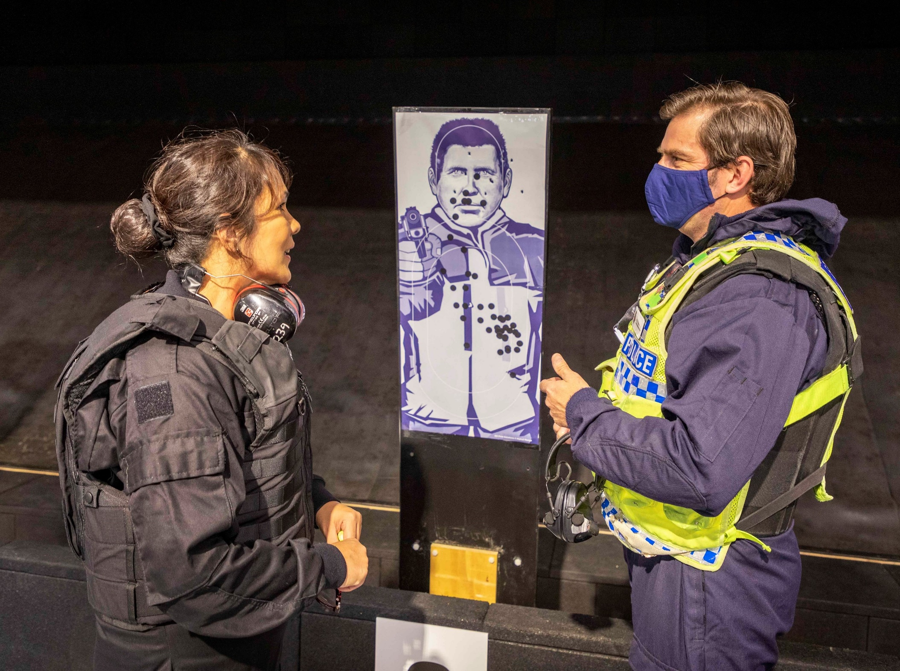
Gender equality is an organisational cultural issue
Organisational culture is a security issue
Gender equality is a security issue

Slide 6
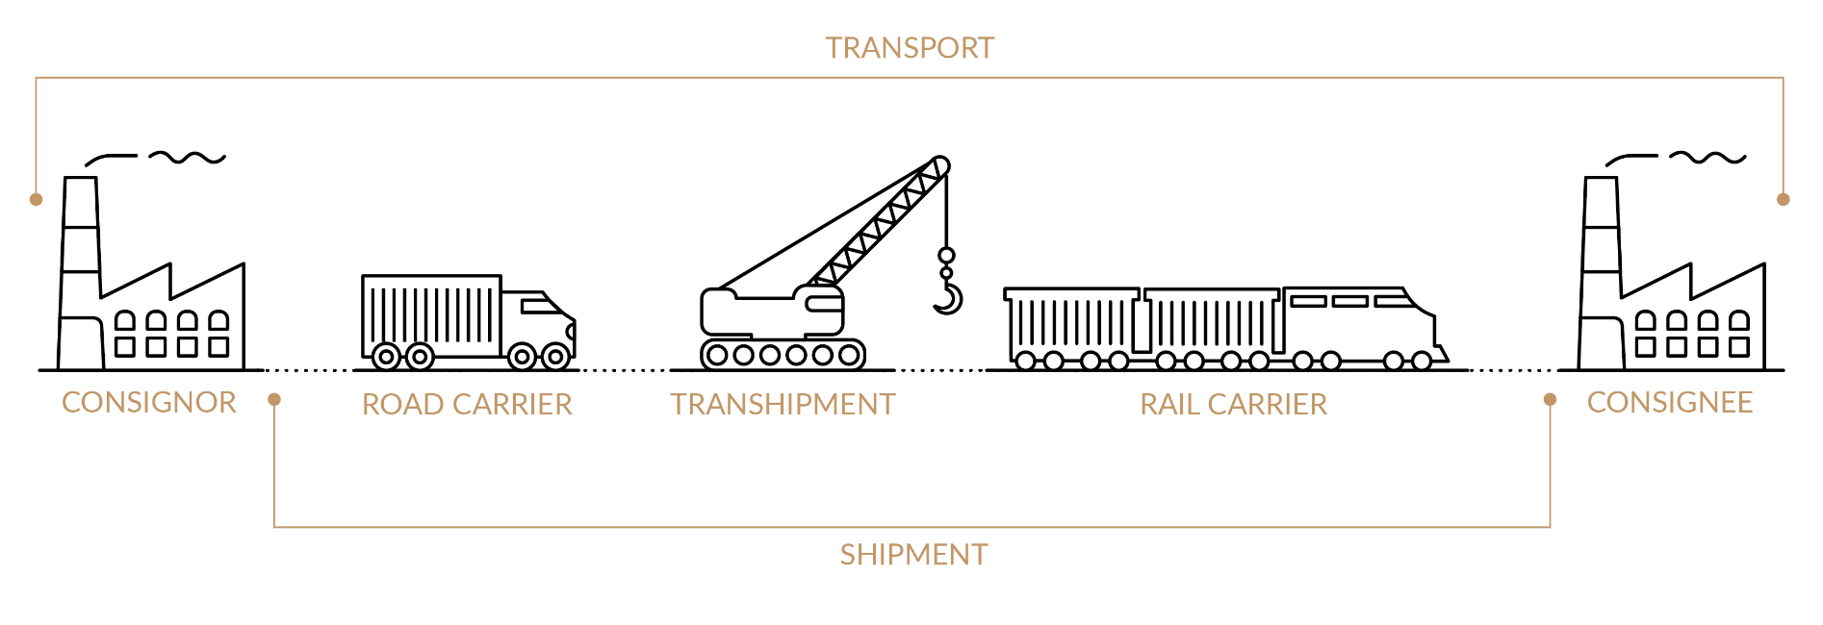
Benefits of Gender Equality in Transport Security
Gender equality and diversity enhance innovation
Gender equality strengthens engagement and performance
Gender equality benefits shortages of professionals in STEM areas.
Gender equality benefits profitability in organizations
Diversity of opinions and point of views strengthens security culture

Slide 7
Future Challenges in Transport Security
New reactor fuel design
New reactor designs eg fully fuelled micro reactor
New security requirements
Regulatory challenges

Slide 8
What resources can WINS offer for women to enhance their professionalism and meet these challenges ?

Slide 9

Best Practices to consider in Nuclear Security
Ensure Inclusive hiring, retention and promotion processes.
Built a diverse talent pipeline
Advocate for female role models in Nuclear security
Create a culture of inclusion incorporating innovative practices that change stereotypes
Publicly demonstrate commitment to gender parity and diversity -> Gender parity pledge

Slide 10
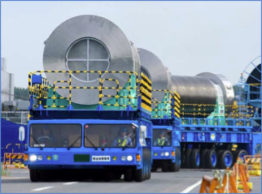
How WINS IS moving forward ……..
WINS has embarked on an institutional change….

Slide 11
WINS Gender Equality By Design

Slide 12
Inclusive language
Self assessment tools
Inclusive events design
Inclusive Environment
Gender inclusion diversity policies
Notes:
Like security by design, gender parity by design is a set of deliberative actions to achieve an outcome.
Gender parity by design is then a strategy to change the environment and make inclusive. This implies and institutional change !
This means that gender parity by design is not an afterthought or an add on.
It must be consciously incorporated into the design of policies, programmes and events that advance gender parity.
Example: create inclusive event announcements appealing to women from different backgrounds
Gender parity is about the equal representation of gender identities.

Slide 13

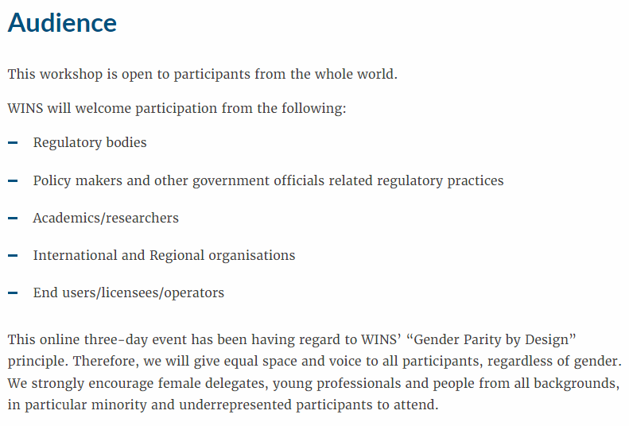
‘Gender Equality by Design’
WINS Inclusive Design of all events
Notes:
Design
Inclusive Topics: To attract females to male dominated majors, we need to ensure that career fields are not represented in a narrow and outdated manner. Attempts should be made to identify and effectively communicate those aspects of the field that would be especially appealing to women. E.g. In topics where women are underrepresented as for instance Cyber security include a subtopic referring or the role or challenges of women in this area.
Diversify the panel speakers and moderatos: invite women from different ethnical background to participate. Identify women from networks as e.g. WIN ARGENTINA, VENEZULEA, INDIA etc.
Identify possible cultural, social , financial barriers that impede women to participate in panel discussions and workshop. E.g. language barriers
2. Promotion
Inclusive announcement:
Neutral Language : Adopt gender-blind language > e.g. avoid the use of himself /Herself instead use ‘They’ or refer to person, people, individual, human,
Order maters: Word order may maintain or generate androcentricity. -> propensity to mention men first
Inclusive description : ‘WINS is promoting gender parity and diversity in its events, female delegates and people from all backgrounds are strongly encouraged to apply’

Slide 14

‘Gender Equality by Design’
WINS Inclusive Facilitation
WINS is committed to creating an
environment that is inclusive and diverse.
In our events we ensure that each person has equal access to the time and contributes equally to the conversation
For WINS language matters !
Inclusive language in different languages
Notes:
In our events we are trying to incorporate some inclusive practices as :
- opening the meeting with a statement regarding diversity and the commitment of WINS in the gender parity by design programme
Invite participants to share their pronouns in their introductory statement. E.g., she/her, he/his, they/them. Keep using those pronounces when referring to a participant.
Use of neutral and inclusive language. E.g., Avoid: Each participant has five minutes to present HIS argument. Use instead: Each participant has 5 five minutes to present THEIR argument. Avoid: ladies and gentlemen, Use instead: Everyone.
Prevent and exhibit zero tolerance with “manterrupting” (a man unnecessarily interrupting a woman) to “mansplaining” (a man interrupting a woman to explain something that she knows more about than he does) to “bropropriating” (a man taking credit for a woman’s idea).

Slide 15
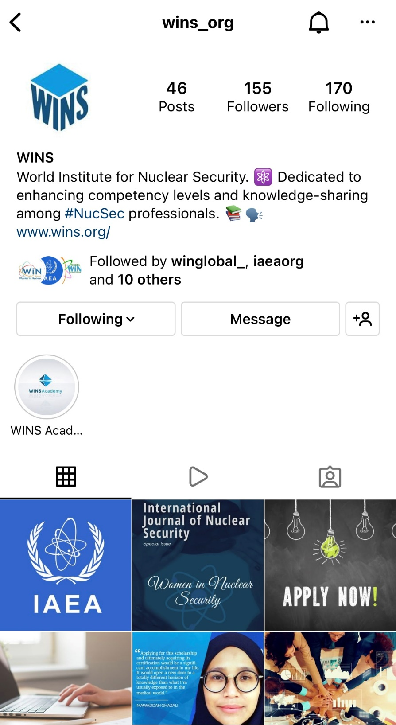

‘Gender Equality by Design’
Outreach
Increase, centralise and coordinate outreach. To successfully close the gender gap in male-dominated fields,like transport security significant outreach targeting women from different backgrounds must be conducted.

Slide 16
Our goal is that this work will change the profile of our security profession,
permanently.

Slide 17
The way forward……………
Professional development of women for women by women

Slide 18

Nuclear Security learning programmes
The WINS Academy: Professional Development and Certification
“Born out a desire to provide learning on aspects of nuclear security”.
Online Self-paced learning
Professional knowledge development
Problem-solving approach
Practitioner-focused, cross-disciplinary and immediately useful
Practical information with case studies, exercises and questions for reflection
Independently tested
Recognition of achievement
Information Circular 901: Joint Statement on Certified Training for Nuclear Security Management
The WINS Academy, “ISO 9001 and 29993 certified”
Notes:
One of the ways WINS is playing its part, it to provide continued professional development for nuclear security. The need for a high-quality professional development and certification programme for practitioners led to the creation of the WINS Academy. As the first international certification programme of its kind, participants receive the professional knowledge and recognition necessary to demonstrate their expertise in the management of nuclear security and radioactive source security. Our programmes are for individuals with responsibilities for nuclear security and for individuals wishing to understand more about nuclear security.
Underpinning WINS and the WINS Academy programme is a commitment to quality. This is demonstrated by our external achievement of ISO 9001: 2015 and ISO 29993:2017 certification for our learning services. This adds strong credibility for the quality of the training service and programmes that we offer and deliver to our learners.
The WINS Academy provides a vital role to help meet the global commitments made by Information Circular 901, providing certified training to enhance the understanding about the requirements for nuclear security from a management and leadership perspective, and “designed to develop a network of certified professionals who are implementing meaningful and sustainable changes to security culture and best practices worldwide.”

Slide 19
WINS Academy
Nuclear Security professional development, certification and competency building
Certified Nuclear Fundamentals Security Professional
“Flexible starting points”
Certified Nuclear Security Specialisations Professional (CNSSP)
Communications
Cyber
Governance
Regulation
Rad Source Mngt. (CRSP)
Incident Mgnt
Project Mgnt
STE
Transport
MORC NSS
Foundation in Nuclear Security
Foundation in MORC
Starting point and progression, based on individual knowledge and experience
Notes:
As part of our restructuring, we plan to provide learners the flexibility to decide where to begin their learning journey based on their current level of knowledge and experience:
At a Fundamental level for those that have:
“little or no experience in Nuclear Security and want to learn about it” or “have recently started working in a civil nuclear capacity or I am aspiring to find a job in nuclear” or “those that simply wish to refresh their knowledge on the nuclear security fundamental requirements”
AND At a Specialisation level for those that have:
“some experience already and understand the basics of and basis for nuclear security requirements” or “have an interest to learn more about specific aspects of nuclear security that are appropriate to their job role” or “those that want to continue you broaden my professional knowledge and understanding of nuclear security”
Our goals include:
Developing Fundamental knowledge about Materials Outside of Regulatory Control (MORC)
Creating and develop more Specialisations, that meet the needs of industry and more specific job roles in nuclear security, radioactive source security and MORC
Enable the progression and broadening of nuclear security for all our learners
Help learners to build their own personal portfolio of nuclear security competences

Slide 20
Taking the first step - Scholarships for Women
Become a WINS Member https://www.wins.org/user/register/
Apply for a Scholarship!
https://www.wins.org/scholarships
ACADEMY PROGRAMMES
SCHOLARSHIPS AVAILABLE for WOMEN AND MEN and WOMEN from DEVELOPING COUNTRIES
AVAILABLE for Purchase:
CNSP = 900 EUR
CRSP = 750 EUR
Contact us at academy@wins.org
Learn more at https://www.wins.org/wins-academy/
Notes:
We have many opportunities for WiN Global Members to continue their understanding and continued professional development in all areas of nuclear and radioactive source security. All that we ask is that you also become a member of WINS, it is free to join, and you can apply for a Scholarship to be able to complete one of our WINS Academy learning programmes. Be part of a growing global network of nuclear security professional. We believe that security is everyone's business.

Slide 21
How can the results be sustained?
Critical mass of female certified professionals
Women acknowledged as experts, leaders and role models
Direct relationship between gender equality and security culture
Stay connected with each other – network
We can change the structure and the culture of our profession

Slide 22



Learn more at: wins.org
Follow us:
#GenderParityByDesign
#GenderParityWINS
https://at.linkedin.com/company/world-institute-of-nuclear-security-wins
@WINS_org

