Slide 1
National Nuclear Center of the
Republic of Kazakhstan
Ministry of Energy of the Republic of Kazakhstan
Session 6
Conducting inspections of transport security – case study
Kurchatov, 2022

Slide 2
Requirements for ensuring physical protection during transportation of nuclear materials in the territory of the Republic of Kazakhstan:
Order of the Minister of Energy of the Republic of Kazakhstan dated February 8, 2016 No. 40 "On Approval of the Rules of Physical Protection of Nuclear Materials and Nuclear Facilities";
Order of the Acting Minister of Investments and Development of the Republic of Kazakhstan dated April 17, 2015 No. 460 "On Approval of the Rules of Transportation of Dangerous Goods by Road Transport and the List of Dangerous Goods Allowed for Transportation by Road Transport in the Territory of the Republic of Kazakhstan";
Order of the Minister of Energy of the Republic of Kazakhstan dated May 28, 2021 No. 183 "On Approval of the Rules of Transportation of Nuclear Materials, Radioactive Substances and Radioactive Waste";
Law of the Republic of Kazakhstan dated December 22, 2004 "On Accession of the Republic of Kazakhstan to the Convention on Physical Protection of Nuclear Material" and the Amendment to the Convention ratified by the Republic of Kazakhstan on March 19, 2011 "On Ratification of the Amendment to the Convention on Physical Protection of Nuclear Material".

Slide 3
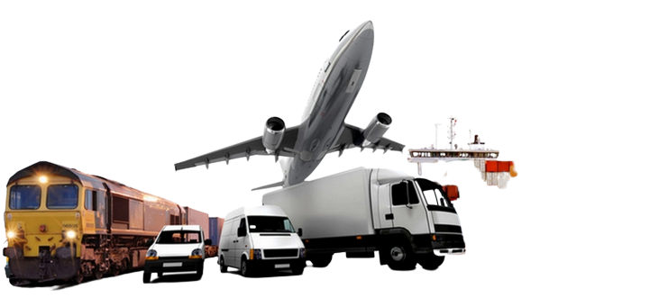
Transportation of nuclear materials by all modes of transport by land, air and water through the territory of the Republic of Kazakhstan is carried out subject to their physical protection.
In order to prevent theft of nuclear materials and/or sabotage, it is necessary to develop organizational and technical measures to ensure their safety during transportation.

Slide 4
Certain aspects of physical protection:
Characteristics of transported nuclear material;
Route;
Participants and their responsibilities;
Procedure of physical protection;
Actions of personnel in emergency situations.
The following parties are involved in ensuring physical protection of transportation of nuclear materials:
accompanying persons;
shipper;
carrier;
consignee

Slide 5
Approaches to ensuring physical protection during transportation:
to protect nuclear material in accordance with its category;
to limit as much as possible the total time of nuclear materials being in transit;
to minimize the number and duration of transfers of nuclear material (transshipment from one vehicle to another, transfer of nuclear material to temporary storage and receipt of that material after such storage, as well as temporary storage pending the arrival of the means of transport);
to prepare schedules and routes of vehicle movement taking into account the transportation conditions;
to conduct mandatory preliminary check of trustworthiness of all persons involved in transportation of nuclear material;
to ensure that the number of persons with prior transport information is minimum, as necessary

Slide 6
to identify routes that exclude crossing of areas of natural disasters, riots or areas with a known threat;
to eliminate the possibility of leaving packages and (or) transport means without the presence of personnel (supervision) for longer than is absolutely necessary;
to ensure that persons driving, escorting and protecting nuclear materials have the appropriate clearance;
to exclude putting of signs and symbols on vehicles and entry in transport documents of information indicating the nature of the cargo and the purpose of the vehicles;
large industrial facilities should not be located near the route;
provision of technically sound and specially equipped vehicles

Slide 7
Organizational measures:
to perform shipment of nuclear materials only after receiving a written confirmation of readiness to accept nuclear materials from the consignee, and in case of transportation of nuclear materials by the consignee, also a license for transportation of nuclear materials;
to use coding and special communication channels to transmit messages on transportation of nuclear materials;
to ensure notification of the consignee about shipment of the goods and of the shipper about receipt of the goods;
to organize, no later than 30 calendar days, the interaction of the shipper or consignee with the law enforcement agencies of the Republic of Kazakhstan in order to jointly determine additional measures ensuring protection and safety of transported nuclear materials, repelling a possible attack on a vehicle en route, or in case of an emergency along the route;
prior to loading and dispatching nuclear materials, to inspect vehicles for the absence of devices capable of disabling the vehicle, damaging the nuclear material being transported and/or facilitating unauthorized acts on nuclear materials.

Slide 8
operation of vehicles by highly qualified drivers or crews who have undergone special training and have the appropriate access to work;
drivers of vehicles, crew members or crews involved in ensuring physical protection during transportation, as well as security personnel and accompanying persons pass orientation and medical examination for the respective modes of transport before each trip;
availability of a certificate of admission of the driver to transportation of dangerous goods in the territory of the Republic of Kazakhstan

Slide 9
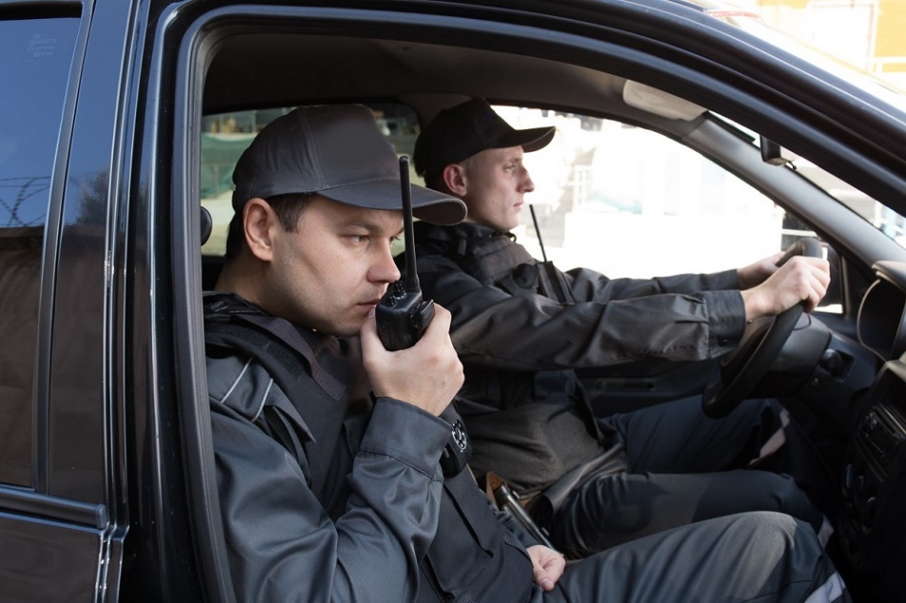
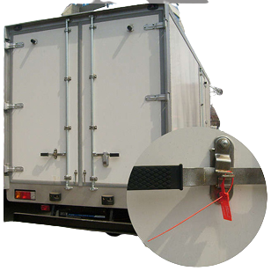
The carrier's liability for ensuring physical protection during transportation of nuclear materials arises from the moment of loading nuclear materials until the moment of unloading of nuclear materials in accordance with the legislation of the Republic of Kazakhstan.
Prior to each dispatch of nuclear materials the shipper and the carrier, together with the security and response forces, shall verify the integrity of the locks and seals on the package, vehicle, compartment or cargo container. At the same time, the cargo compartments of vehicles under protection shall not be opened along the route until they reach the destination point.
The shipper, together with the consignee, ensure continuous monitoring of the location of the vehicle and the state of its physical security, as well as notification of the response forces by using two methods of communication.

Slide 10
Thank you very much!
National Nuclear Center of the Republic of Kazakhstan

