Slide 1
IAEA Assistance in Developing
Transport Security Regulations
David Ladsous
IAEA Division of Nuclear Security

Slide 2
IAEA Approach for Development of Transport Security Regulations
IAEA developed methodology and toolbox
To develop country-specific regulatory process reflecting national constitutional and legal framework, local threat environment, cultural traditions, technical capacities, and human, financial resources of Member State (MS)
Pool of international legal and technical experts available

Slide 3
IAEA Assistance for Transport Security Regulatory Infrastructure Development
As part of IAEA assistance to MS in establishing Nuclear Security Regulatory infrastructure, IAEA supporting developing of nuclear security regulations
Needs expressed through Integrated Nuclear Security Support Plans (INSSPs):
As of today, 42 official requests on transport security regs.:
14 draft regulations reviewed at national level (12 African States)
2 European countries requested support on drafting regulations
Agency supporting capacity building in regulatory functions (inspection, evaluation of effectiveness of security regime and system)
1 regional workshop on transport security inspections (2022)
5 national TTX (2021-2022), 2 cross boarders TTX

Slide 4
Methodology at a Glance
PHASE I - Assessment and Initial Drafting by Member State
With IAEA Involvement
Nuclear Material
NSS26-G
0
Legal Framework Established
1
Legal Inventory
INSSP, IPPAS, Designated Technical and Legal Experts
2
NIDI meeting
3
Scope/Structure
4
Initial draft
5
Public Notice
Hybrid
NSS 9-G
NSS26-G
Radioactive Material
NSS 9-G (rev 1)
PHASE II - Review and Comment by IAEA Experts and National Level Review/Workshop – MS and IAEA
9
Consolidation
8
NWS Finalization
7
Internal review
6
Experts review using Working Material
PHASE III – Finalization Toward Publication
10
Formatting
11
Publication/
Promulgation
12
Implementation
Office of Legal Affairs (OLA)
Division of Nuclear Safety & Security
(NSNS)
Step Description
IAEA Involvement

Slide 5
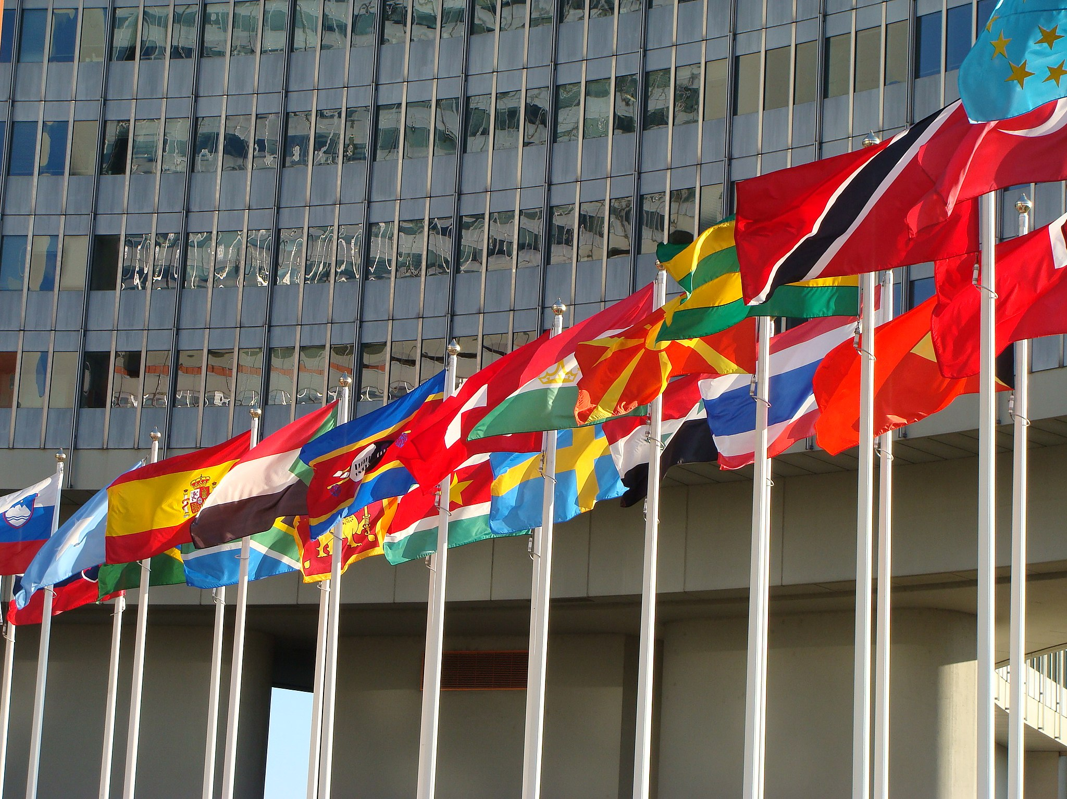
International Atomic Energy Agency
David Ladsous Unit Head, Transport Security
IAEA Division of Nuclear Security
D.Ladsous@iaea.org
(+43-1) 2600-23149

