Slide 1
Reviewing Last Slovene Regulatory-related Endeavours to Strengthen Safe/Secure Transport of Radioactive Material
Janez Češarek
Slovenian Nuclear Safety Administration (SNSA)
Virtual meeting, June 2021

Slide 2
Recent nuclear security-related pledges
INFCIRC/908 – Mitigating Insider Threats
INFCIRC/910 – Strengthening the Security of High Activity Sealed Radioactive Sources
INFCIRC/918 – Countering Nuclear Smuggling

Slide 3
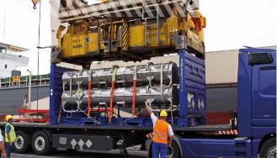
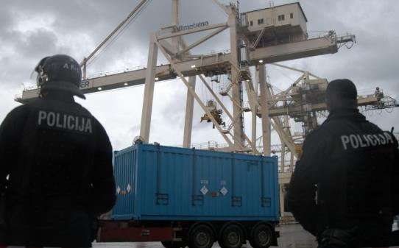
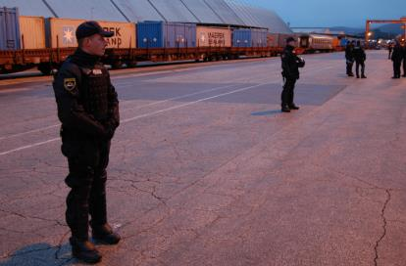
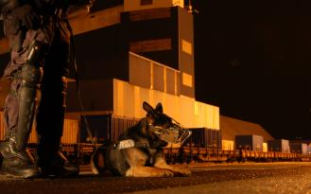
Major transports of nuclear material
Receipts of fresh nuclear fuel elements (for Krško NPP)
Transport of depleted uranium (as shielding)
Transport of orphan sources (e.g. U- and Th-substances)
Transits of spent nuclear fuel (or irradiated) – occasionally
Other transports (e.g. fission chambers, HEU)
https://www.flickr.com/photos/iaea_imagebank/5262614805/in/photostream/
https://www.nek.si/_files/2476/NEK_ANG_NET.pdf
https://www.flickr.com/photos/iaea_imagebank/5262612121/in/photostream/
https://www.flickr.com/photos/iaea_imagebank/5262629337/in/album-72157625603060574/

Slide 4
Nuclear threat assessment process
Once a year
(nuclear facilities)
Required in written form by a carrier (transporter)
Threat Assessment
(Worked out by Police)
Physical Protection Plan
To be informed:
SNSA, SRPA, operators of nuclear facilities; carrier
Consent
SNSA
Approval
MI
❶
❷
Art. 145, Ionising Radiation Protection and Nuclear Safety Act
Art. 23 and 25, Rules on the physical protection of nuclear facilities, nuclear and radioactive material and transport of nuclear material

Slide 5
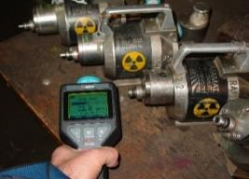
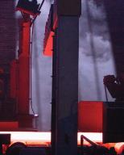
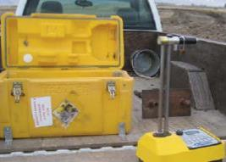
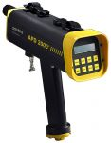
Radioactive sources and our approaches to security
Use/transportation*: Radiation Practice
Rules on the use of radiation sources and radiation activities (Chapter V)
Category 1
Category 2
Category 3
Category 4
Category 5

Slide 6
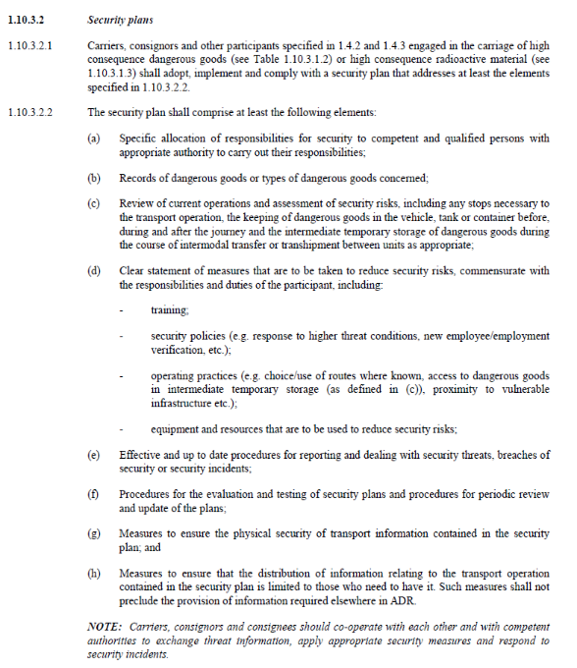
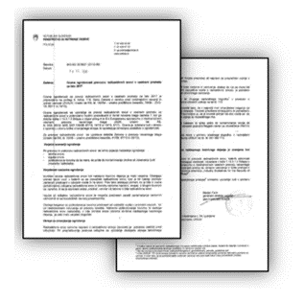
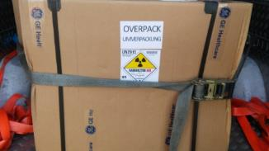
Transport of radioactive material – Cat. 1 & 2
ADR 1.10 and its applications (security plan,…)
Generic letter – treat assessment, issued in 2017, 2018, 2019, 2020 and 2021

Slide 7
A quick insight in some recent activities
Legislation (transportation - radiation practice)
Security plan is „a must“ for Cat. 1 and 2 – including transits
National stakeholders‘ group
ADR‘s revisions
EACA
Co-operation with Police (threat)
Trainings and awareness raising
7
Notes:
7

Slide 8
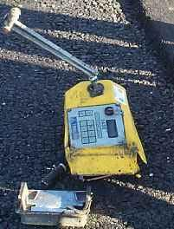
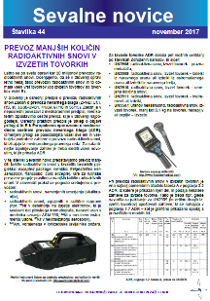
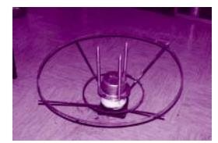
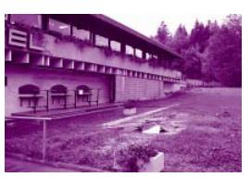
Additional slide
No security-related „events“ in the past two decades
Regulators‘ role(s), also their outreach – multi-pronged
ADR as a cornerstone
Lessons learnt (from a bunch of foreign „events“) & continuous improvement
This picture is for illustration purpose only.
http://www.elibrary.dep.state.pa.us/dsweb/GetRendition/Document-44793/html
https://www.ijs.si/ijsw/Arhiv%20Novic?action=AttachFile&do=get&target=Novice092.pdf

