Slide 1
Development of national regulation related to transport security
Ms. Zsófia Galyas-Szepes
Section Head
Department of Radiation Sources, Safeguards and Security
Hungarian Atomic Energy Authority

Slide 2
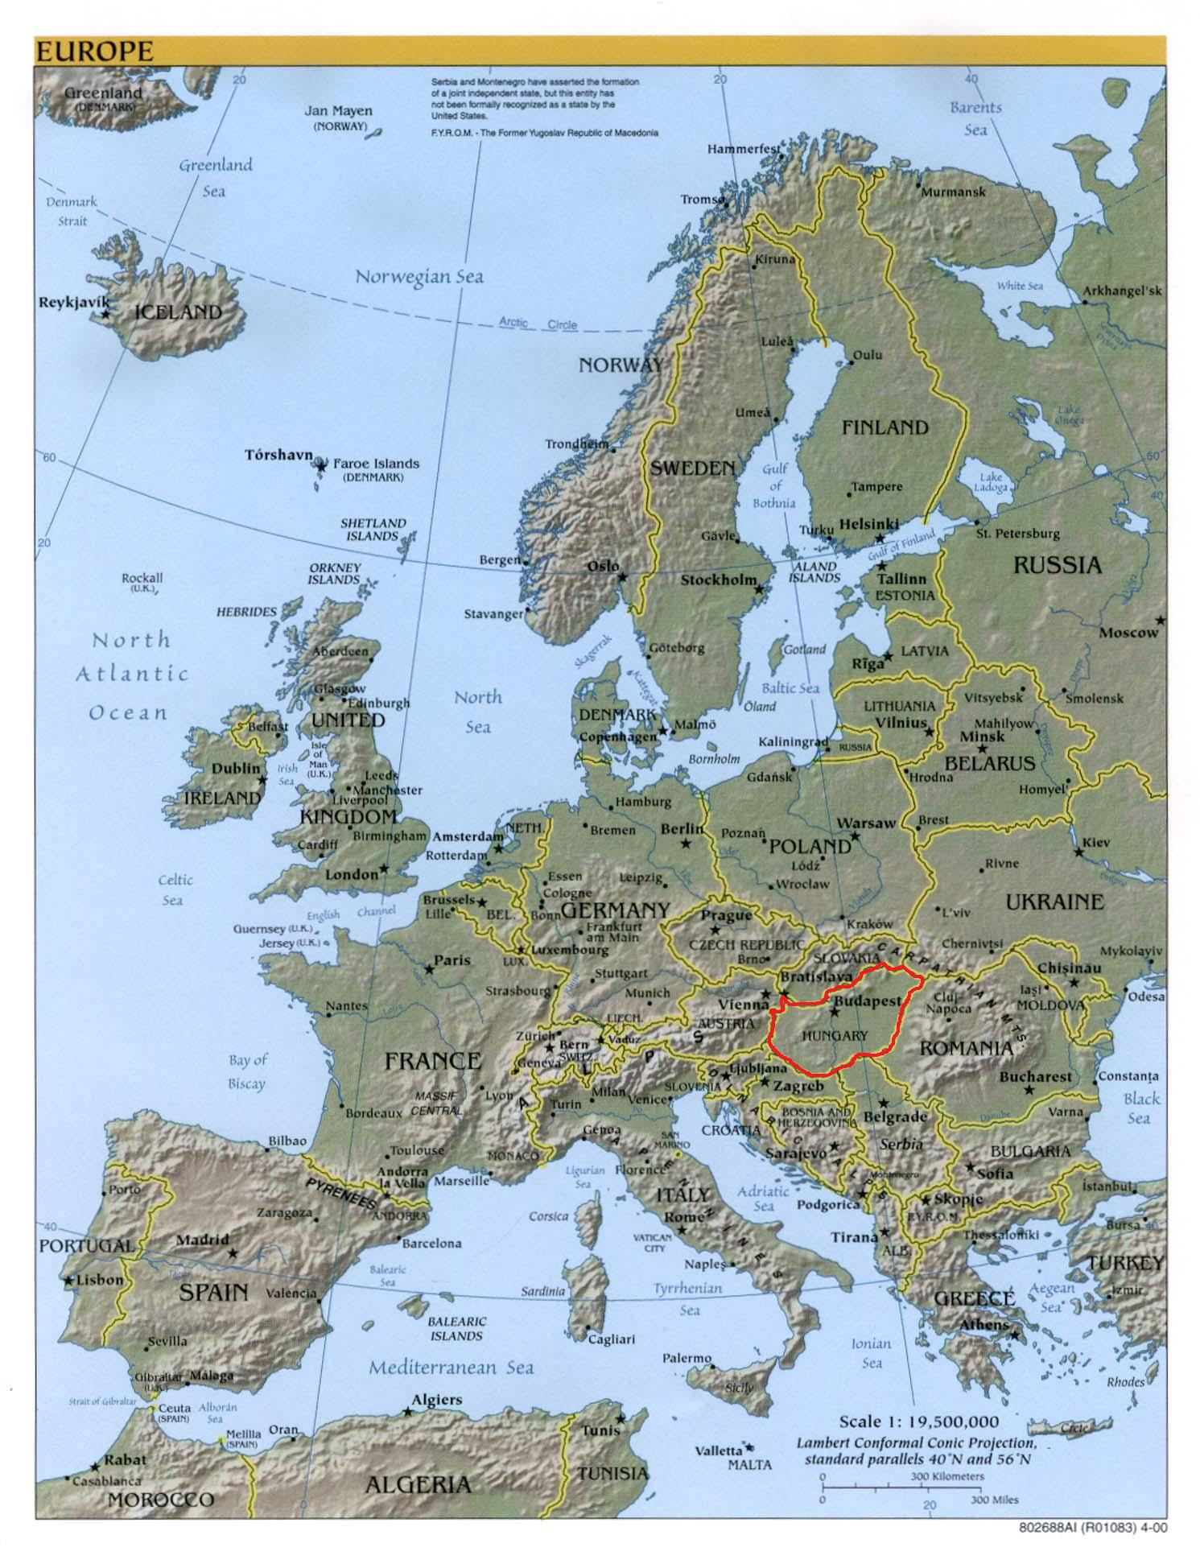
HUNGARY
Population: ≈ 10 million
Area: 93,030 km²
Capital: Budapest (≈ 2 million)
NATO Member since 1999
EU Member State since 2004
Notes:
Transport point of view – inland country, transit country

Slide 3
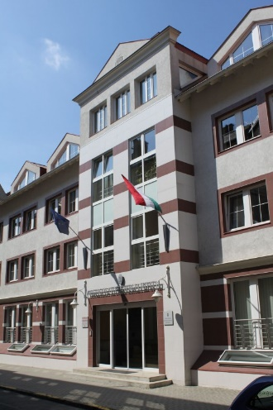
Who we are? Hungarian Atomic Energy Authority
Government office
Independent organisation with national scope of authority
HQ: Budapest
On-site office, Paks NPP
Regional inspectors (7 regions)
Fields of regulatory responsibilities:
Nuclear safety, Nuclear security, Safeguards, Radiation protection, Nuclear emergency management, Architecture

Slide 4
Developing national regulations
International legislative framework – CPPNM, A/CPPNM, ICSANT - promulgated by national law
International recommendations – IAEA NSS 13, IAEA NSS 9
International Mode Specific Agreements concerning the Carriage of Dangerous Goods (ADR, RID, ADN, ICAO, SOLAS) Chapter 1.10. – Security provisions
Government Decree 190/2011. (IX. 19.) Korm.
on physical protection requirements for various applications of atomic energy and the corresponding system of licensing, reporting and inspection In force: 4 October, 2011
Notes:
Requirements based on the recommendations of NSS 9 and NSS 13 in accordance with the related Conventions and legal regulations.
(for example: state responsibility, national competent authority, principle of graded approach, categorization, etc.)

Slide 5
Developing national regulations cont’d
General provisions
Scope, definitions
Assessment of national threat, DBT
Categorization
Goal of physical protection
Basic requirements for PPS
Required PP level
Function of PPS and its implementation
Prescriptive requirements

Slide 6
Categorization

Slide 7
Developing national regulations cont’d
General provisions
Scope, definitions
Assessment of national threat, DBT
Categorization
Goal of physical protection
Basic requirements for PPS
Required PP level
Function of PPS and its implementation
Prescriptive requirements

Slide 8
Security levels
Security levels are based on graded approach.
The PPS shall provide protection against sabotage during the transport through the compliance with the legal requirements related to transport safety.
Level | Requirements
A | PPS ensures the prevention of sabotage and unauthorized removal.
B | PPS reduces the opportunity of sabotage and unauthorized removal.
C | PPS reduces the opportunity of unauthorized removal.
D | PPS applies prudent security measures.

Slide 9
Security levels cont’d
Material | Security level
Cat I nuclear material (use, storage and transport ) | A
Cat 1 radioactive source (use, storage and transport ) | B
Cat 1 radioactive waste (processing, storage and transport)
Cat II nuclear material (use, storage and transport )
Cat III nuclear material (transport )
Cat 2, 3 radioactive source (use, storage and transport ) | C
Cat 2, 3 radioactive waste (processing, storage and transport)
Cat III nuclear material (use, storage )
Cat 4, 5 radioactive source (use, storage and transport ) | D
Cat 4 radioactive waste (processing, storage and transport)
Non-categorized nuclear material (use, storage and transport )

Slide 10
Developing national regulations cont’d
Further requirements
Nuclear security culture
Insiders
Training and exercise
Testing and maintenance
Regulatory licensing and inspection
Data supply, reporting system

Slide 11
Challenges and lessons learned
Review (periodic and ad hoc)
Modification
Acceptance of the new regulation
Dedicated contact point
→ transportsecurity@haea.gov.hu
Development of guidance
→ Guideline PP-15 Preparation of the physical protection plan required for the transport of nuclear and other radioactive materials
→ Guidance to complete and submit in the Declaration of Conformity

Slide 12
Useful links
GD in English:
http://www.oah.hu/web/v3/HAEAportal.nsf/AF56E3A1E23F3932C1257CA700432BBC/$File/190-2011%20Korm%20-%20201705_final_REV.pdf
English website:
http://www.oah.hu/web/v3/HAEAportal.nsf/web?openagent
Physical protection guidance material in English:
http://www.oah.hu/web/v3/HAEAportal.nsf/web?openagent&menu=03&submenu=3_3

Slide 13
Thank you for your attention!
Questions?
www.haea.gov.hu
szepeszs@haea.gov.hu.

