Slide 1
ROMANIA
National Commission for Nuclear Activities Control
National Nuclear Security Framework for
Nuclear and other radioactive material in transport in Romania
Mr. Repanovici Sorin
Nuclear Security Expert

Slide 2
The Fuel Cycle For Romanian CANDU 6 NPP
Mining
Uranium Ore
Extraction
Feldioara
Conversion
Factory
Conversion
Pitesti Nuclear
Fuel Factory
Fuel Fabrication
Drobeta Turnu-Severin
Heavy Water Factory
Heavy Water Production
Cernavoda NPP Units 1 and 2
Electricity Production
Spent Fuel Disposal
The solution is not yet decided
Cernavoda
Dry Storage Facility
Spent Fuel Storage

Slide 3
Cernavoda NPP Site (1)
Construction started in 1980 with 5 units;
U1 - Full Power: December 1996;
U2 - Full Power: September 2007;
U3 - Full Power: 2018 ?;
U4 - Full Power: 2020 ?;
U5 - Project abandoned.

Slide 4
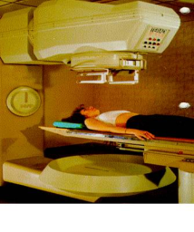
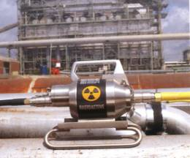
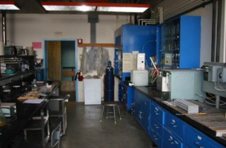
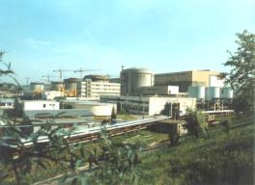
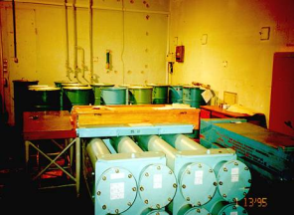
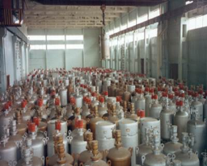
Common Legitimate Uses
Medicine
Industry
Research
Nuclear Energy
Research reactors
Storage & disposal

Slide 5
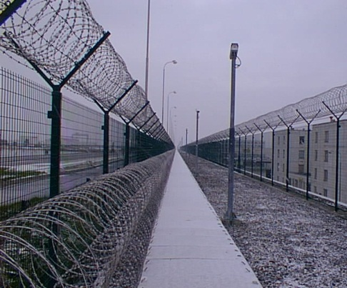
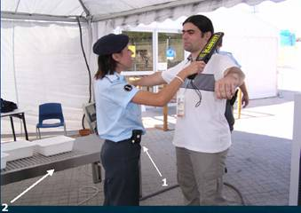
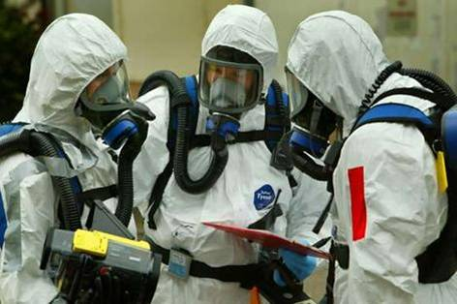
Nuclear Security
Prevention
Detection
Response
… criminal or intentional unauthorized acts involving or directed at nuclear material, other radioactive material, associated facilities, or associated activities.
Measures taken to control and protect nuclear and other radioactive material and associated facilities from falling into the wrong hands
Notes:
5
Consider replacing picture for ‘response’

Slide 6
National Legislative and Regulatory Framework Related to
Nuclear Security
Romania as IAEA Member State adhere to legally binding international instruments and become party to and have enacted in national laws the obligations of:
States Parties in the Convention on the Physical Protection of Nuclear Material (CPPNM)
the Amendment to the Convention on the Physical Protection of Nuclear Material (ACPPNM)
States Parties in the Convention on Early Notification of a Nuclear Accident (NOT)
States Parties in the Convention on Assistance in the Case of a Nuclear Accident or Radiological Emergency (ASSIST)
States Parties in the International Convention for the Suppression of Terrorist Bombings (Terrorist Bombings Convention).
States Parties under UNSCR 1540 - Non-proliferation of Weapons of Mass Destruction - adopted under Chapter VII of the UN Charter.

Slide 7
Supporting Multilateral Instruments
Romania is a State Party to the following multilateral instruments which promote nuclear security:
the Treaty on Non-proliferation of Nuclear Weapons (NPT);
the International Convention on the Suppression of Acts of Nuclear Terrorism (ICSTANT);
the Comprehensive Test-Ban Treaty (CTBT).
Romania is actively involved in the Global Initiative to Combat Nuclear Terrorism (GICNT), subscribing to the commitment to detect, prevent and respond effectively to acts of nuclear terrorism by carrying multilateral activities aimed at improving interoperability among participating States.

Slide 8
Legal and Regulatory Framework for Nuclear Safety and Security
The Nuclear Act of Romania is the Law no. 111/1996 on the Safe Deployment, Regulation, Licensing and Control of Nuclear Activities, republished, with subsequent modifications and amendments
CNCAN (the National Commission for Nuclear Activities Control) is the national competent authority responsible for the regulation, licensing and control of nuclear and radiological installations, nuclear and other radioactive materials and all associated activities.
The regulations issued by CNCAN cover the following areas:
nuclear safety,
radiological protection,
management systems for nuclear installations and associated activities;
physical protection of nuclear installations and materials,
non-proliferation of nuclear weapons,
safe management of radioactive waste and spent fuel,
transport of nuclear and other radioactive materials,
on-site emergency preparedness and response.
protection of nuclear installations against cyber threats.

Slide 9
Romania’s nuclear security architecture
Legislative framework, Threat Assessment, Applicable regulations
Roles and responsibilities of competent authorities
National Commission for Nuclear Activities Control
Romanian Border Police
Romanian Intelligence Service
The General Inspectorate of Romanian Police
National Customs Authority
General Inspectorate for Emergency Situations
General Inspectorate of Romanian Gendarmerie
Special Aviation Unit
International and regional coordination
Planning and organization
Detection capabilities
Detection plan for orphan sources recovery
National policy to improve detection at border (EU Border)
Custom Detection equipment at crossing points
Cooperation with NSDD, and operated by Border Police
National Emergency Response Plan
National Coordination Plan Response to Illicit Trafficking Incidents
Protocols between all institutions involved in detection architecture
Training plans
Exercises

Slide 10
National Mechanism for Cooperation in Nuclear Security
Inter-agency cooperation for security of transport
BORDER POLICE (IGPF)
NATIONAL POLICE (IGPR)
Emergency Situation - IGSU
Ministry of Foreign Affairs
Regulatory
BODY
CNCAN
CUSTOM (DGV)
Ministry Of Healt
Ministry of Defence
Intelligence Service
National Nuclear Reasearch Institutes (TSO’s)
Notes:
INTERAGENCY COOPERATION
The overall guiding principles for effective cooperation and coordination of the institutions in the law enforcement system, separation of powers, division of competencies and tasks, are embedded in the texts of the Constitution, Criminal Code, Criminal Procedure Code, the laws governing the organization and operation of both the judiciary as a whole and the institutions in the criminal justice system as the RBP and RIO.
The specialized law enforcement agencies cooperate at various levels, according to their competencies and roles.
The main methods used to ensure efficient co-operation and co-ordination are as follows:
Coherent development of the domestic legal framework,
Developing inter-agency protocols and programs (RBP concluded aprox. 50),
Setting up and activating inter- ministerial work groups,
Promoting direct inter-agency consultation and dialogue.
In order to fully implement the co-ordination principles, a mechanism for control and reporting pertinent developments and seeking advice on possible follow-up is already in place.
On the other hand, the results of the cooperation performed between different institutions in the framework of organizing joint operations, joint working groups and common evaluations are well known at several decision levels.
The Romanian Border Police carries out its own activities in surveillance and control of the border cooperating mainly with the National Customs Authority, the Romanian Naval and Ruttier Authorities within the Ministry of Transportation etc.
The General Inspectorate of Border Police co-operates with the central public administration authorities, judicial institutions, other state central institutions as well as the representatives of the civil society.
The division of tasks and cooperation relations existing at central level is replicated and duly observed at territorial branches.
And now I would like to give you an example of the good practices characterizing our inter-agency cooperation.
TRIDENT is a task force involving the Ministry of Interior (Romanian Border Police and Romanian Police) and the Ministry of Finance (National Customs Authority). TRIDENT bureaus have access to all data bases belonging to the above-mentioned institutions, having as main task:
Countering all types of cross-border crimes, with a stress on
Countering trafficking in drugs
Countering economical crimes
Countering cyber crimes.
The result of TRIDENT activities is made up of analytical packages which are afterwards forwarded to the prosecutor, as he is the one who decides the institution which will take over and develop the investigation.
TRIDENT task force was developed by the Ministry of Administration and Interior based on a twinning project with UK and DE, in 2005. In the first phase, 3 bureaus were set up (Iasi – at the Western Romanian – Moldavian border and Satu Mare – at the Northern Romanian – Ukrainian border). Each bureau has a special coordinator from one of the involved ministries, appointed according to the existing needs. At national level, the activity of the 5 TRIDENT bureaus is being coordinated by the Central Unit for Analysis and Intelligence, within the National Police.
You will receive additional information regarding this task force during your stay here.

Slide 11
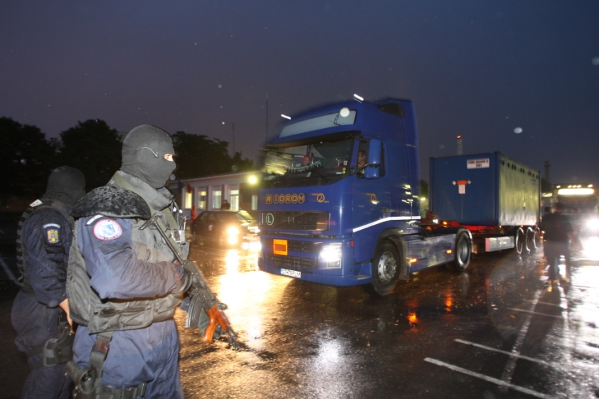
Physical Protection for the transport

Slide 12
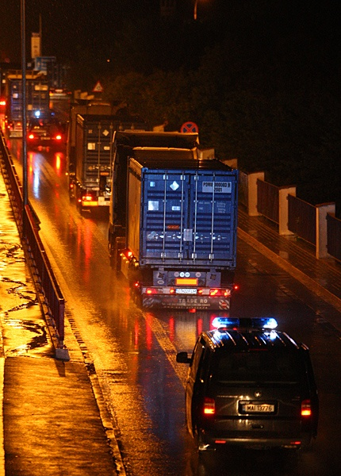
THE TRUCKS

Slide 13
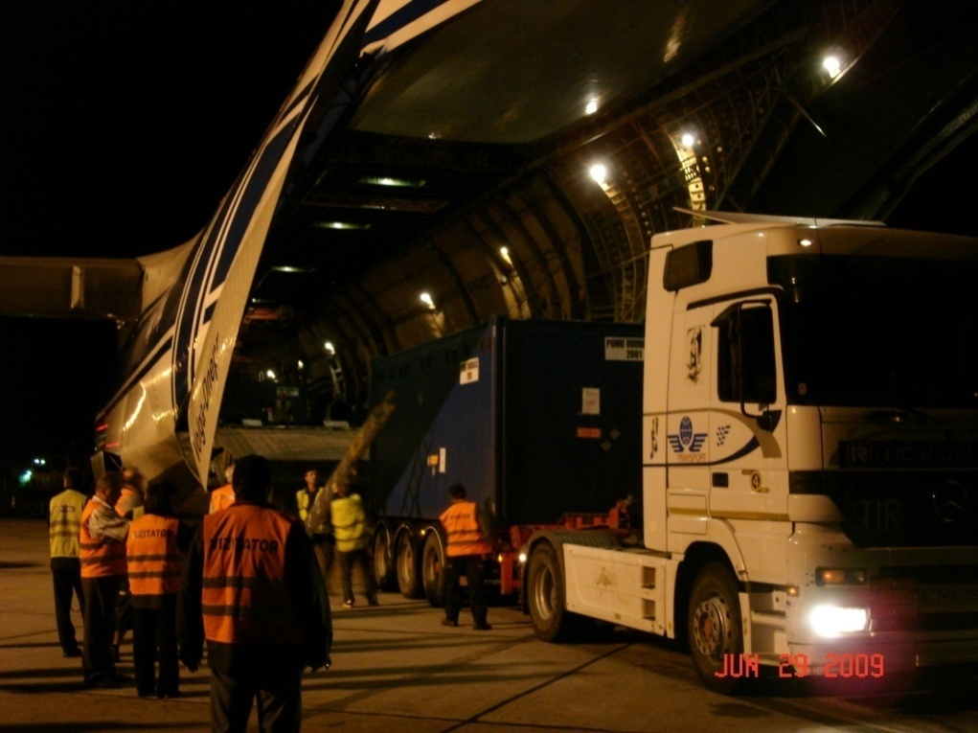
Loading The Aircraft

Slide 14
The Aircraft

Slide 15
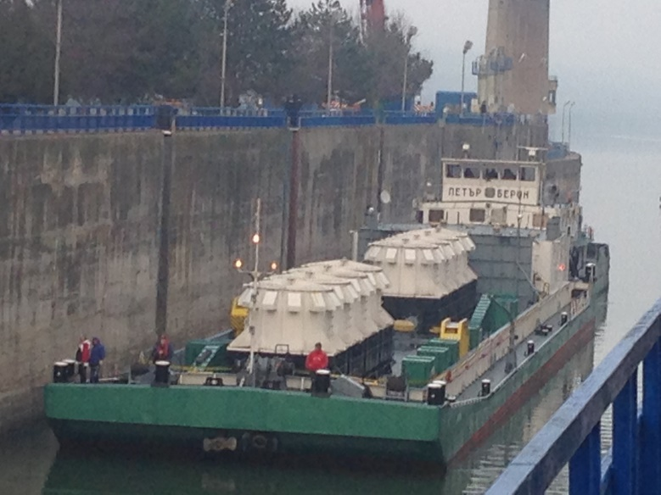
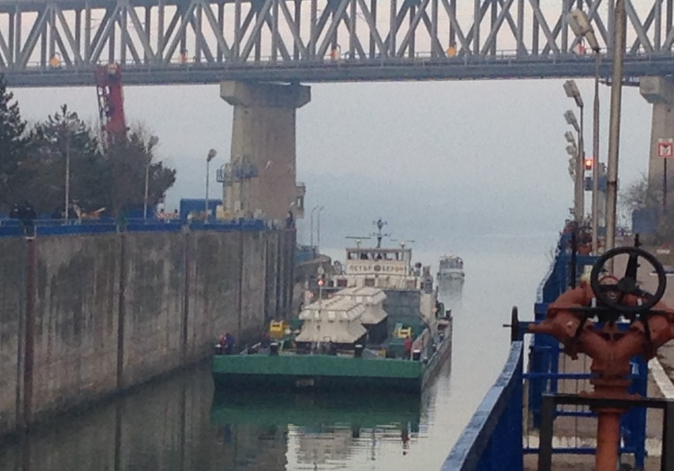
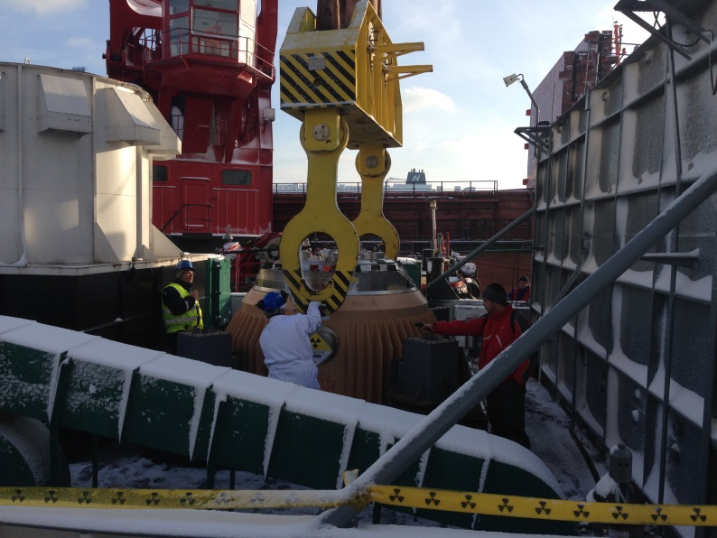
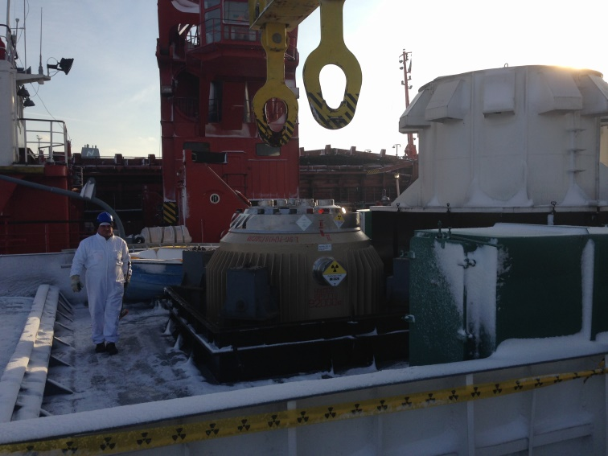
The Spent Fuel Transport on the Danube

Slide 16
Romanian National Exercise Scenarios: Combat a terrorist attack on Nuclear fuel transportation

Slide 17
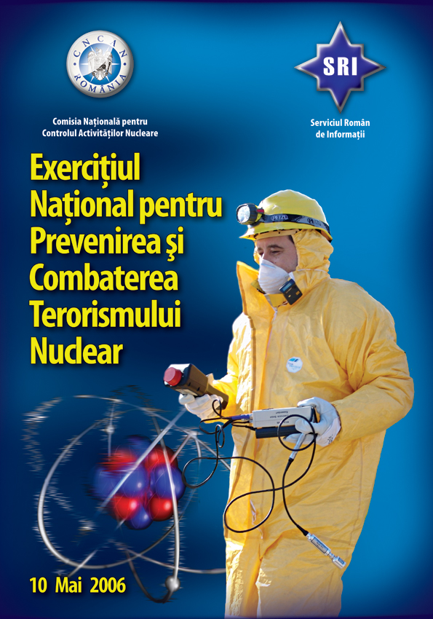
Romanian National Exercise (3/6)

Slide 18
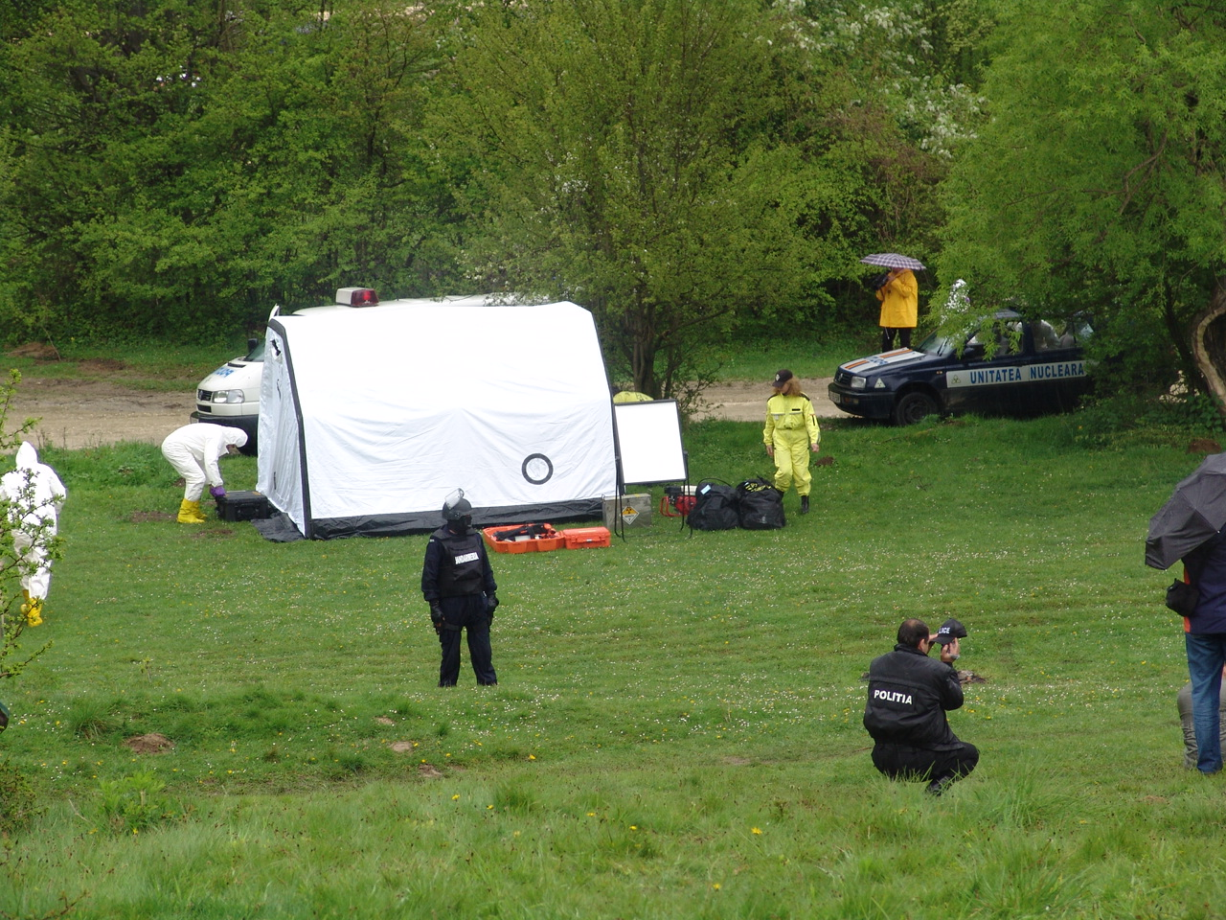
Romanian National Exercise (4/6)

Slide 19
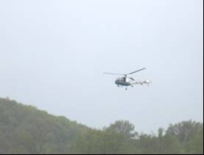
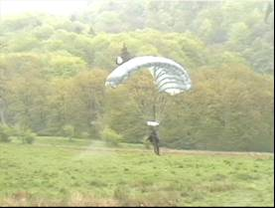
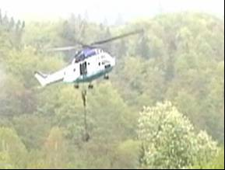
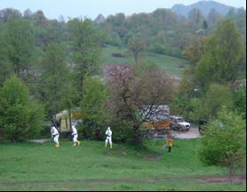
Romanian National Exercise (5/6)

Slide 20
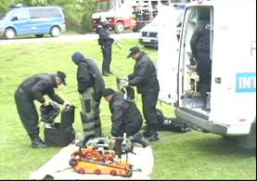
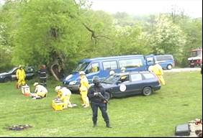
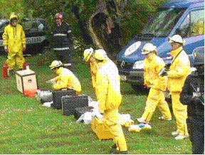
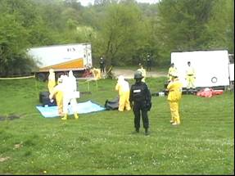
Romanian National Exercise (6/6)

Slide 21
NAUTILIUS 2011 EXERCISE

Slide 22
NAUTILIUS 2011 EXERCISE (1)
Sponsor: Norway Government
Scenario: Terrorist attack on spent fuel transports from Kozlodui NPP to Russian Federation
Place: Bulgarian/Romanian Border, on Danube
Participants: Authorities from Bulgaria and Romania

Slide 23
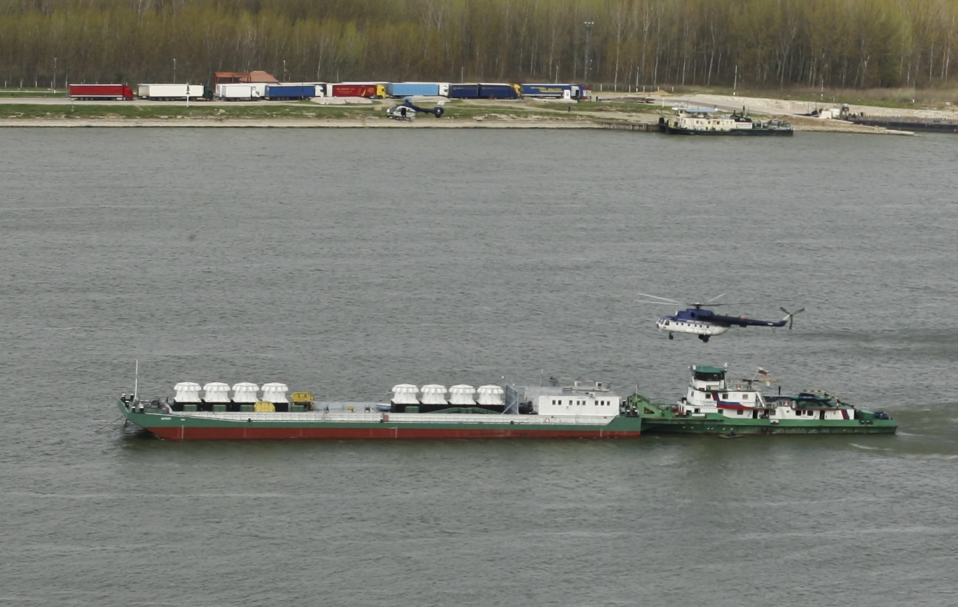
NAUTILIUS 2011 EXERCISE (2)

Slide 24
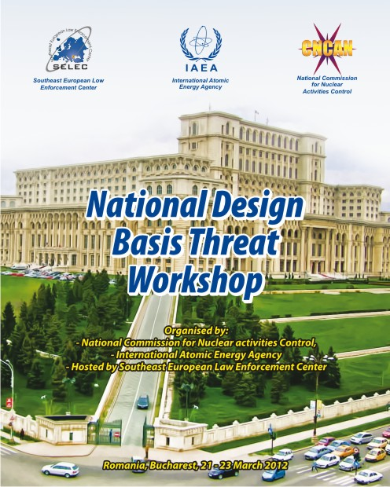
National Training Programs
Notes:
Ministerul Apararii
Asigurarea protectiei spatiului aerian
Monitorizare, schimb de date si informatii ptr transporturile speciale
Intervenție si suport in afara amplasamentului

Slide 25
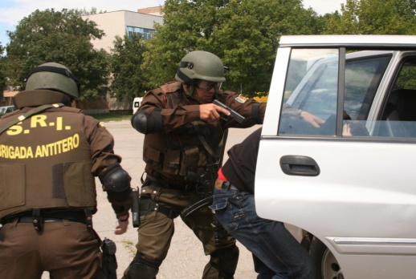
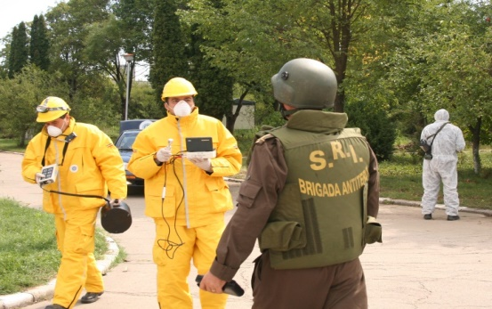
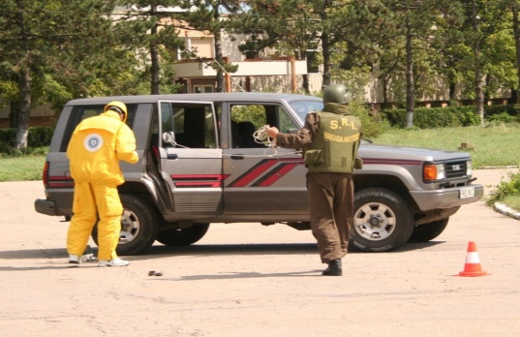
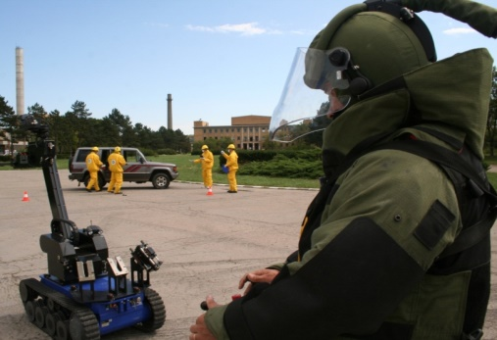
National and Regional Exercises Programs
Notes:
Ministerul Apararii
Asigurarea protectiei spatiului aerian
Monitorizare, schimb de date si informatii ptr transporturile speciale
Intervenție si suport in afara amplasamentului

Slide 26
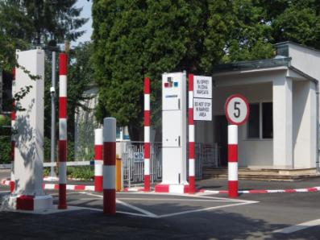
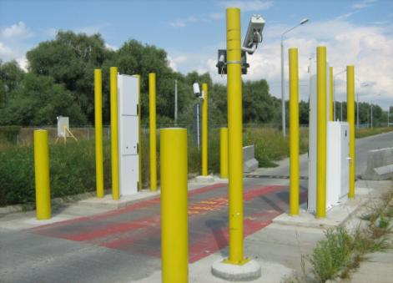
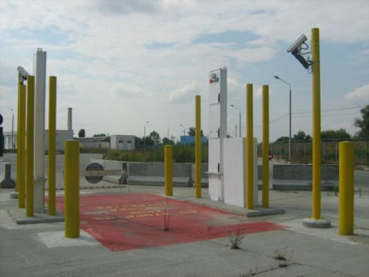
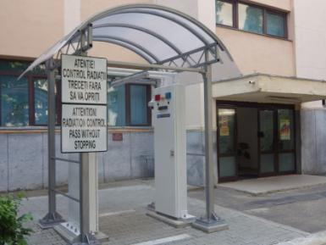
Nuclear Smuggling Detection and Deterrence Equipment

Slide 27
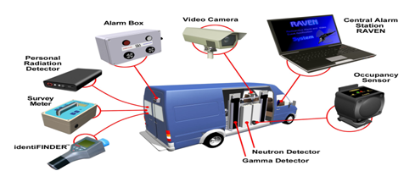
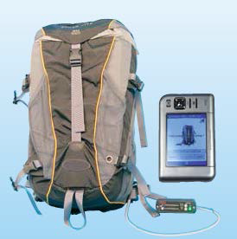
N.S.D.D.: Mobile Detection System (MDS)
Design to detect penetrating radiation - gamma and neutron
Gamma detector uses scintillating plastic and the neutron detector uses He tubes
Currently in Romania we have 8 MOBILE DETECTION SYSTEMS located in 8 locations, 6 of them with IN-MOTION capability.
The vans were upgraded with IN-MOTION capabilities by P.N.N.L. experts in JULY 2015

Slide 28
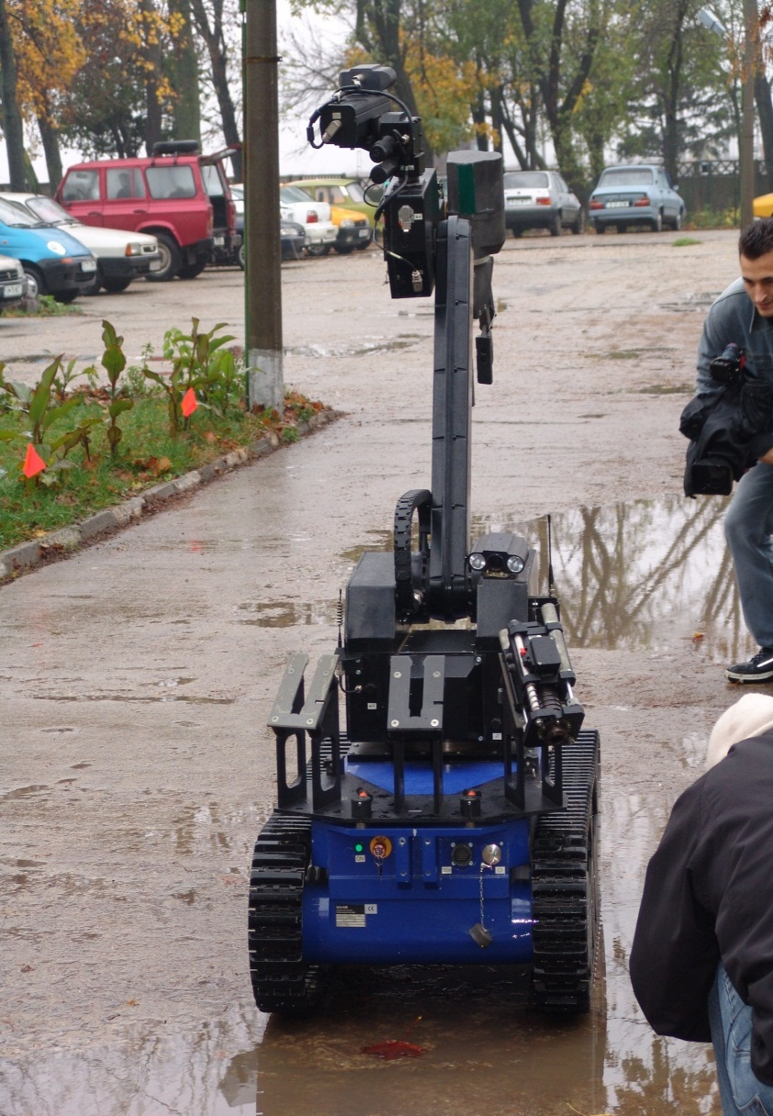
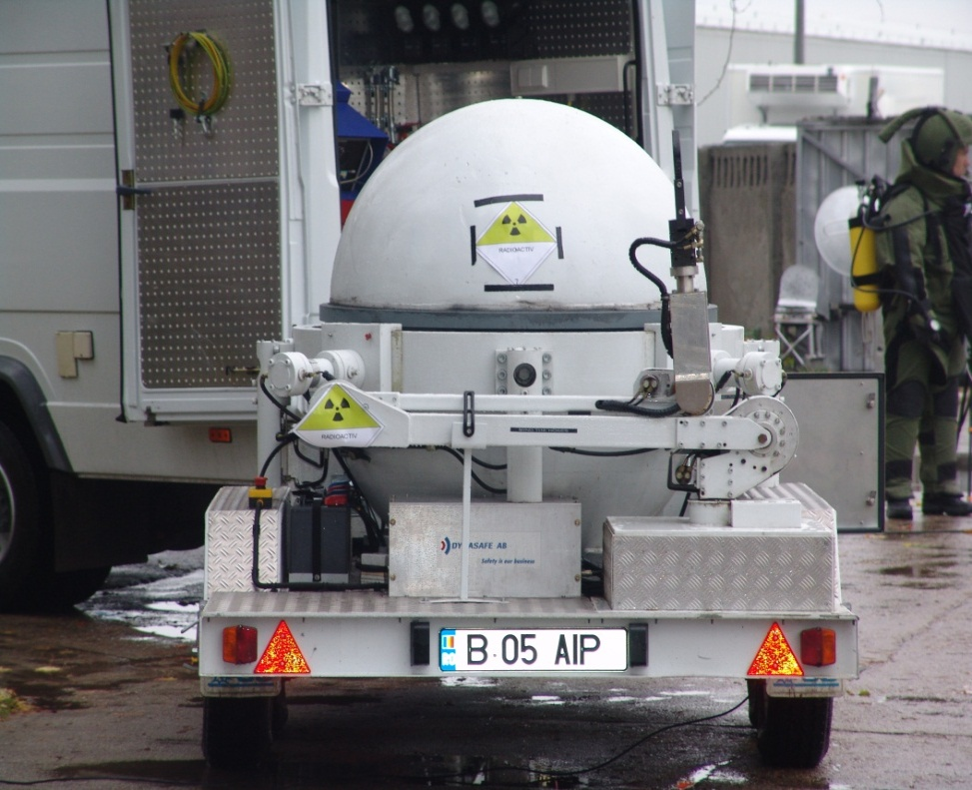
Equipment, technologies and human resources

Slide 29
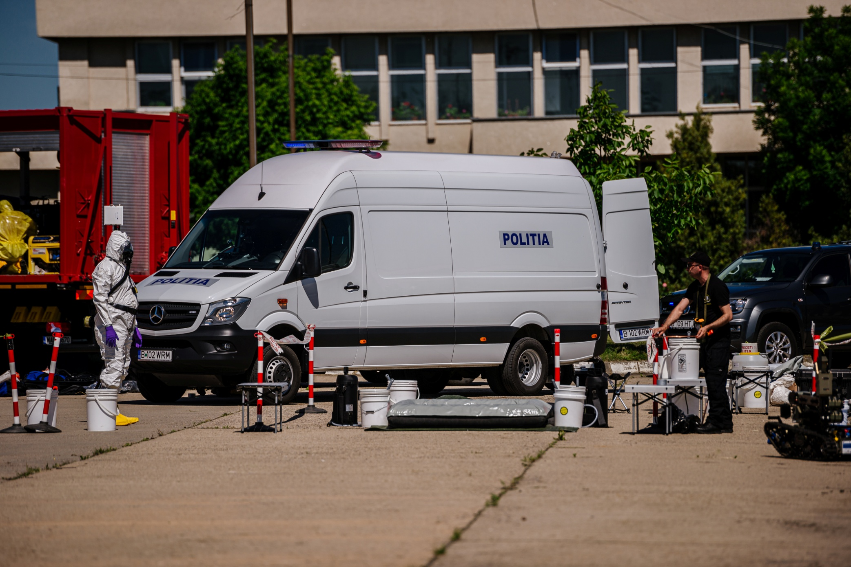
SIAS CBRN Unit capabilities during Nuclear Security Events

Slide 30
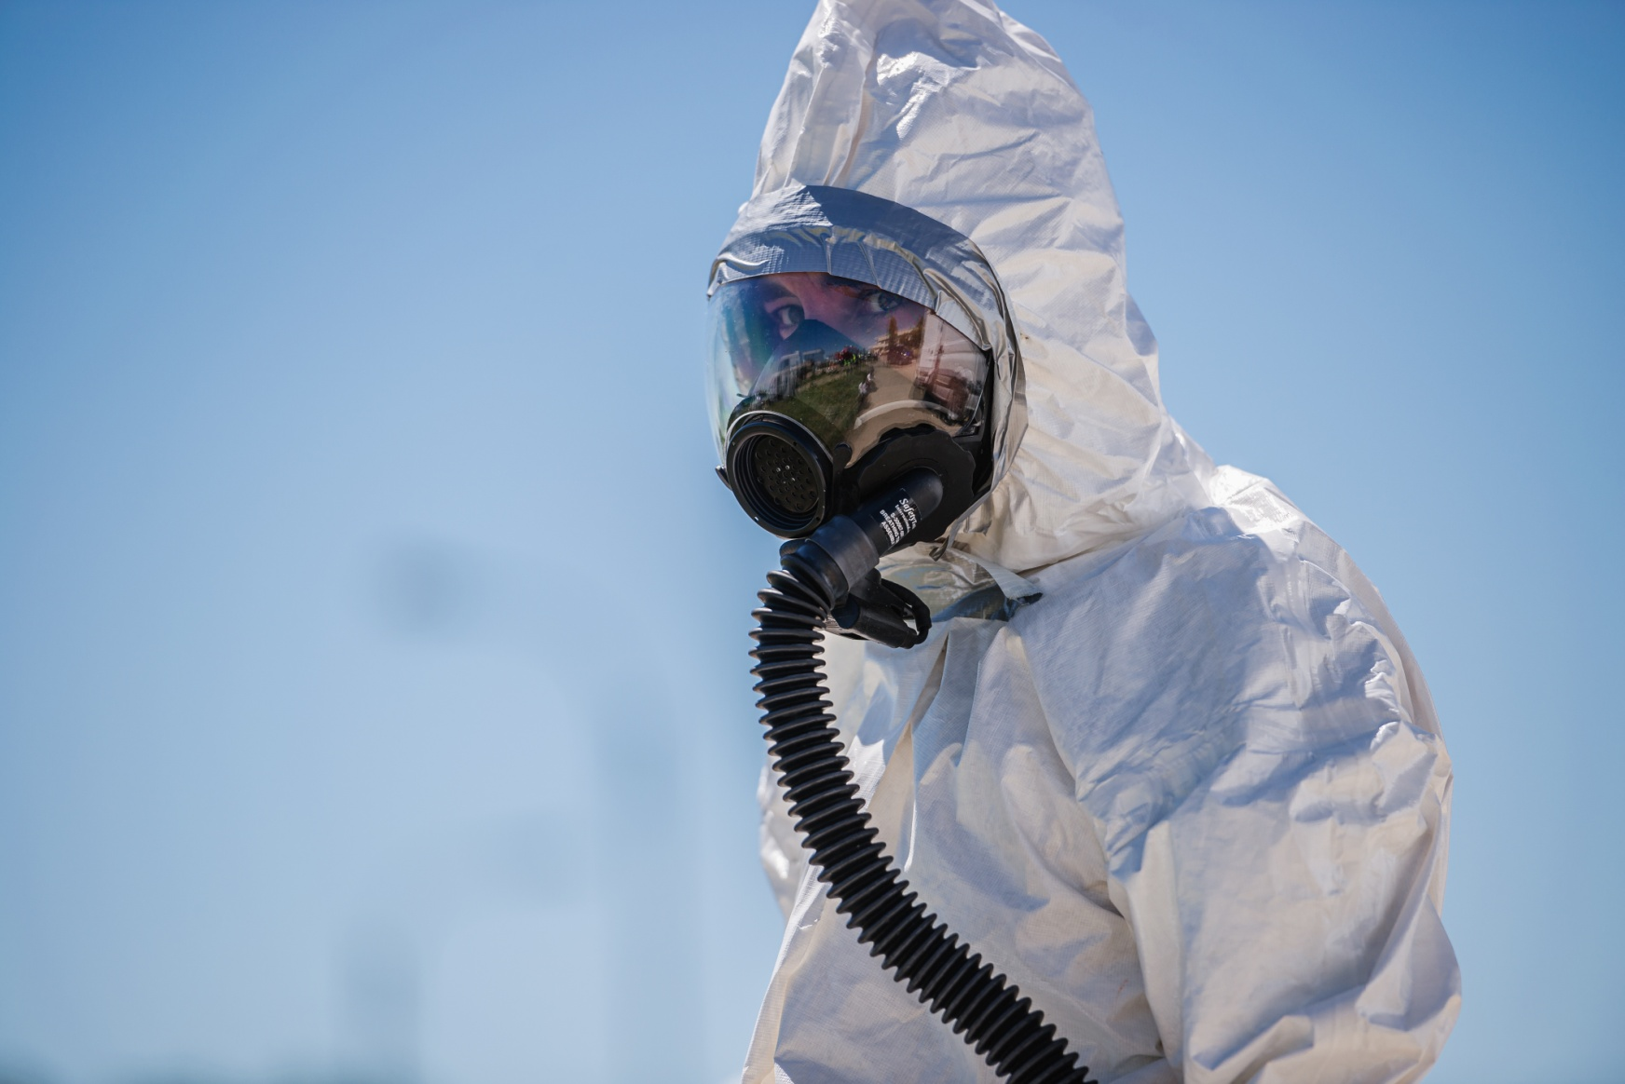
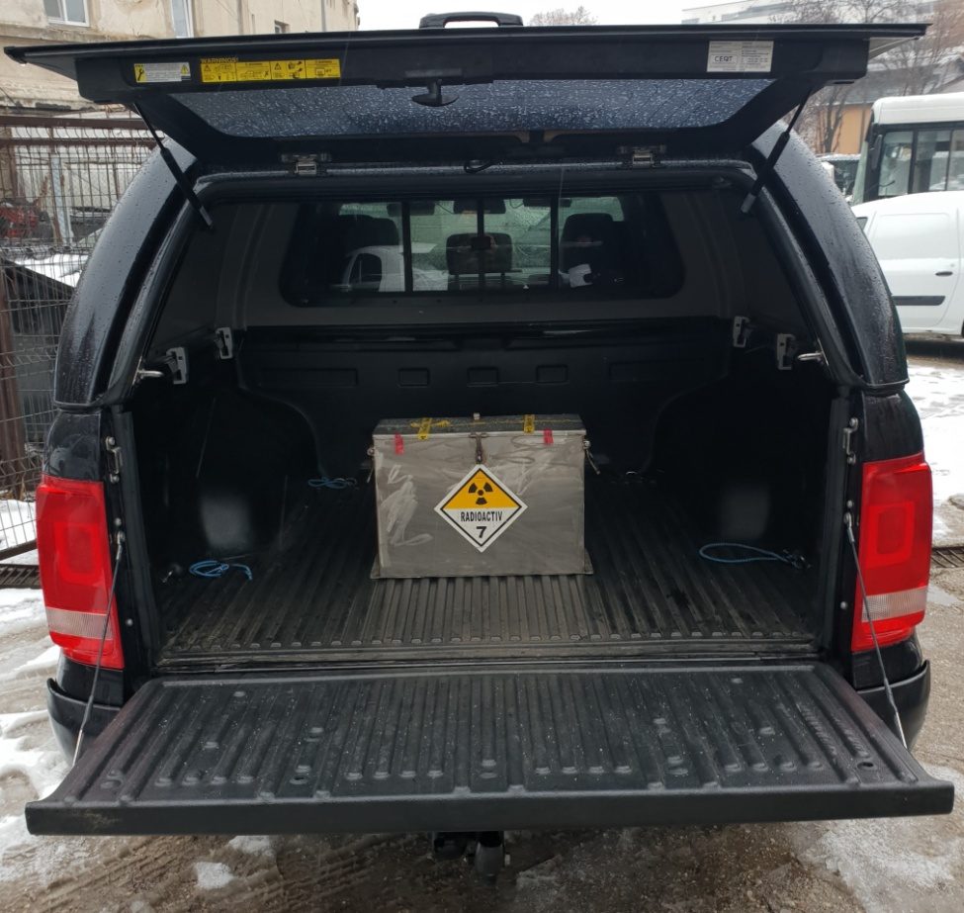
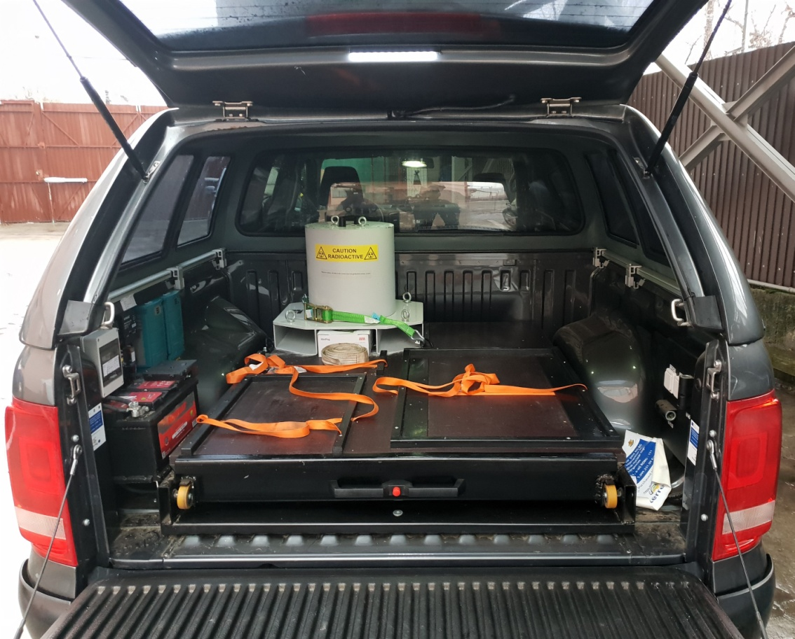
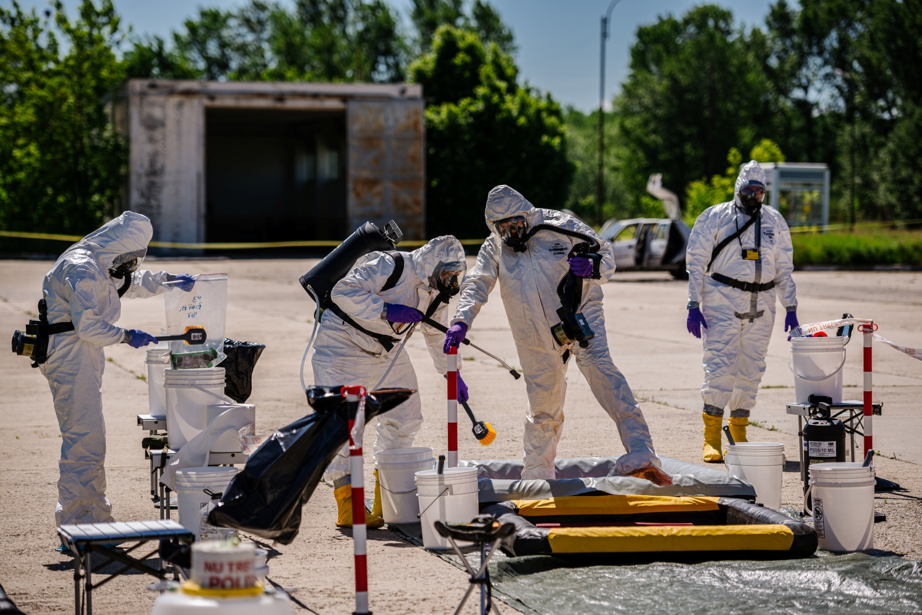
SIAS CBRN Unit capabilities for Nuclear Security Events

Slide 31
Thank you for your attention !

