Slide 1
Advancing Gender Parity in Nuclear Security: Why It Matters and How It Can Be Done
Lars van Dassen
WINS, World Institute for Nuclear Security

Slide 2
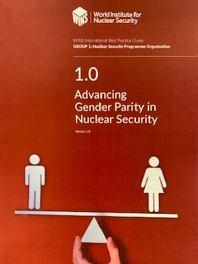
Building my case on . . . .
A Best Practice Guide (BPG) produced and issued by WINS in March 2021.
This BPG builds on other work we have done in the area – but most of all, it is informed by practice and empirical impressions from nuclear security and equal right issues all over the world.

Slide 3
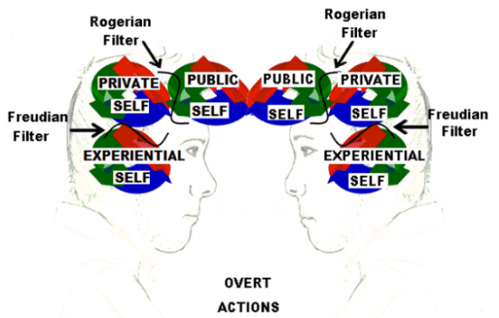
The case for gender parity has many layers . . . , and reasons
“It’s about justice, stupid!”
It brings innovation and increased performance
We increase the access to talent and the happiness in the workplace
The efficiency increases
And . . . . it leads to better nuclear security

Slide 4
Justice. . . . .
In the world there are men and women. In most cases their distribution is 50-50. Their salaries, positions and access to occupations and positions are not.
In experiments on how people would want a society to be if they do not know which place and position they occupy in such a society – most people opt for systems with equal chances and opportunities.

Slide 5
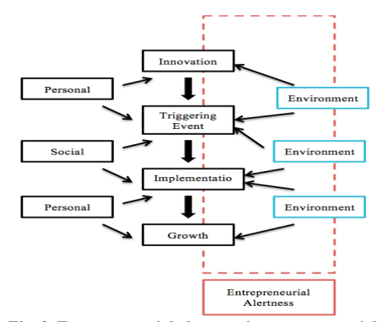
Innovation and performance . . .
Diverse organizations perform better than mono-cultures. And they generate better and more ideas. This includes organizations where men and women are equal in number, rights and opportunities. All perform better – also the men.
The reasons for this have been studied – where there is diversity the span of juxtaposition is bigger and others’ achievements stand out clearer and cause more inspiration.

Slide 6
Talent and happiness
Why would you want five good applications for an open position if you can have ten? And why would you want to leave out the applicants that are very often those with the most training and education?
And how can you live without good laughs in the workplace? Inclusiveness makes people feel comfortable and safe – and the road to being, saying and doing freely and creatively grows.

Slide 7
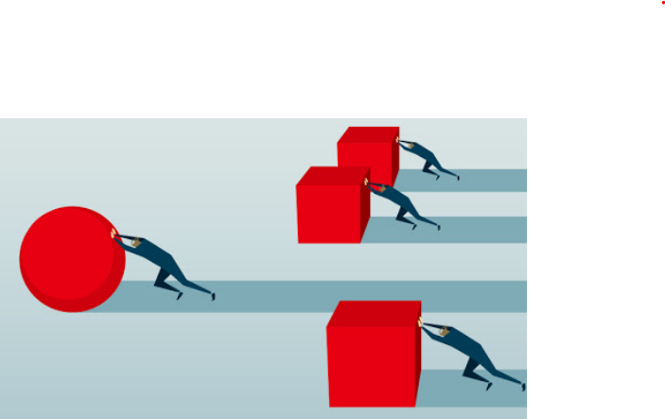
Efficiency . . .
At the end of the day and as a consequence of more innovation, better performance, happier and more productive working climates, the efficiency tends to grow.
Striving for gender parity is striving for viability for the organization, be it a regulator, government authority, an NGO, a private company or an international organization.

Slide 8
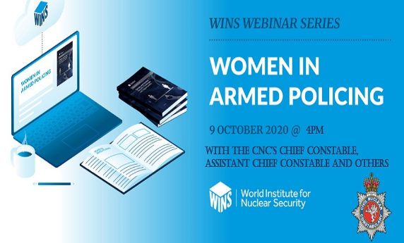
Gender parity and nuclear security
Studies show that men and women have different perceptions of what is risky, dangerous and challenging. Men and women also look at the counter-measures (security) differently, and on how to use them.
Organizations that include both women and men will have broader views of risks and security and with that be able to be more effective.

Slide 9
Nuclear security by design – gender parity by design . .
Choosing to build in security measures at facility levels from the beginning is a deliberate choice. If you do it, the chances are that your security systems work better.
To choose gender parity as a means and objective is also a choice and one that makes success more likely. It takes an open conducive work culture. And management commitment, as well as persistence, honesty, partners and set targets.

Slide 10
End note in short . . .
To choose and promote gender parity as part of your nuclear security systems and organizations - is a short cut to improved nuclear security . . . . . .

