Slide 1
Strategies for Empowering Women for Success & Growth
U.S. Department of Energy
National Nuclear Security Administration
Kate Doty & Lindsey Gehrig
Pacific Northwest National Laboratory

Slide 2
Overview
International Initiatives for Gender Equality
Introduction to NNSA’s Nuclear Security Women’s initiative (NSW)
Strategies for Success
Employee Resource Groups
Mentoring
Institutional commitments (parity pledges)
Resources and Opportunities
Professional Organizations
Fellowships

Slide 3
International Organizations
International Organizations have made a commitment to achieving gender equality and empowering all women and girls
UN SDG 5: Achieve gender equality and empower all women and girls
Despite improvements such as more women in leadership roles, full gender equality remains unchanged.
UN SDG 5 works to promote a number of goals, including ensuring effective participation and equal opportunities for leadership at all levels of decision-making in political, economic and public life.
UN ECLAC, Division for Gender Affairs
Plays an active role in gender mainstreaming in Latin America and the Caribbean
It works in close collaboration with the national machineries for the advancement of women in the region, civil society, the women’s movement, feminist organizations and public policymakers, including national statistics institutes.

Slide 4
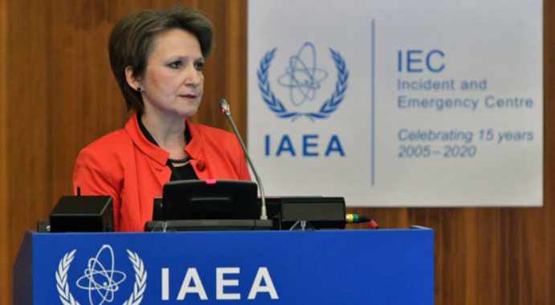
International Organizations
IAEA: committed to gender equality
"Gender equality and the empowerment of women lie at the heart of the Sustainable Development Goals, and they are vital to fully realizing the rights and potential of everyone. These fundamental aims must also inform our work at the IAEA." - Rafael Mariano Grossi, IAEA Director General
Host webinars about the role of women in the nuclear enterprise
"International Women's Day: IAEA Women Leaders share their Journeys"
“Gender equality needs to be accepted and recognized in daily life by each and every person, and especially managers who need to show the way and lead by example.”
“Breaking the glass ceiling: A Woman’s Story from Radiation Science to Nuclear Security”
- Elena Buglova, Director of the Division of Nuclear Security
Elena Buglova is currently the Director of the IAEA’s Division of Nuclear Security. (Photo: D. Calma/IAEA)

Slide 5
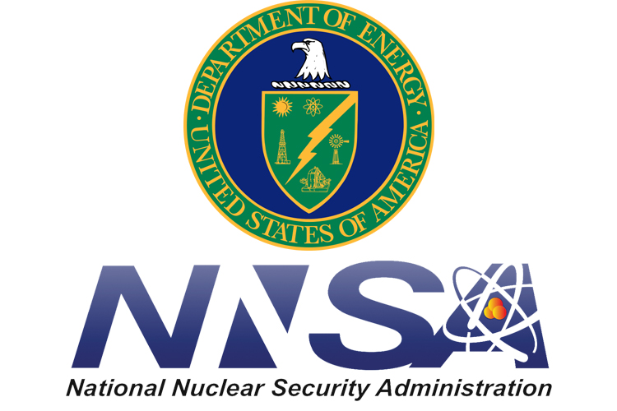
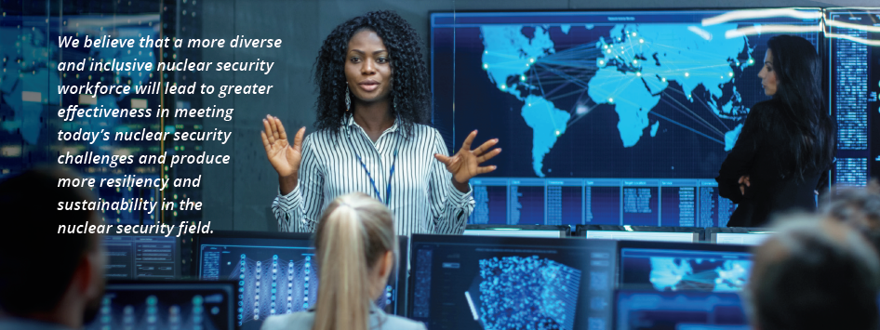
Nuclear Security Women: Who We Are
NNSA’s Office of International Nuclear Security (INS) established the Nuclear Security Women (NSW) initiative in 2019
INS’ NSW Initiative aims to:
Promote the role and visibility of women
Provide education, training, research, and other professional development opportunities
Increase women’s representation in all aspects of nuclear security
We are leveraging our relationships with international organizations, non-governmental organizations, and partner countries to make progress

Slide 6
Nuclear Security Women: What We Do

Slide 7
Strategies for Success: Employee Resource Groups
What is an Employee Resource Group (ERG)?
Provides support to employees
Builds community
Possible Activities
Meetings and/or newsletters for information sharing
Networking opportunities and social events
Speakers and discussions on relevant topics
Photo: https://feminem.org/2017/12/12/looking-women-courage-mentorship/

Slide 8
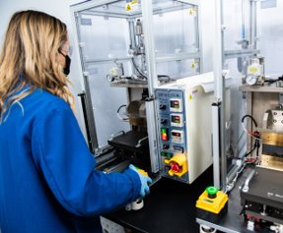
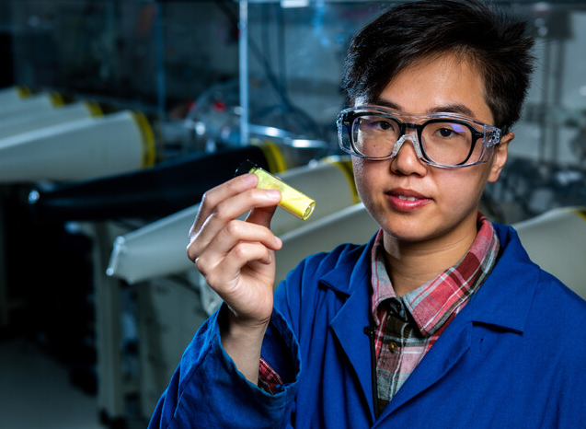
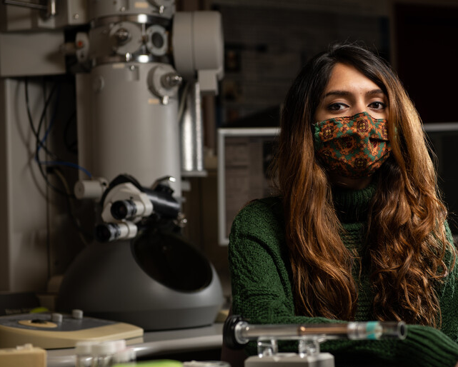
Strategies for Success: Commitment
Gender parity pledges
Gender (and other) bias training

Slide 9
Strategies for Success: Mentorship
Empowered women empower women
Role models & representation
Everyone can participate
Mentoring increases job satisfaction
Mentoring incentivizes participation in traditionally male dominated fields
https://www.trainingjournal.com/articles/features/celebrating-power-mentoring-international-women%E2%80%99s-day-2020

Slide 10
Resources and Opportunities: Professional Organizations
Offer networking, mentorship, substantive engagement
Global, regional, local
Membership Organizations
WinGLOBAL
World Institute for Nuclear Security (WIN) and various country chapters
U.S. Women in Nuclear
Women in Nuclear Medicine
Women in Defense
Women of Color Advancing Peace, Security, and Conflict Transformation
En voz Alta
Women in International Security
Girl Security
Informational Resources
WinARCAL
NTI – Gender Champions in Nuclear Policy
WomenAdvance Chemical Security
Young Women in Nonproliferation Initiative (administered by the Middlebury Institute of International Studies at Montery)
Leadership Council for Women in National Security
Women in Chemistry Symposium
Public Policy and Nuclear Threats (PPNT) Bootcamp
CBRNE Career Central Job Board

Slide 11
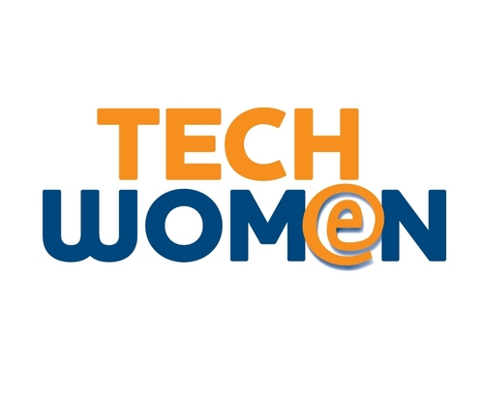
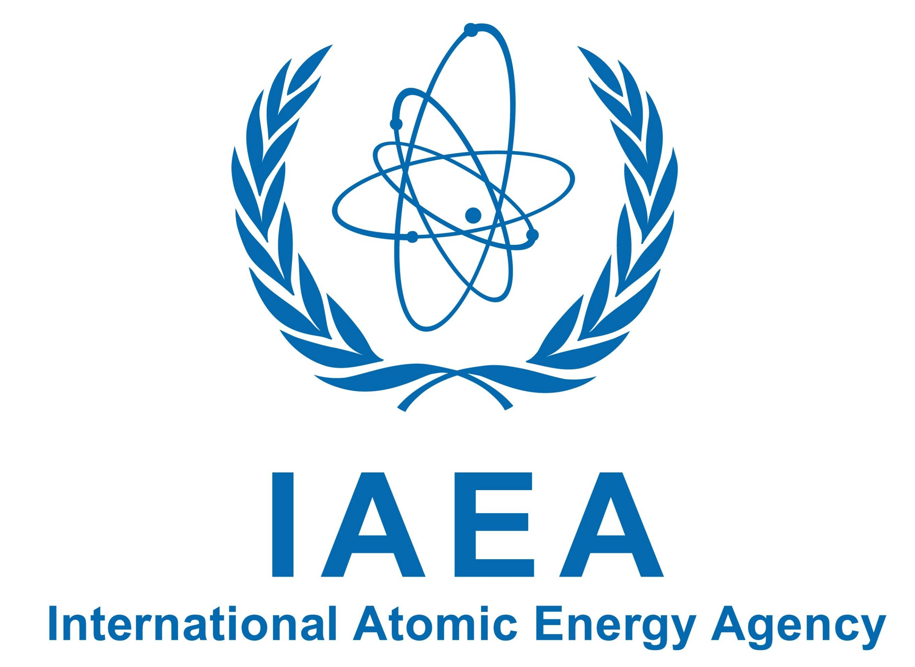
Resources and Opportunities: Fellowships
Strengthen and grow technical skills that advance your career
Gain international experience
For you and/or your mentees/colleagues
IAEA-Marie Sklodowska-Curie Fellowship Programme
Rand Corporation Stanton Nuclear Security Fellows Program
International Fellowships administered by the American Association of University Women
IAEA Fellowship Program administered by the Canadian Bureau for International Education
Council on Foreign Relations International Affairs Fellowship in Nuclear Security
Foreign Policy Interrupted Fellowship
The David M. Rubenstein Fellows
TechWomen administered by the Bureau of Education and Cultural Affairs

Slide 12
The Take Aways
Support each other at all levels
Educate
Empower
Connect

